Slide 1
Word of the Day
Week of Tuesday, January 17th through Friday, January 20th

Slide 2
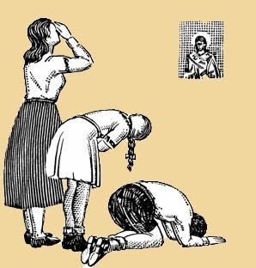
Tuesday, January 17th – 1st Block
Can you guess what the term venerate [ven-uh-reyt] means?
What part of speech is venerate?
From the Latin venerari (to revere, worship)
Other Forms: venerator (noun), unvenerated (adj)
“I venerate old age; and I love not the man who can look without emotion upon the sunset of life, when the dusk of evening begins to gather over the watery eye, and the shadows of twilight grow broader and deeper upon the understanding.”
– Henry Wadsworth Longfellow

Slide 3
Tuesday, January 17th – 2nd Block
venerate – verb. To feel or show deep respect for,
especially due to age or tradition; to honor
What is another word for venerate (synonym)?
Admire, esteem, exalt, idolize, treasure
What word means the opposite of venerate (antonym)?
Abhor, condemn, despise, detest

Slide 4
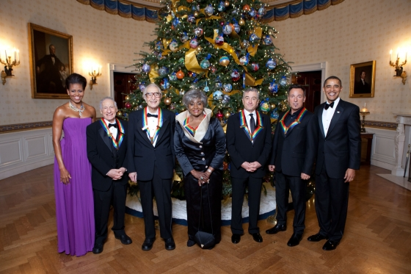
Tuesday, January 17th – 3rd Block
Can you use the word venerate to describe the image to the left?
Example: Each year, the Kennedy Center for the Performing Arts, venerates a handful of talented performers in a ceremony attended by the President and First Lady.
Now try writing your own sentence using the word venerate in a manner that shows your understanding.
2009 Kennedy Center Honorees (with the President and Mrs. Obama) – [From Left] Mel Brooks, Dave Brubeck, Grace Bumbry, Robert De Niro, and Bruce Springsteen

Slide 5
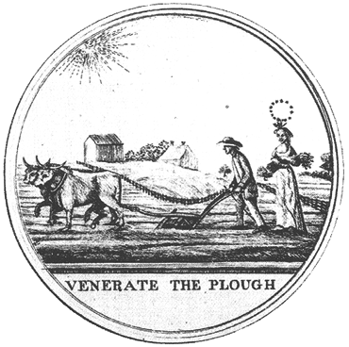
Tuesday, January 17th – 4th Block
What other images would you associate with the term vernerate?
Complete the following analogy:
Venerate is to value, as compensate is to _____.
Satisfy, repay, reimburse, make good, etc. [Synonyms]

Slide 6
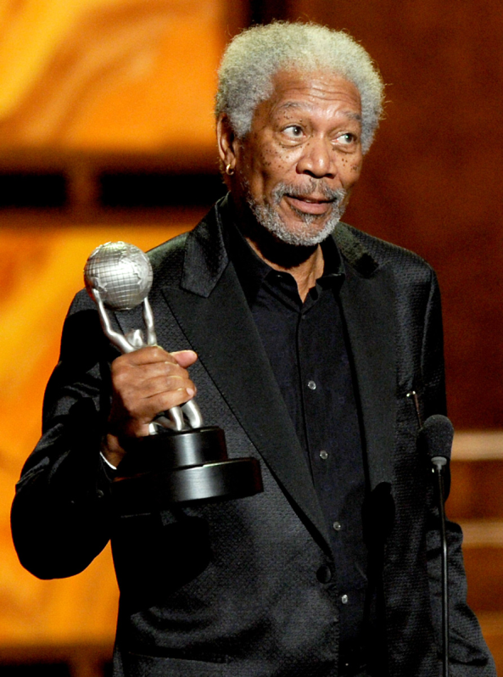
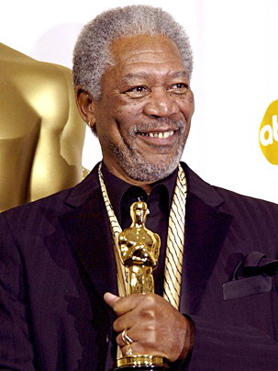
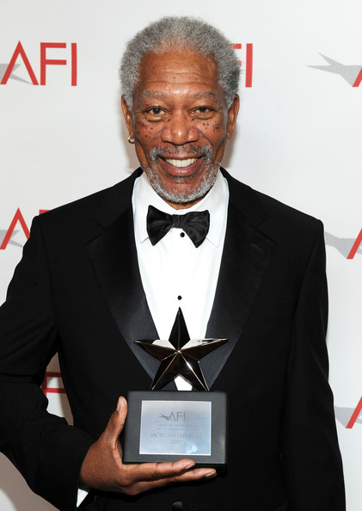
Wednesday, January 18th – 1st Block
Do you know the meaning of the word accolade [ak-uh-leyd]?
What part of speech is accolade?
From the Latin ad- (to) + collum (neck); accollare (to embrace around the neck)
Other Forms: accolade (adj)
“Getting a standing ovation was kind of humbling that so many people are so happy that I have been named for this award. A lot of people say you're due - maybe you are, maybe you aren't - it's an accolade.” -- Morgan Freeman

Slide 7
Wednesday, January 18th – 2nd Block
accolade – noun. An award given as a sign of appreciation or respect
What other word means the same thing as accolade (synonym)?
Laurels, kudos, distinction, honor
What word means the opposite of accolade (antonym)?
Condemnation, criticism

Slide 8
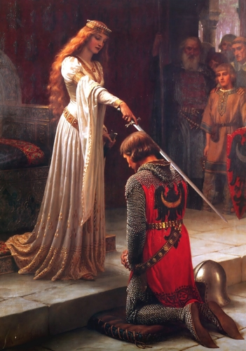
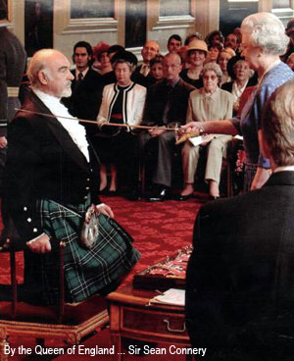
Wednesday, January 18th – 3rd Block
Can you use the word accolade to describe the picture to the left?
Example: The tradition of knighting someone is centuries old, but the accolade is still given today.
Now it’s your turn. Try writing your own sentence using the word accolade in a different context.

Slide 9
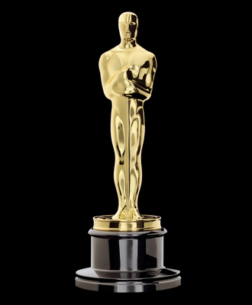
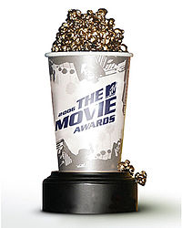
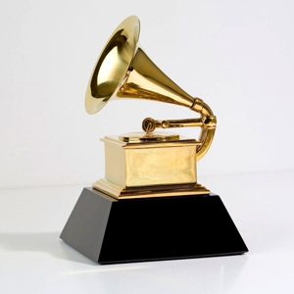
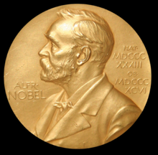
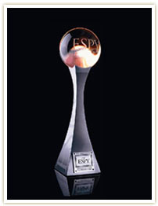
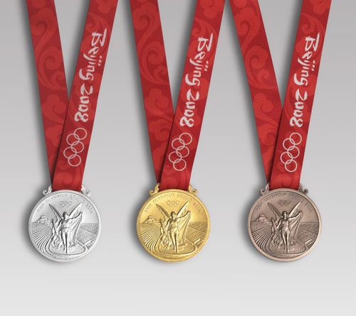
Wednesday, January 18th – 4th Block
What accolade would you most like to receive?
What is wrong with the following analogy?
Accolade is to meritorious, sentence is to innocent.
Meritorious people should be given accolades, but innocent people should not be given convictions.

Slide 10
Thursday, January 19th – 1st Block
What does the word extol [ik-stohl] mean?
Can you guess what part of speech extol is?
From the Latin ex- (up) + tollere (to raise)
Other Forms: extoller (noun), extollingly (adv), extolment (noun)
“Many are always praising the by-gone time, for it is natural that the old should extol the days of their youth; the weak, the time of their strength; the sick, the season of their vigor; and the disappointed, the spring-tide of their hopes”
-- George Caleb Bingham

Slide 11
Thursday, January 19th – 2nd Block
extol – verb. To praise highly; laud
What other words or phrases mean the same as extol (synonyms)?
Commend, venerate, acclaim, esteem
What words mean the opposite of extol (antonyms)?
Criticize, condemn, execrate

Slide 12
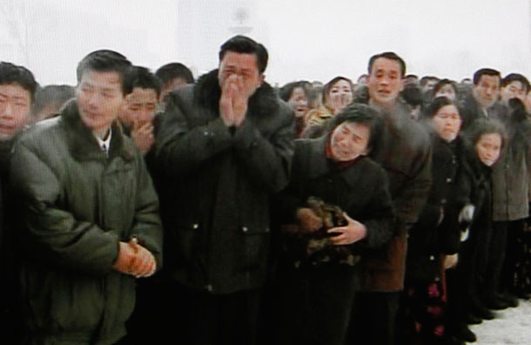
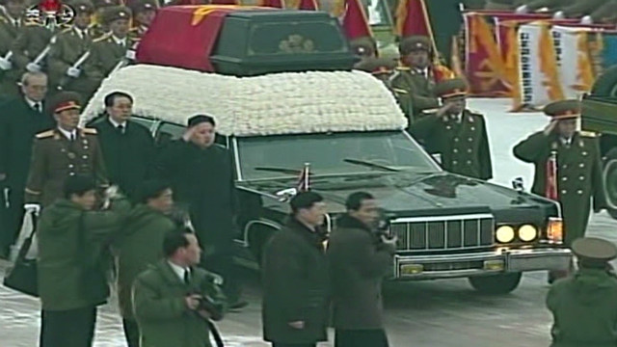
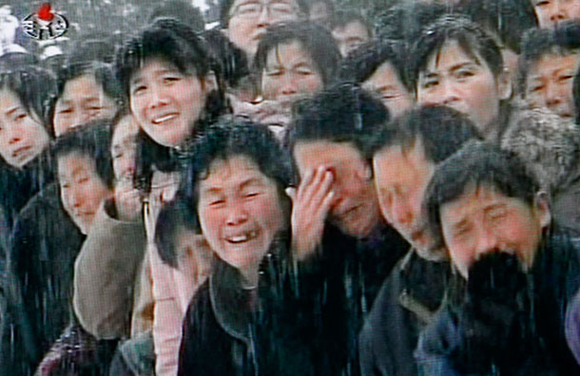
Thursday, January 19th – 3rd Block
Can you describe the image to the left using the term extol?
Example: Thousands attended the funeral procession of North Korean leader Kim Jong-Il to mourn and extol the man they once called “Dear Leader” and ‘Our Father.”
Now write your own sentence using extol in a manner that illustrates your understanding.

Slide 13
Thursday, January 19th – 4th Block
Can you unscramble the analogy?
[is to] [extol] [as] [cherish] [blame] [is to] [desecrate].
Extol is to blame, as desecrate is to cherish. [Antonyms]
What other images would you associate with extol?

Slide 14
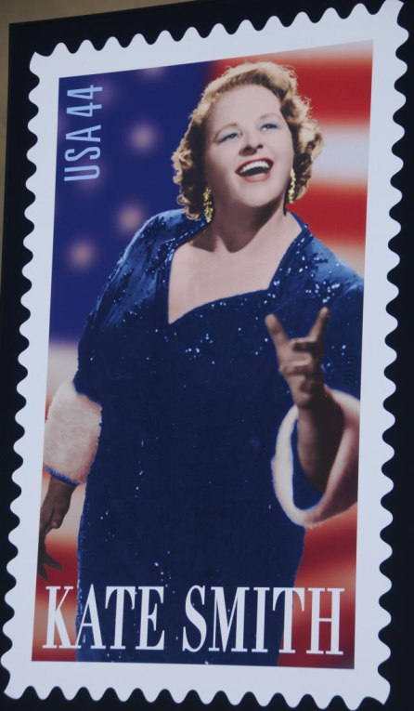
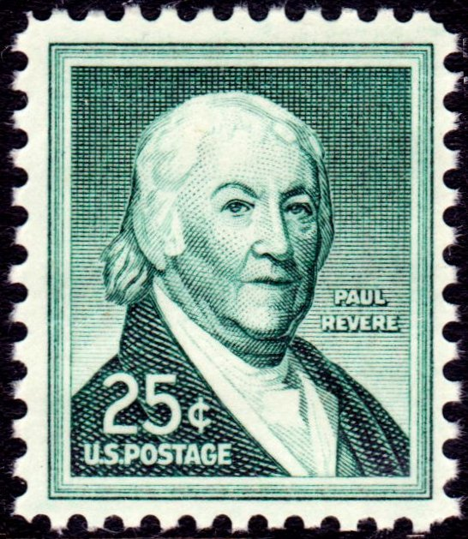
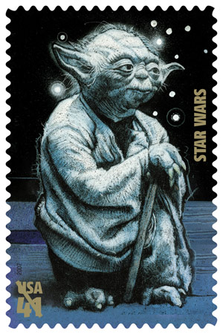
Friday, January 20th – 1st Block
From the context clues given, can you guess what revere [ri-veer] means?
What part of speech is revere?
From the Latin reverentia (awe, respect)
Other Forms: reverable (adj), reverer (noun), unrevered (adj), reverance (noun)
“Russia, France, Germany and China. They revere their writers. America is still a frontier country that almost shudders at the idea of creative expression.”
-- James Michener

Slide 15
Friday, January 20th – 2nd Block
revere – verb. To regard highly with love and respect
What word or phrase means the same thing as revere (synonym)?
Reverence, honor, pay homage, venerate
What word means the opposite of revere (antonym)?
Disregard, condemn, despise, abhor

Slide 16
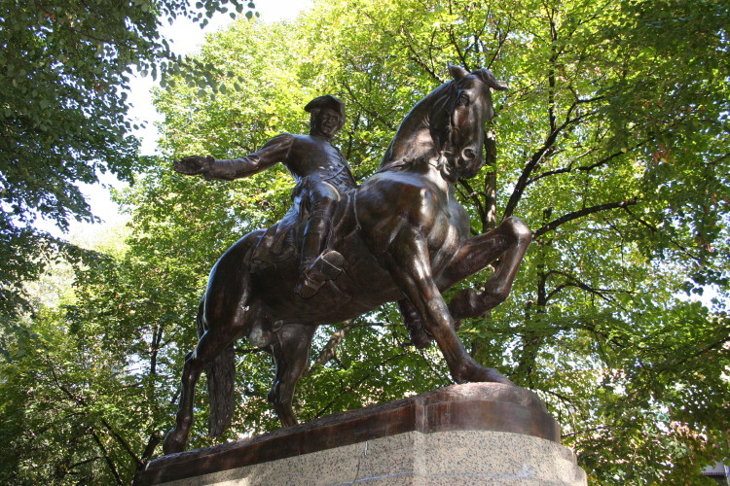
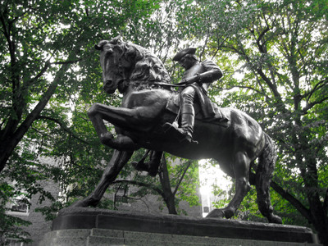
Friday, January 20th – 3rd Block
Can you use the word revere to describe the image to the left?
Example: Many statues have been crafted to revere the role that Paul Revere played in the American Revolution.
Write a sentence using the word revere about someone or something that you respect.

Slide 17
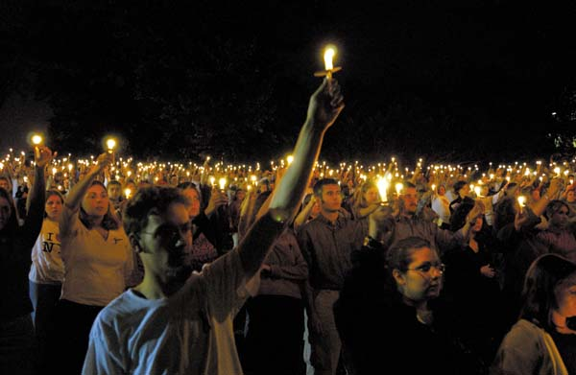
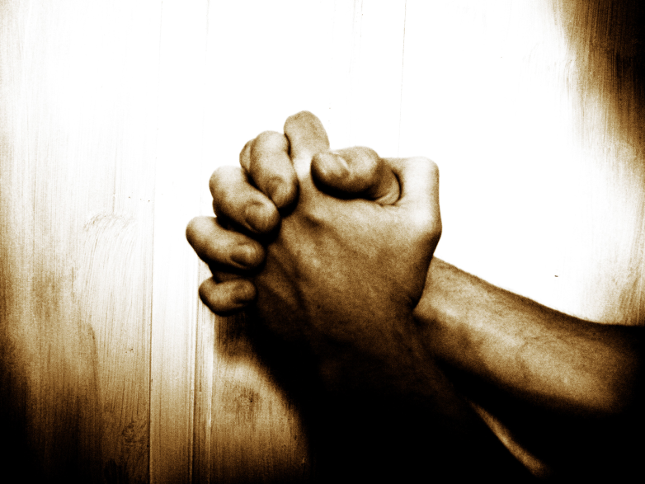
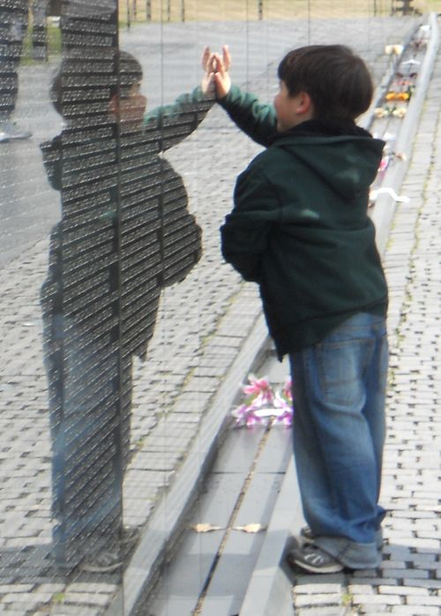
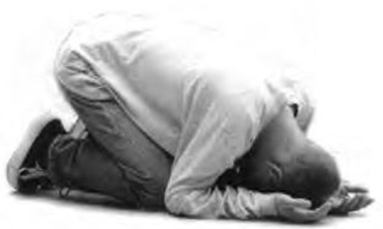
Friday, January 20th – 4th Block
How can people physically demonstrate their reverence?
Can you complete the following analogy:
Revere is to magnify, as deter is to ______.
Prevent, restrain, warn, etc. [Synonyms]

