Slide 1
Word of the Day
Monday, December 5th through Wednesday, December 14th

Slide 2
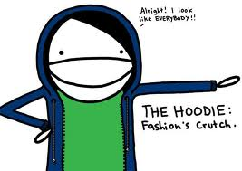
Monday, December 5th – 1st Block
What do you think the word prosaic [proh-zey-ik] means?
What part of speech is prosaic?
From the Latin prosa (straightforward, direct)
Other forms of prosaic include: prosaically (adv), prosaical (adj), prosaicness (noun)
“Unless one is wealthy there is no use in being a charming fellow. Romance is the privilege of the rich, not the profession of the unemployed. The poor should be practical and prosaic. It is better to have a permanent income than to be fascinating.” -- Oscar Wilde

Slide 3
Monday, December 5th – 2nd Block
prosaic – adjective. Commonplace or dull; matter-of-fact; unimaginative
What is another word for prosaic (synonym)?
Mundane, humdrum, banal
What word or phrase means the opposite of prosaic (antonym)?
Creative, imaginative, stimulating

Slide 4
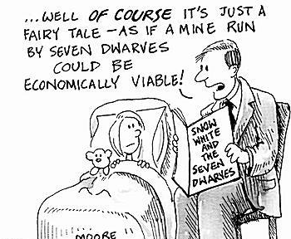
Monday, December 5th – 3rd Block
How can you use the word prosaic to describe the picture to the right?
Example: Suzy often wished that her father would take a less prosaic approach to storytime.
Now, write your own sentence using the word prosaic in a manner that illustrates your understanding of the word.

Slide 5
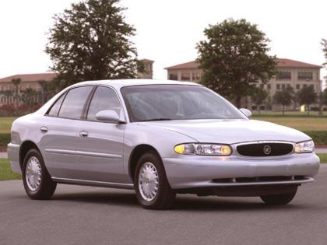
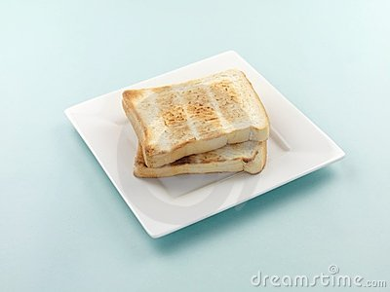
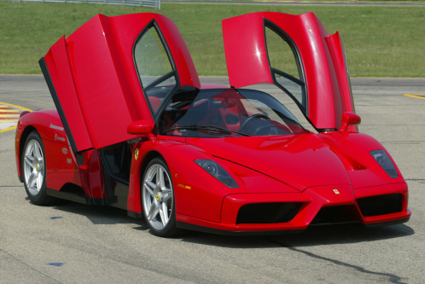
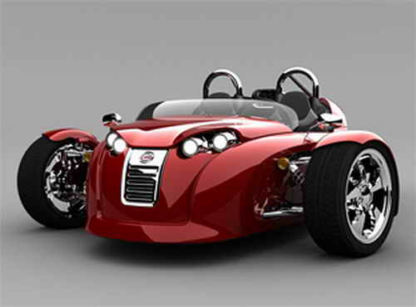
Monday, December 5th – 4th Block
What other image would you associate with the term prosaic?
Can you complete the following analogy:
Prosaic is to
as exotic is to ________.

Slide 6
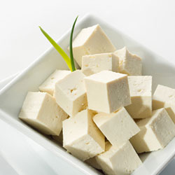
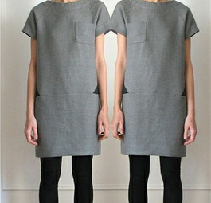
Tuesday, December 6th – 1st Block
What do you think the word vapid [vap-id] means?
What part of speech is vapid? How can you tell?
From the Latin vapidus (flat, insipid)
Other forms include: vapidity (noun), vapidly (adv) vapidness (noun)
“A lot of music you might listen to is pretty vapid, it doesn't always deal with our deeper issues. These are the things I'm interested in now, particularly at my age.”
-- Annie Lennox

Slide 7
Tuesday, December 6th – 2nd Block
vapid – adjective. Lacking freshness and zest; flat; stale
What is another word for the term vapid (synonym)?
Insipid, tedious, dull
What word or phrase means the opposite of vapid (antonym)?
Pungent, stimulating, exciting

Slide 8
Tuesday, December 6th – 3rd Block
Can you describe the image to the right using the word vapid?
Example: In an effort to become less vapid, Lloyd hired a professional consultant.
Now try writing your own sentence using the term vapid in a manner that illustrates your understanding of the word.

Slide 9
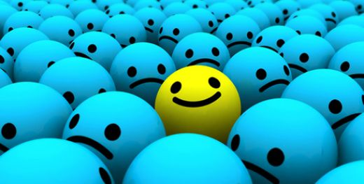
Tuesday, December 6th – 4th Block
Can you create a caption for the picture using the word vapid?
What is wrong with the following analogy?
Vapid is to colorless, as savory is to delectable.
Not a thing! Both are synonym relationships.

Slide 10
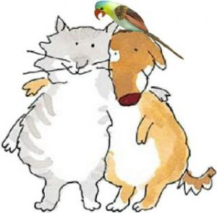
Wednesday, December 7th – 1st Block
Can you guess what amicable [am-i-kuh-buhl] means?
What part of speech is amicable? How can you tell?
From the Latin amicus (friend or friendly)
Other forms include: amicability (noun), amicableness (noun), amicably (adv)
“The talks are amicable, and that’s always a good thing in terms of getting things resolved.” -- Kathy Baker

Slide 11
Wednesday, December 7th – 2nd Block
amicable – adjective. Showing goodwill; peaceable; friendly
What other word or phrase means the same as amicable (synonym)?
Amiable, cordial, affable, harmonious
What means the opposite of amicable (antonym)?
Hostile, unfriendly, belligerent
Did You Know? Amiable means good-natured and likable. It’s usually used to describe people. Amicable means characterized by goodwill. It describes relationships or interactions between people. So, for instance, two amiable people might share an amicable friendship. Both amiable and amicable are derived from the Latin amicabilis, meaning friendly, but amiable came into the language via French. The adjectives were originally synonymous, but they have diverged in modern usage.

Slide 12
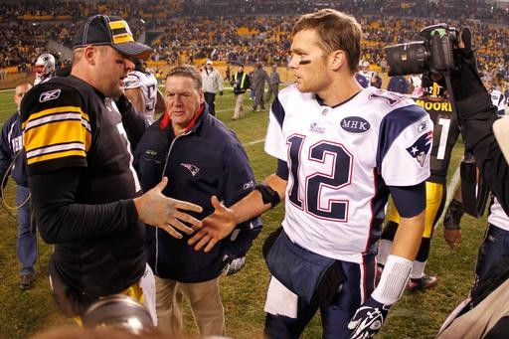
Wednesday, December 7th – 3rd Block
Can you use the word amicable to describe the picture to the right?
Example: Despite losing to the Steeler’s Tom Brady and Ben Roethlisberger amicably shook hands.
Now, try writing your own sentence using the word amicable.

Slide 13
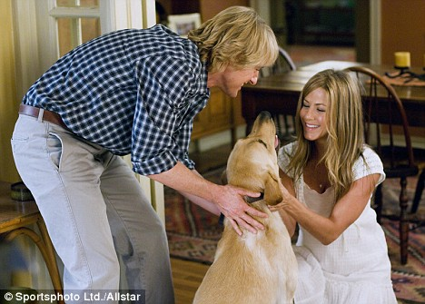
Wednesday, December 7th – 4th Block
Can you think of any other relationships you would consider amicable?
Can you complete the following analogy?
Amicable is to precarious, as abstemious is to ____.
Gluttonous, greedy, lavish, etc. (antonyms)

Slide 14
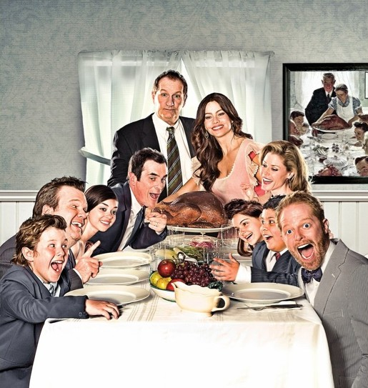
Thursday, December 8th – 1st Block
Can you determine what convivial [kuhn-viv-ee-uhl] means?
What part of speech is convivial? How do you know?
From the Latin com- (together) + vivere (to live)
Other forms include: convivialist (noun), conviviality (noun), convivially (adv)
“One does not leave a convivial party before closing time.” -- Winston Churchill

Slide 15
Thursday, December 8th – 2nd Block
convivial – adjective. Fond of feasting, drinking, and merry company; friendly, agreeable, jovial; fond of good company
What word/phrase means the same as convivial (synonym)?
Celebratory, festive
What is the opposite of convivial (antonym)?
Disagreeable, unfriendly, somber

Slide 16
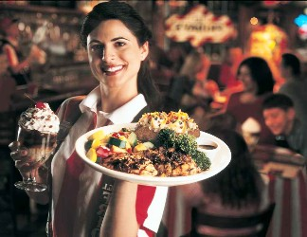
Thursday, December 8th – 3rd Block
Can you use the word convivial in a sentence to describe the picture?
Example: Restaurants like TGI Fridays and Chili's rely on a convivial atmosphere to bring in customers.
Now, try writing your own sentence using convivial in a manner that illustrates your understanding.

Slide 17
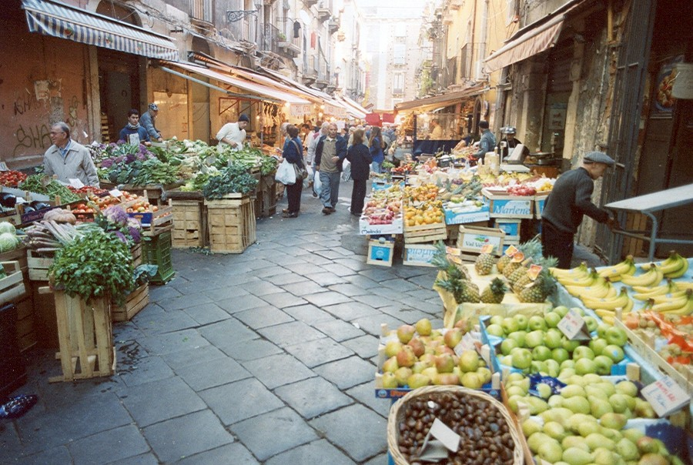
Thursday, December 8th – 4th Block
Can you think of any other images associated with convivial?
Complete the following:
If good holiday get-togethers are convivial, then good dentist visits are _______.
Brief, pain-free, efficient, etc.

