Slide 1
Word of the Day
Monday, November 7th through Thursday, November 10th

Slide 2
November not-so trivial Trivia
November is the 11th month of the year in the Julian and Gregorian calendars.
November is from the Latin novem meaning “nine“. November had been the ninth month in the pre-Julian calendar (named for Julius Caesar and begun in 45 B.C.) but retained its name although not its placement, when January and February were added.
November is a month of spring in the Southern Hemisphere and autumn in the Northern Hemisphere.
November is associated with All Saints Day (November 1) and All Souls Day (November 2) in the Christian liturgical calendar.
In the pagan “wheel of the year”, November begins at or near Samhain in the Northern Hemisphere and Beltaine in the Southern Hemisphere.

Slide 3
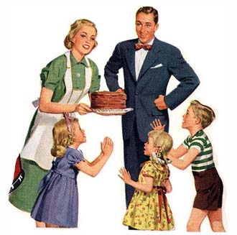

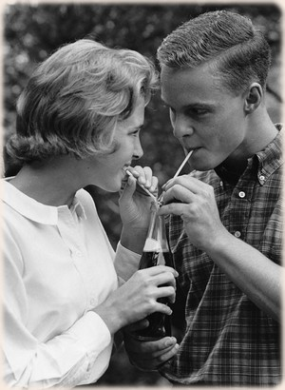
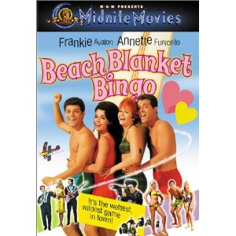
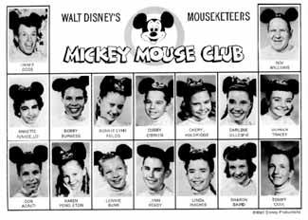

Monday, November 7th – 1st Block
What is the definition of the word banal [buh-nal] ?
What part of speech is banal?
From the French banel meaning communal
Other forms of the word include: banality (noun), banally (adv)
“To some, the '50s were a decade marked by the banal, the predictable.”
-- Annette Funicello,
American actress

Slide 4
Monday, November 7th – 2nd Block
Banal – adjective. Dull or stale because of overuse; lacking in spirited qualities.
What is another word for banal (synonym)?
Trite, hackneyed, cliché, clichéd, commonplace, hack, moth-eaten, musty, shopworn, stereotyped, timeworn, tired, well-worn
What word means the opposite of banal (antonym)?
Fresh, new, original, unique, uncommon

Slide 5
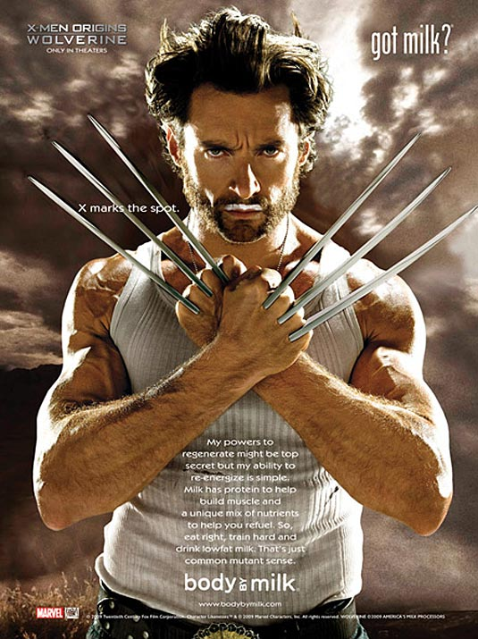
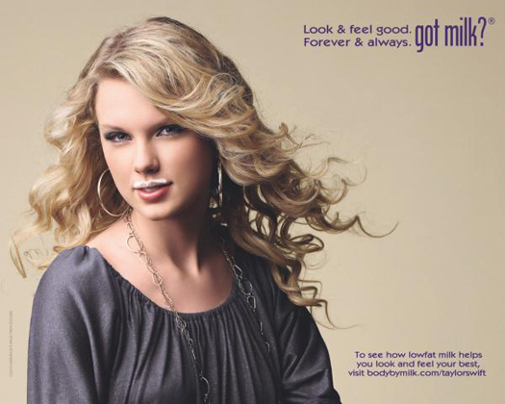
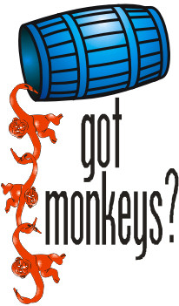
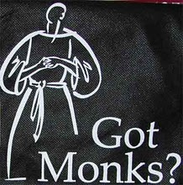

Monday, November 7th – 3rd Block
Can you use the word banal to describe these pictures?
The “Got Milk” ad campaign, while fresh in its inception, became banal with overuse; copied by many.
Now write your own sentence using the word banal in a manner that illustrates your understanding of the word.

Slide 6
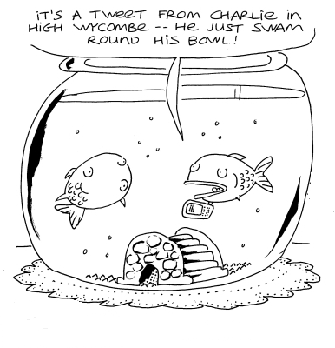
Monday, November 7th – 4th Block
How does the cartoon relate to the term banal?
Please complete the following analogy:
Hyperbole is to exaggeration, as banal is to ________________.
Trite, hackneyed, cliché, hack, moth-eaten, musty, stereotyped, tired, well-worn, etc. [Synonyms]

Slide 7
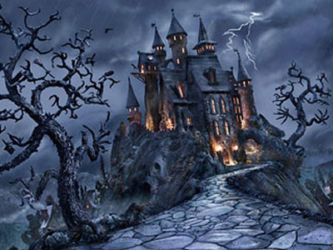

Tuesday, November 8th - 1st Block
What is the definition of the word cliché [klee-shay]?
What part of speech is cliché?
Cliché comes from the French cliché meaning literally, printer’s stereotype plate.
Other forms of the word include: clichés (plural)
“I don't believe that old cliché that good things come to those who wait. I think good things come to those who want something so bad they can't sit still.”
-- Ashton Kutcher, actor

Slide 8
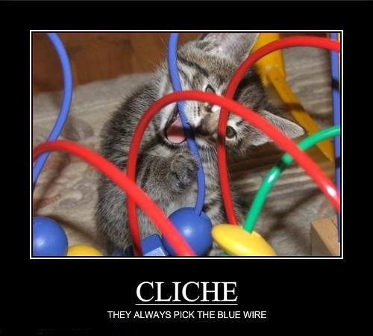
Tuesday, November 8th – 2nd Block
Cliché – noun. An idea or expression that has become stale due to overuse.
Can you think of a synonym for cliché?
Overused, out-of-date, fusty, platitude, bromide
Can you think of an antonym for cliché?
Unused, current, fresh, seminal, new, novel, original
Just because kittens are cute. ☺

Slide 9
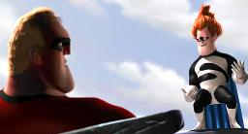
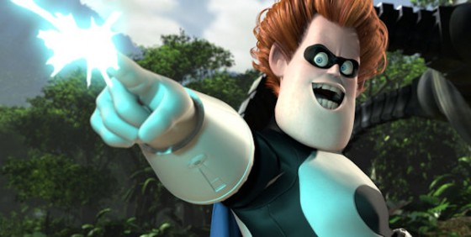
Tuesday, November 8th – 3rd Block
Can you use the word cliché to describe the pictures to the right?
Even against Mr. Incredible, Syndrome couldn’t resist the urge to monologue, a cliché among movie villains.
Now write your own sentence using the word cliché in a manner that illustrates your understanding of the word.

Slide 10
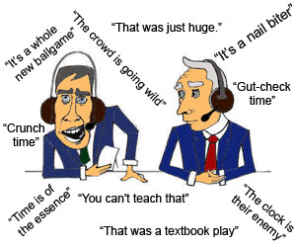
Tuesday, November 8th – 4th Block
How does the cartoon relate to the word of the day - cliché?
Can you complete the following analogy:
Cliché is to original as _______ is to consistent.
Conflicting, incompatible, inconsistent, unpredictable, etc.
  [Antonyms]

Slide 11
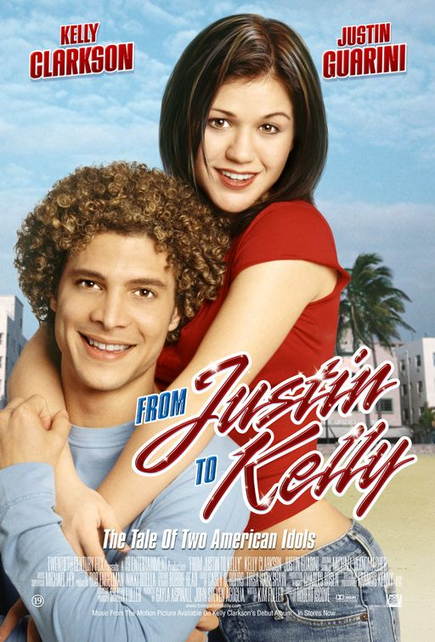
Wednesday, November 9th – 1st Block
What is the definition of the word insipid [in-sip-id]?
What part of speech is insipid?
From the Latin in- (not) + sapidus (tasty)
Other forms of the word include: insipidity (noun), insipidly (adv), insipidness (noun)
“… the most insipid movie released this century.” -- Kelly Clarkson, of
American Idol fame, commenting on
From Justin to Kelly.

Slide 12
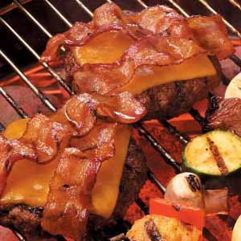
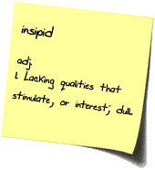
Wednesday, November 9th – 2nd Block
Insipid – adj. Lacking flavor or taste; unexciting.
What is another word for insipid (synonym)?
Bland, anemic, drab, inane, banal, trite, unpalatable
What word means the opposite of insipid (antonym)?
Exciting, savory, exhilarating, interesting, flavorful, tasty
These burgers insipid? No way!

Slide 13
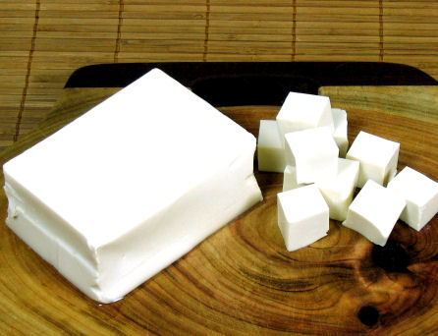
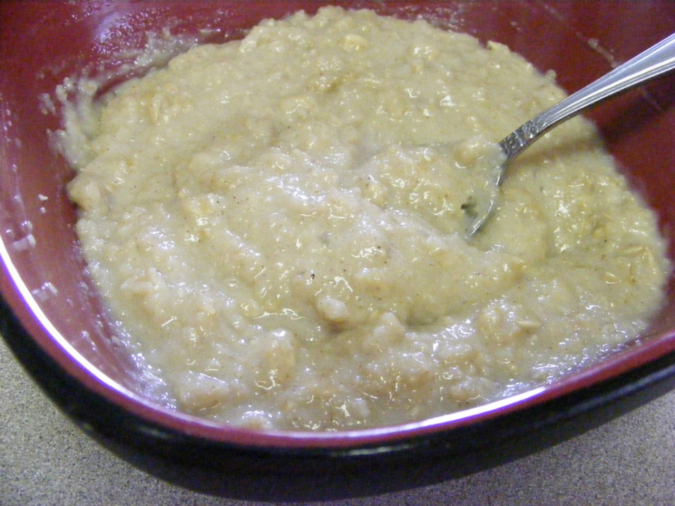
Wednesday, November 9th - 3rd Block
Can you use the word insipid to describe the pictures to the right?
Few people enjoy the insipid taste of plain tofu or oatmeal.
Now write your own sentence using the word insipid.
Plain Tofu
Plain Oatmeal

Slide 14
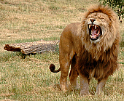
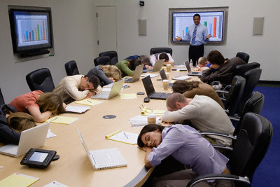
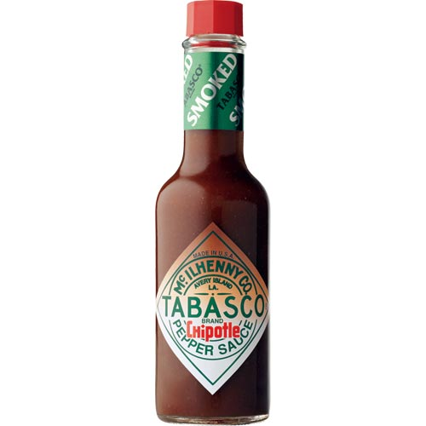
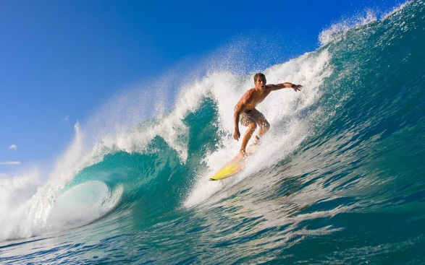
Wednesday, November 9th – 4th Block
Which picture best relates to the term insipid?
Can you complete the following analogy:
Insipid is to ____________, as weak is to Lady Canes weightlifters.
Chocolate, bacon cheeseburger, roaring lion, catching the perfect wave, fresh baked apple pie.
  [Non-examples]

Slide 15
Thursday, November 10th – 1st Block
What is the definition of the word platitude [plat-i-tude]?
What part of speech is platitude?
From the French, platitude meaning flatness.
Other forms of the word include: platitudinous (adj)
Good things come to those who wait.
There’s no “I” in TEAM
Time heals all wounds
It was meant to be.
“A platitude is simply a truth repeated till people get tired of hearing it..”
-- Stanley Baldwin, English statesman

Slide 16
Thursday, November 10th – 2nd Block
Platitude – noun. An idea or expression that has been used again and again. An obvious remark uttered as though original.
What is another word (or phrase) for platitude (synonym)?
Bromide, adage, banality, trite, cliché, commonplace, vapid
What word or phrase means the opposite of platitude (antonym)?
Coinage, nuance, vivacious, sincerity, profundity, lively

Slide 17
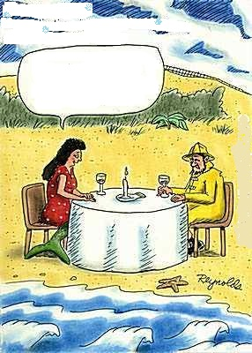
Thursday, November 10th – 3rd Block
Think of a platitude that can fill the mermaid’s speech bubble.
How about…
Don’t be sad. There’s plenty of other fish in the sea.

Slide 18
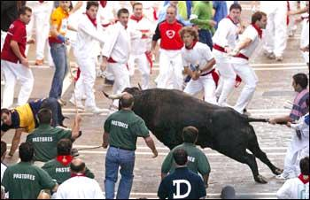
Thursday, November 10th – 4th Block
What platitude does this picture make you think of?
Is this analogy correct? If not, what is wrong with it?
Voracious is to ravenous, as platitude is to sincere speech.
Not correct.
Voracious and ravenous are synonyms. Platitude and sincere speech are antonyms.
Take the bull by the tail.

Slide 19
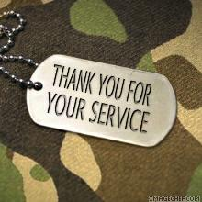
VETERANS DAY
Tomorrow is Veterans Day, in which we remember and thank all those who have served our country in the armed forces.
Have a safe and relaxing Veterans Day, Hurricanes.

