Slide 1
Word of the Day
Monday,
November 28th
through
Friday, December 2nd

Slide 2
December not-so trivial Trivia
December is the 12th month of the year in the Julian and Gregorian calendars.
December is from the Latin decem meaning “ten“. Just as November lost its original place in the calendar with the reforms of Julius Caesar (circa 45 B.C.), December was moved from the tenth to the twelfth month with the addition of January and February.
December is a month of summer in the Southern Hemisphere and winter in the Northern Hemisphere.
The winter solstice occurs in late December (around December 20-21), on the longest night/shortest day of the year.
December’s flower is the narcissus, or holly.
December 25 is the 2nd holiest day in the Christian liturgical calendar, marking the birth of the Christ child.

Slide 3
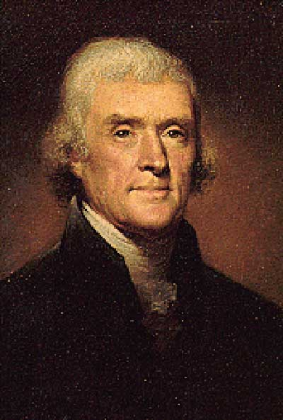
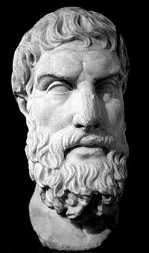
Monday, November 28th – 1st Block
What is the definition of the word epicurean?
How do you pronounce the word epicurean? [ep-i-kyoo-ree-uhn]
What part of speech is epicurean?
From the Middle English epicurien (one devoted to pleasure) by way of the Latin Epicurus and the Greek Epikoúreios
Other forms of the word include: epicure (noun), epicureanism (noun)
Bust of Epicurus, Greek Philosopher
“I am an Epicurean. I consider the genuine (not the imputed) doctrines of Epicurus as containing everything rational in moral philosophy which Greek and Roman leave to us.”
- Thomas Jefferson
3rd American President

Slide 4
Monday, November 28th – 2nd Block
Epicurean – adjective. Having to do with relishing the pleasure of eating and drinking
  Someone with epicurean habits is an epicure.
What is another word for epicurean (synonym)?
Gourmet, gastronome, gourmand, hedonist, bon vivant
What word means the opposite of epicurean (antonym)?
Austere, ascetic, abstemious, plain
“Epicurean” has an older meaning, that of a follower of the Greek philosopher Epicurus (ca. 341-270 B.C.), who espoused that human beings were free to follow self-interest as a basic motivating force (the first capitalist?). In Epicureanism, happiness is the ultimate goal of life, and the pursuit of pleasure is how to achieve that happiness. However, although the word today has connotations of physical pleasure, followers of this philosophy sought pleasure through freedom from emotional turmoil and worry.

Slide 5
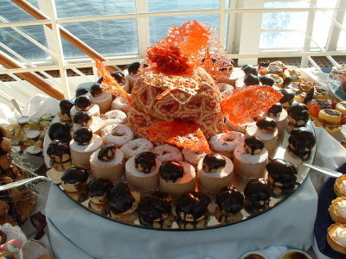
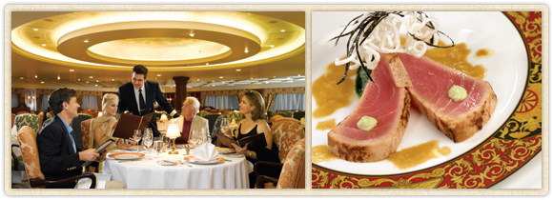
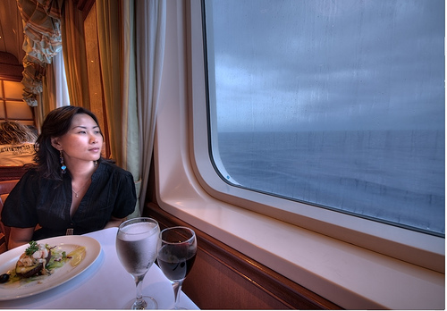
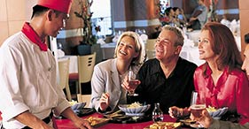
Monday, November 28th – 3rd Block
Can you use the word epicurean to describe these pictures?
Example: Cruise ship dining has a reputation as an epicurean experience.
Now write your own sentence using the word epicurean in a manner that illustrates your understanding of the word.

Slide 6
Monday, November 28th – 4th Block
Create your own dialogue between the two men pertaining to, or using the term epicurean?
Please complete the following analogy:
Epicurean is to ________, as strong is to powerful.
Gourmet, lover of food, gourmand, etc.
  [Synonyms]

Slide 7
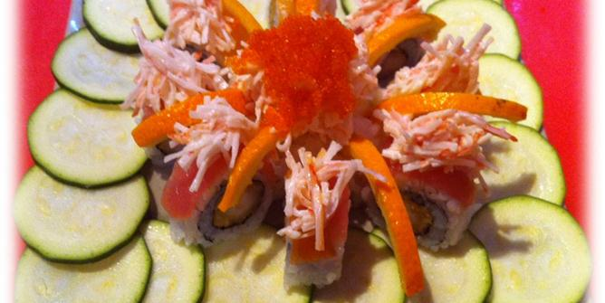
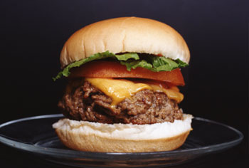
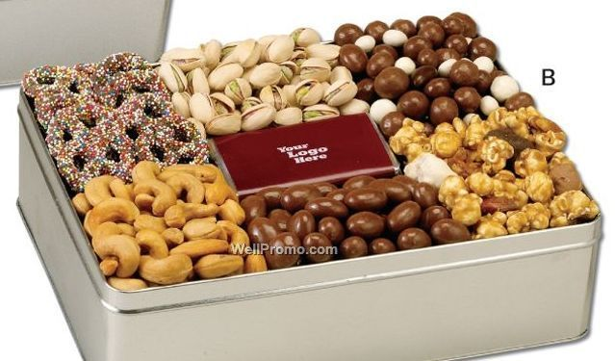
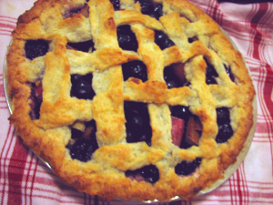
Tuesday, November 29th - 1st Block
What is the definition of the word savory?
How do you pronounce savory [sey-vuh-ree] ?
What part of speech is savory?
Comes from the Middle English (ca. 1175–1225) savori replacing an older form of the word, savure
Other forms of the word include: savorily (adv), savoriness (noun)
“Let the stoics say what they please, we do not eat for the good of living, but because the meat is savory and the appetite is keen.”
-- Ralph Waldo Emerson
American essayist and poet

Slide 8
Tuesday, November 29th – 2nd Block
Savory – adjective. Tasty and good smelling; piquant
Can you think of a synonym for savory?
Ambrosial, fragrant, succulent, scrumptious, mouthwatering, yummy, scrumptious, delicious
Can you think of an antonym for savory?
Inedible, bland, unpalatable, yucky

Slide 9
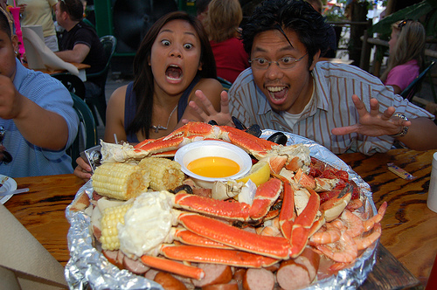
Tuesday, November 29th – 3rd Block
Can you use the word savory to describe the picture to the right?
Example: The savory snow crab arrangement appealed to the couple’s epicurean tastes.
Now write your own sentence using the word savory in a manner that illustrates your understanding of the word.
Hungry yet?

Slide 10
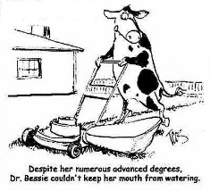
Tuesday, November 29th – 4th Block
Which cartoon do you think relates more closely to the Word of the Day, savory? Why?
Please complete the following analogy:
Savory is to disgusting, as __________ is to far away.
Nearby, close-at-hand, next door, etc.
[Antonyms]

Slide 11
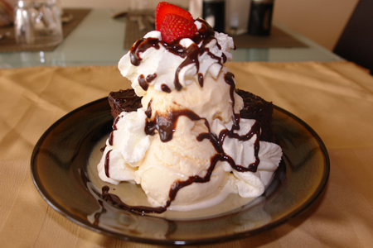
Wednesday, November 30th – 1st Block
What is the definition of the word delectable?
How do you pronounce the word delectable? [dih-lek-tuh-buhl]?
What part of speech is delectable?
From the Latin delectabilis (delightful)
Other forms of the word include: delectableness (noun), delectability (noun), delectably (adv)
“These high wild hills and rough uneven ways
Draw out our miles and make them wearisome;
But yet your fair discourse hath been as sugar,
Making the hard way sweet and delectable.” -- from King Richard II, by William Shakespeare

Slide 12
Wednesday, November 30th – 2nd Block
Delectable – adjective. Delicious; highly pleasing or enjoyable; delightful
What is another word for delectable (synonym)?
Savory, delicious, pleasurable, ambrosial, gratifying, scrumptious
What word means the opposite of delectable (antonym)?
Disagreeable, distasteful, repulsive, nasty

Slide 13
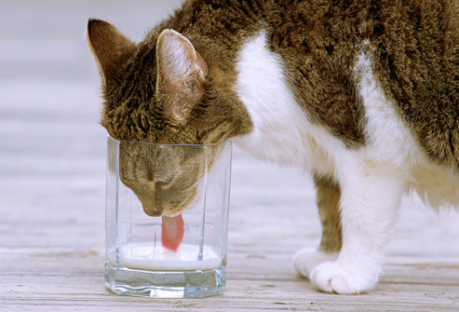
Wednesday, November 30th - 3rd Block
Use the word delectable to describe the picture to the right?
Example: Getting her head stuck in a glass is a small price to pay for a taste of delectable milk.
Now write your own sentence using the word delectable, to demonstrate your understanding of the word.

Slide 14
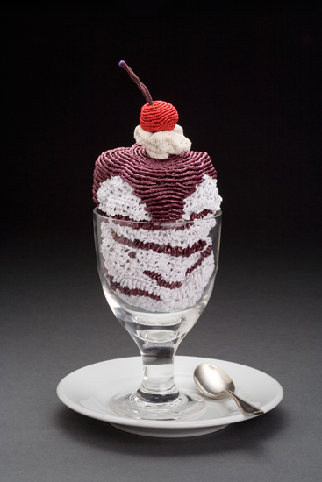
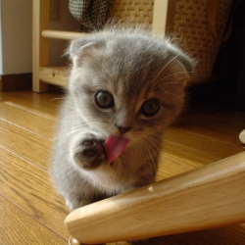
Wednesday, November 30th – 4th Block
Which picture best relates to the term delectable? Why?
Can you complete the following analogy:
Delectable is to dessert, as ______ is to conflagration.
Hot, fiery, roaring, etc.
[Descriptive adjectives]
Would you change your mind if you knew that the left hand image is made entirely of wool?

Slide 15
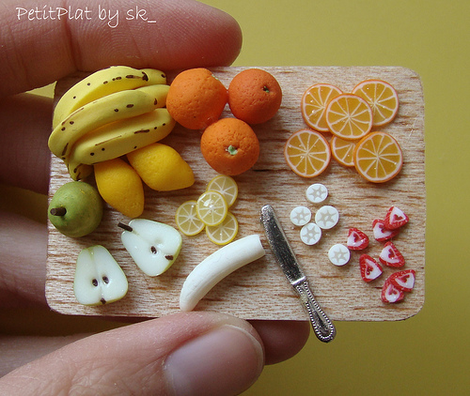
Thursday, December 1st – 1st Block
What is the definition of the word abstemious?
How do you pronounce abstemious [ab-stee-mee-uhs]?
What part of speech is abstemious?
From the Latin ab- (from) + temetum (strong drink)
Other forms of the word include: abstemiously (adv), abstemiousness (noun)
“One never hears any mockery of them as you occasionally heard about previous leadership styles, and again, the sort of modesty, the work ethic, the down to business, abstemious personal style, I think, has played well here.”
-- William McCahill, diplomat

Slide 16
Thursday, December 1st – 2nd Block
Abstemious – adjective. Holding back from eating or drinking too much.
What is another word (or phrase) for abstemious (synonym)?
Abstinent, ascetic, moderate, temperate, frugal, nonindulgent, disciplined, restrained
What word or phrase means the opposite of abstemious (antonym)?
Gluttonous, greedy, lavish, indulgent
Abstemious in Dutch is nuchter, bezadigd, matig, sober

Slide 17
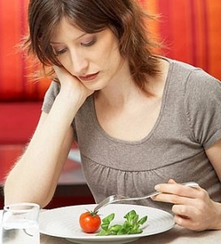
Thursday, December 1st – 3rd Block
Can you use the word abstemious to describe the picture to the right?
Example: Julie struggled with the abstemious demands of her diet plan.
Now write your own sentence using the word abstemious.

Slide 18
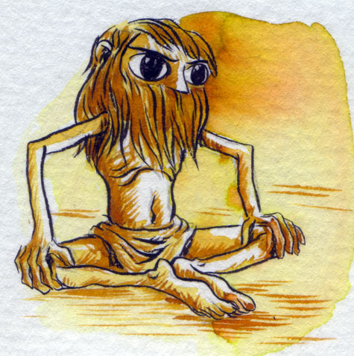
Thursday, December 1st – 4th Block
Can you think of another image that relates to the term abstemious?
What’s wrong with the following analogy:
Abstemious is to restrained, as precarious is to certain.
Abstemious and restrained are synonyms, while precarious and certain are antonyms.

Slide 19
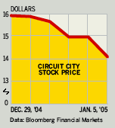
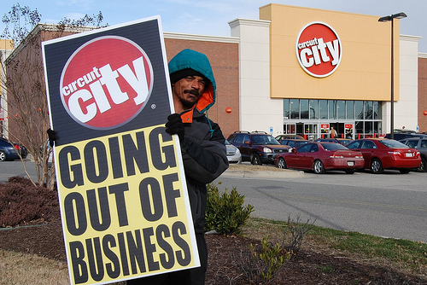
Friday, December 2nd - 1st Block
What is the definition of the word lackluster?
How do you pronounce lackluster [lack-luhst-er]?
What part of speech is lackluster?
From the Old English lac (deficiency) + the Middle French lustre (radiance, gloss)
Alternate spelling: lacklustre
“No. 2 electronics retailer Circuit City Stores blamed rivals' aggressive promotions for its lackluster yearend.”
-- Business Week (2005)
“Circuit City to Go Out of Business After 60 Years “
-- Bloomberg, 2009

Slide 20
Friday, December 2nd - 2nd Block
Lackluster – adj. Lacking vitality, energy, or brightness; boring.
What is another word (or phrase) for lackluster (synonym)?
Dull, prosaic, insipid, blah, lusterless
What word or phrase means the opposite of lackluster (antonym)?
Stellar, exciting, vivacious, lively, spirited, enthusiastic

Slide 21
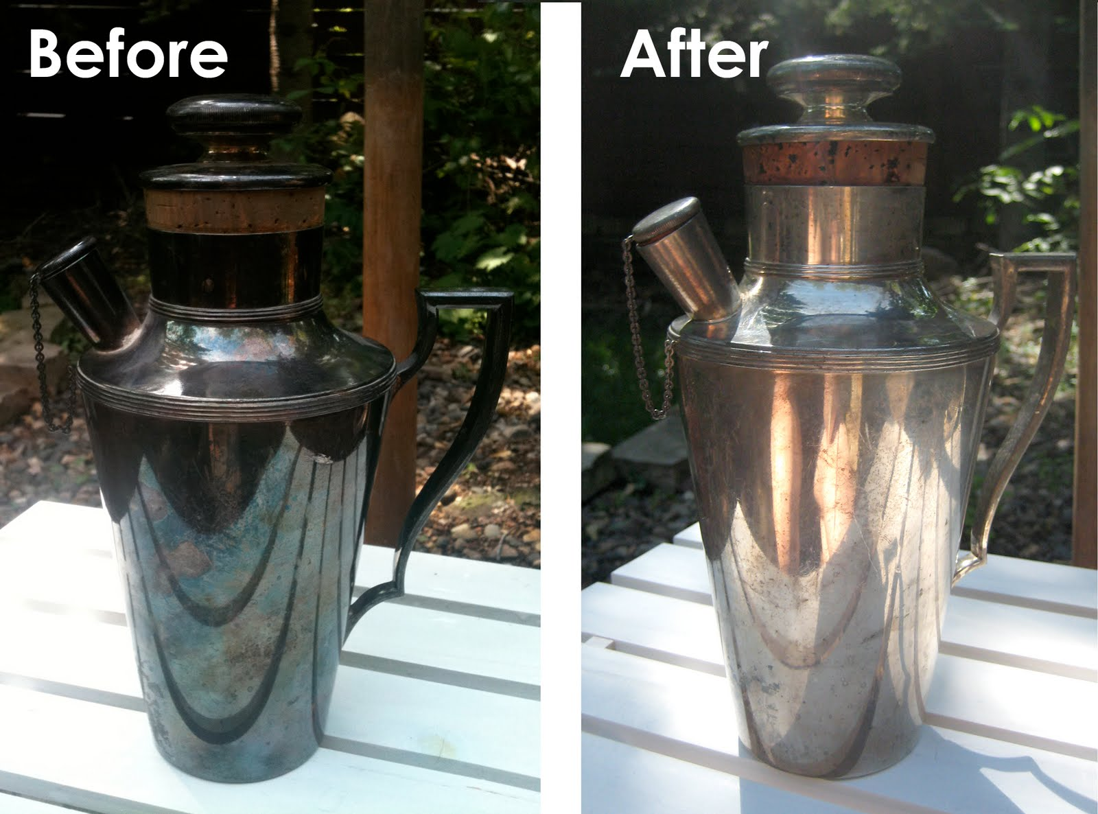
Friday, December 2nd - 3rd Block
Can you use the word lackluster to describe the pictures to the right?
Example: The lackluster antique pitcher just needed a little elbow grease and polish to shine.
Now write your own sentence using the word lackluster.

Slide 22
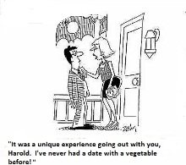
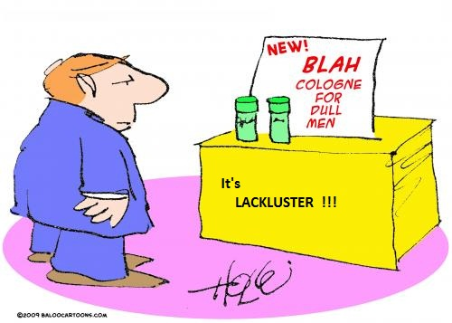
Friday, December 2nd - 4th Block
Which image best relates to the term lackluster? Why?
Can you finish the following analogy:
Lackluster is to shiny new car, as meek is to ______.
Lewis and Clark, Apollo astronauts, hero, Alexander the Great, world explorers, etc.
[Non-examples]

