Slide 1
Word of the Day
Monday, November 14th through Friday, November 18th

Slide 2
November not-so trivial Trivia
November is the 11th month of the year in the Julian and Gregorian calendars.
November is from the Latin novem meaning “nine“. November had been the ninth month in the pre-Julian calendar (named for Julius Caesar and begun in 45 B.C.) but retained its name although not its placement, when January and February were added.
November is a month of spring in the Southern Hemisphere and autumn in the Northern Hemisphere.
November is associated with All Saints Day (November 1) and All Souls Day (November 2) in the Christian liturgical calendar.
In the pagan “wheel of the year”, November begins at or near Samhain in the Northern Hemisphere and Beltaine in the Southern Hemisphere.

Slide 3
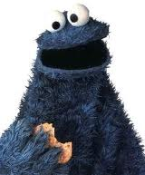

Monday, November 14th – 1st Block
What is the definition of the word voracious [vaw-rey-shuhs]?
What part of speech is voracious?
From the Latin vorare (to devour)
Other forms of the word include: voraciously (adv), voraciousness (noun)
“I get bored very easily. I have a voracious appetite and I do not feel alive if I'm repeating something I'm good at. So I'm always looking for new challenges.” -- Jewel

Slide 4
Monday, November 14th – 2nd Block
voracious – adjective. Craving or devouring large quantities, usually food; exceedingly eager or avid in some activity; greedy; gluttonous
What is another word for voracious (synonym)?
Insatiable, ravenous, gorging, devouring, piggy, rapacious, ravenous
What word means the opposite of voracious (antonym)?
Quenched, satisfied

Slide 5
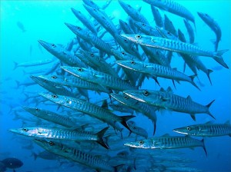
Monday, November 14th – 3rd Block
Can you use the word voracious to describe this picture?
Example: Scuba divers often fear voracious barracuda, despite the fact that they rarely attack humans.
Now write your own sentence using the word voracious in a manner that illustrates your understanding of the word.

Slide 6
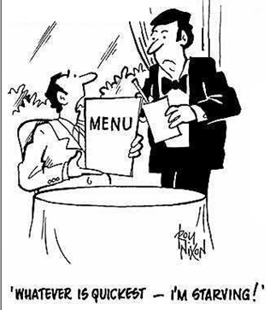
Monday, November 14th – 4th Block
Can you think of another image that you would associate with the term voracious?
Please complete the following analogy:
Voracious is to empty, as ______ is to confounding.
Bewildering, flabbergasted, amazing, perplexing, etc.
  [Synonyms]

Slide 7
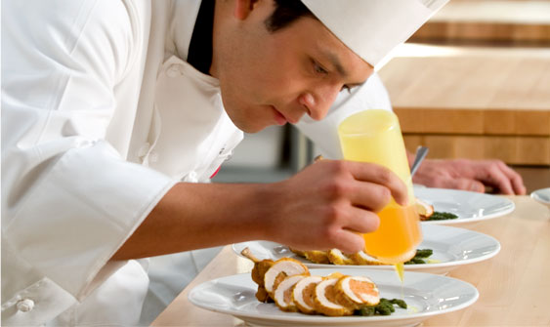
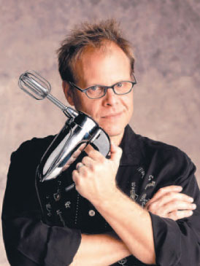
Tuesday, November 15th - 1st Block
What is the definition of the word culinary [kyoo-luh-ner-ee or kuhl-uh-ner-ee] ?
What part of speech is culinary?
Comes from the Latin culina (kitchen, food)
Other forms of the word include: culinarily (adv)
“So I quit my job and went to the New England Culinary Institute for the full two years and worked in the restaurant industry after that until finally I thought I had a grasp on what I needed to do what I do.”
-- Alton Brown

Slide 8
Tuesday, November 15th – 2nd Block
culinary – adjective. Of, pertaining to, or used in cooking or the kitchen
Can you think of a synonym for culinary?
Palatable, savory, succulent, scrumptious, yummy
Can you think of an antonym for culinary?
Inedible, unpalatable, undelicious

Slide 9
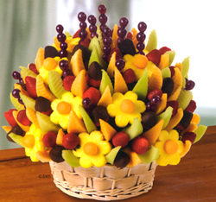
Tuesday, November 15th – 3rd Block
Can you use the word culinary to describe the pictures to the right?
Example: Edible Arrangements has taken the idea of giving flowers and added a culinary twist.
Now write your own sentence using the word culinary in a manner that illustrates your understanding of the word.

Slide 10
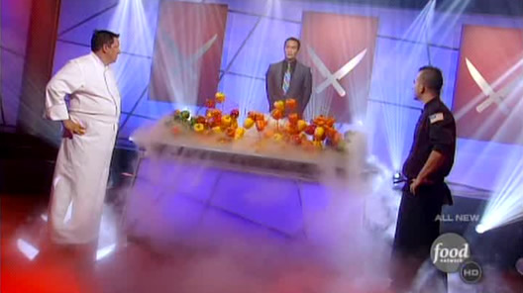
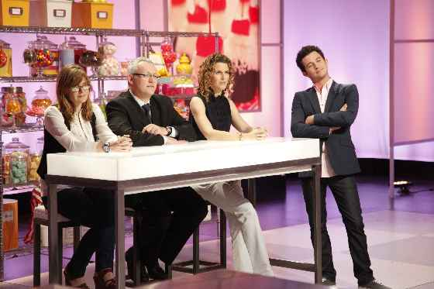
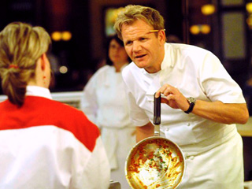
Tuesday, November 15th – 4th Block
How many culinary competitions can you identify?
Can you complete the following analogy:
Culinary is to Emeril Lagasse, as macabre is to _____.
Edgar Allen Poe, Stephen King, Dean Kootz, etc.
[Examples]

Slide 11
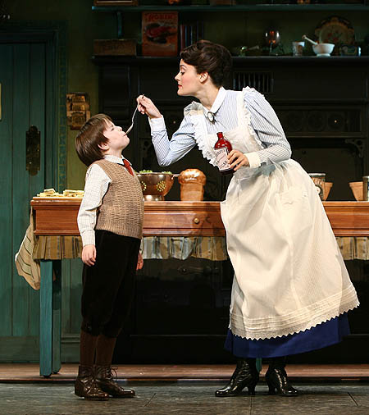
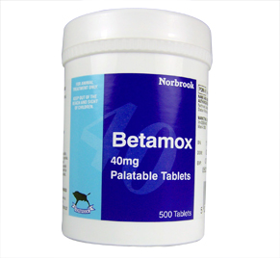
Wednesday, November 16th – 1st Block
What is the definition of the word palatable [pal-uh-tuh-buhl]?
What part of speech is palatable?
From the Latin palatum (root of the mouth
Other forms of the word include: palatability (noun), palatableness (noun), palatably (adv)
“Sometimes the only way to make palatable that which is appalling and apprehensive is to season it with some humor.”
-- Terrence Howard

Slide 12
Wednesday, November 16th – 2nd Block
palatable – adjective. Pleasing to the taste buds; agreeable or acceptable to the mind or feelings
What is another word for palatable (synonym)?
Savory, delectable, appetizing, agreeable, enjoyable
What word means the opposite of palatable (antonym)?
Unsavory, nasty, disagreeable

Slide 13
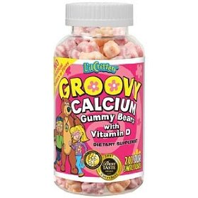
Wednesday, November 16th - 3rd Block
Can you use the word palatable to describe the pictures to the right?
Example: In order to make taking vitamins more palatable for children, manufacturers have resorted to exciting packaging and sugary coatings.
Now write your own sentence using the word palatable.

Slide 14
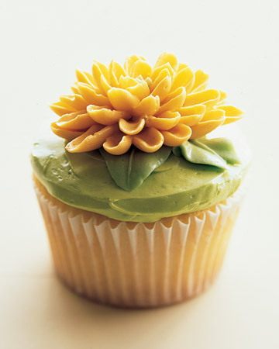
Wednesday, November 16th – 4th Block
Which picture best relates to the term palatable?
Can you complete the following analogy:
Palatable is to bitter, as ______ is to cryptic.
Obvious, clear, apparent, etc.
[Antonyms]

Slide 15
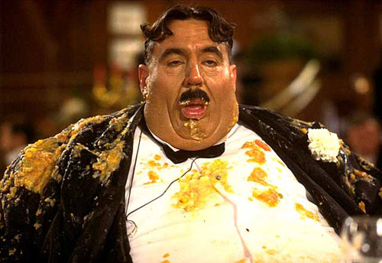
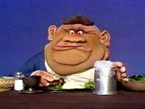
Thursday, November 17th – 1st Block
What is the definition of the word glutton [gluht-n]?
What part of speech is glutton?
From the Latin gluttonem (overeater)
Other forms of the word include: gluttonous (adj), gluttonously (adv)
“He who distinguishes the true savor of his food can never be a glutton; he who does not cannot be otherwise.”
-- Henry David Thoreau

Slide 16
Thursday, November 17th – 2nd Block
glutton – noun. One who overindulges in food and drink
What is another word (or phrase) for glutton (synonym)?
Gorger, gastronome, gourmand, epicurean
What word or phrase means the opposite of glutton (antonym)?
Abstemious, abstinent, moderate, temperate

Slide 17
Thursday, November 17th – 3rd Block
Can you use the word glutton to describe the picture to the right?
Example: In true gluttonous fashion, Homer was unable to settle on just one snack.
Now write your own sentence using the word glutton.

Slide 18

Thursday, November 17th – 4th Block
Can you think of another image that relates to the term glutton?
What’s wrong with the following analogy:
Glutton is to hefty eater, as adversity is to surviving a hurricane.
Glutton and hefty eater are synonyms, while surviving a hurricane is an example of adversity.

Slide 19
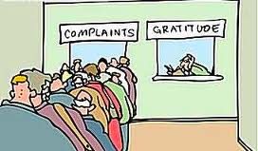
Friday, November 18th – 1st Block
What is the definition of the word gratitude [grat-i-tood]?
What part of speech is gratitude?
From the Latin gratus (thankful)
Other forms of the word include: grateful (adj), overgratitude (noun)
“Feeling gratitude and not expressing it is like wrapping a present and not giving it.”
-- William Arthur Ward

Slide 20
Friday, November 18th – 2nd Block
gratitude – noun. The quality or feeling of being grateful, thankful or having appreciation
What is another word (or phrase) for gratitude (synonym)?
Recognition, praise, thankfulness, acknowledgement
What word or phrase means the opposite of gratitude (antonym)?
Ingratitude, thanklessness, criticism, disparagement

Slide 21

Friday, November 18th – 3rd Block
Can you use the word gratitude to describe the picture to the right?
Example: Perhaps nobody expresses more gratitude at Thanksgiving than the turkey that lives to see the next day.
Now write your own sentence using the word gratitude.

Slide 22



Friday, November 18th – 4th Block
Can you think of any other expressions used to express gratitude?
Can you finish the following analogy:
Gratitude is to affront, as debacle is to ______.
Success, victory, blessing, etc.
[Antonyms]

