Slide 1
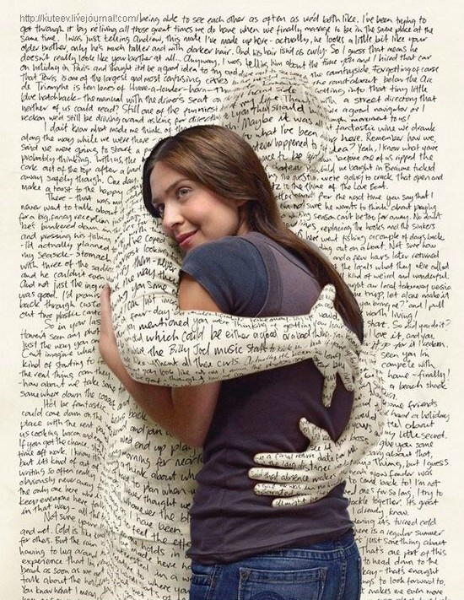
Word of the Day
Week of Monday, October 31st through Friday, November 4th

Slide 2

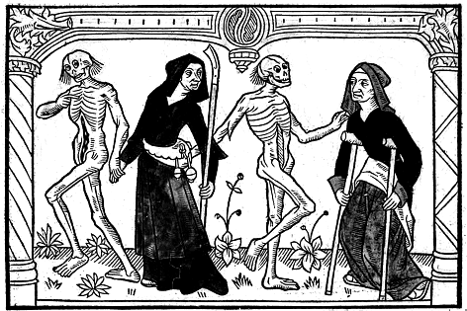
Monday, October 31st – 1st Block
What is the definition of the word macabre?
What part of speech is macabre ?
From the Old French macabe’ (dance of death)
Other forms of the word include: macabrely (adv)
“Luckily nothing happened to me, but I saw a macabre scene, as people tried to break windows in order to get out. People were hitting the panes with chairs, but the windows were unbreakable. One of the panes finally broke, and they started to get out by the window.” -- Franciszek Kowal

Slide 3
Monday, October 31st - 2nd Block
Macabre – adjective. Gruesome and horrifying; dealing with or representing death, especially the grimmer or uglier aspect; inspiring horror
What is another word for macabre (synonym)?
Ghastly, gristly, cadaverous, horrific, creepy, harrowing
What word means the opposite of macabre (antonym)?
Living, normal, wonderful, desirous

Slide 4
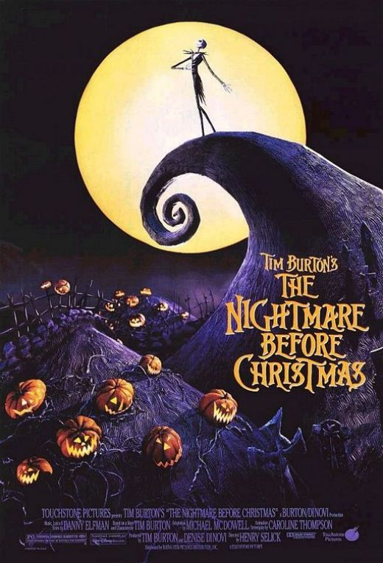
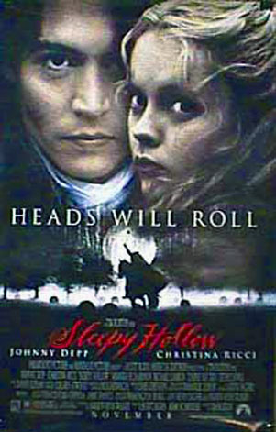

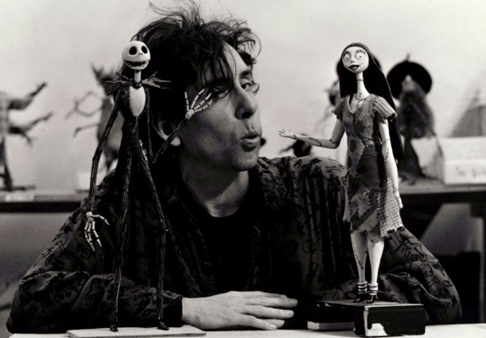
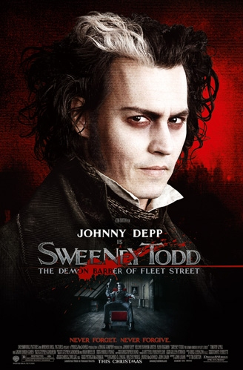
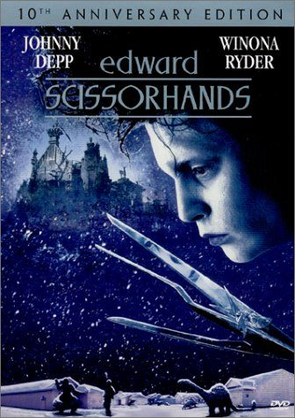
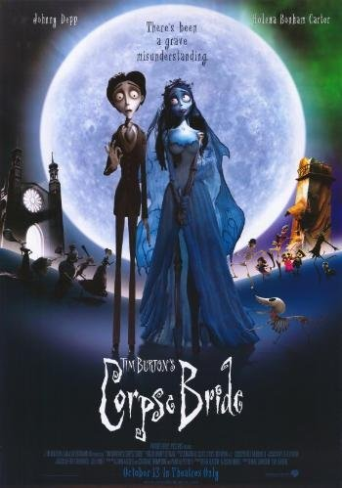
Monday, October 31st – 3rd Block
Can you use the word macabre to describe the picture to the right?
Example: Director Tim Burton has made a career out of bringing his unique, macabre twist to scripts.
Now write your own sentence using the word macabre in a manner that illustrates your understanding of the word.

Slide 5
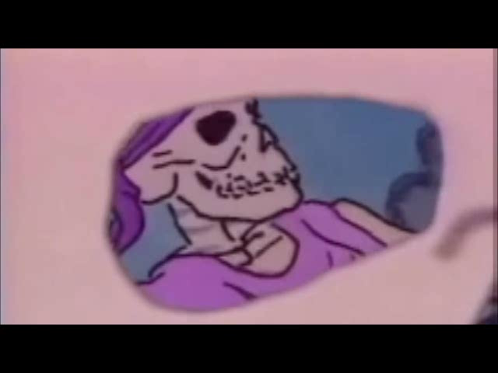
Monday, October 31st - 4th Block
Can you think of another image that relates to the word macabre?
Which choice best fulfills the following analogy:
Macabre is to morbid, as ______ is to fascinating.
a. Perturbing
b. Tantalizing
c. Disenchanting
d. Opposing
Tantalizing (Synonyms)

Slide 6
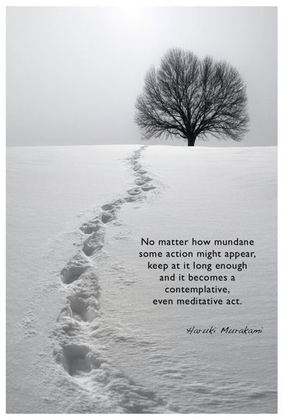
Tuesday, November 1st – 1st Block
What is the definition of the word mundane?
What part of speech is mundane?
From the Latin mundanus (belonging to the world)
Other forms of the word include: mundanely (adverb), mundaneness (noun), unmundane (adjective)
“The joy of life is made up of obscure and seemingly mundane victories that gives us our own small satisfactions.” -- Billy Joel

Slide 7
Tuesday, November 1st – 2nd Block
mundane – adjective. Commonplace; ordinary; unimaginative
What is another word for mundane (synonym)?
Banal, humdrum, prosaic, blasé, mediocre
What word means the opposite of mundane (antonym)?
Exciting, extraordinary, wonderful

Slide 8
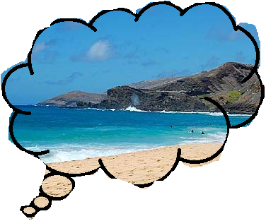
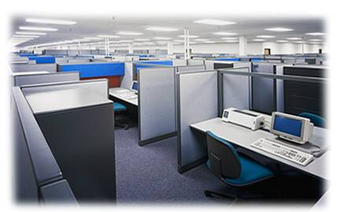
Tuesday, November 1st – 3rd Block
Can you use the word mundane to describe the pictures to the right?
Example: After a two week vacation in Maui, Devin found returning to work a bit too mundane.
Now it’s your turn. Can you use the word mundane in a sentence in a manner that illustrates your understanding.

Slide 9
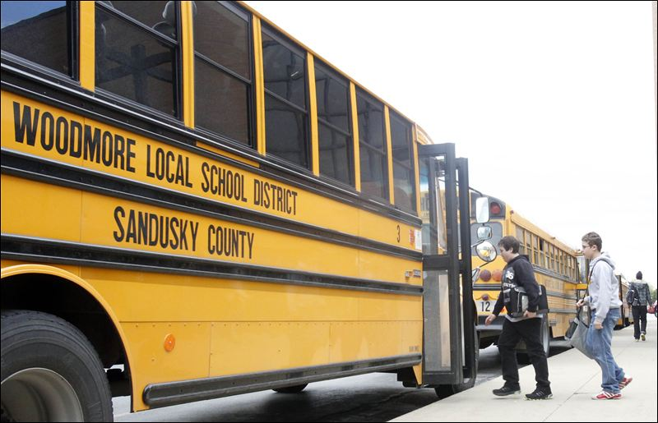
Tuesday, November 1st - 4th Block
Can you think of another image that relates to the term mundane?
Complete the following analogy:
Mundane is to brushing your teeth, as remarkable is to _____.
Skydiving, cliff diving, winning the lottery, etc.
[Examples]

Slide 10
Wednesday, November 2nd – 1st Block
What is the definition of the word trite?
What part of speech is trite?
From the Latin tritus (worn, familiar)
Other forms of the word include: tritely (adv), triteness (noun),
“It is what it is”
“Do as I say, not as I do.”
“Think outside the box.”
“What goes around, comes around.”
“If the shoe fits, wear it.”
“I don't think I could ever do a network sitcom because the humor is often based on some trite circumstance. I don't want to be a part of a show where it's mostly about coming up with the jokes.”
-- Sherilyn Fenn

Slide 11
Wednesday, November 2nd – 2nd Block
trite – adjective. Unoriginal and stale due to overuse
What is another word for trite (synonym)?
Banal, common, hackneyed, hokey, insipid
What word means the opposite of (antonym)?
Original, impressive, important, uncommon

Slide 12
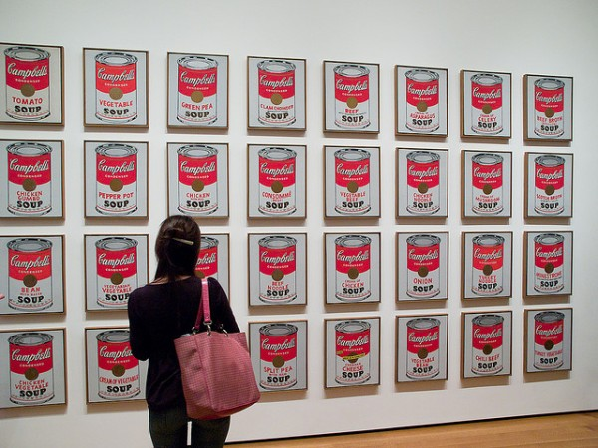
Wednesday, November 2nd – 3rd Block
Can you use the word trite to describe the picture to the right?
Example: Rather than painting a trite portrait or landscape, Andy Warhol created art out of uniquely familiar items.
Now, try writing your own sentence using the word trite.

Slide 13
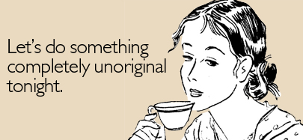
Wednesday, November 2nd – 4th Block
Can you think of another image associate with the word trite?
What’s wrong with the following analogy?
Trite is to mundane, as confounding is to enlightening.
Trite and mundane are synonyms, while confounding and enlightening are antonyms.

Slide 14
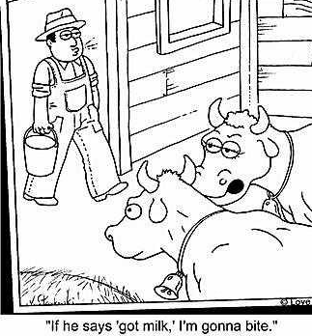
Thursday, November 3rd – 1st Block
What is the definition of the word hackneyed?
What part of speech is hackneyed?
From the Old English hack (broken down nag or horse)
Other forms of the word include: hackneyism (noun)
“The cliché is a hackneyed idiom that hopes that it can still palm itself off as a fresh response.” -- John Gross

Slide 15
Thursday, November 3rd - 2nd Block
hackneyed – adjective. Made commonplace by overuse; trite
What is another word for hackneyed (synonym)?
Clichéd, banal, overused, common, corny
What word or phrase means the opposite of hackneyed (antonym)?
Fresh, new, original, uncommon

Slide 16
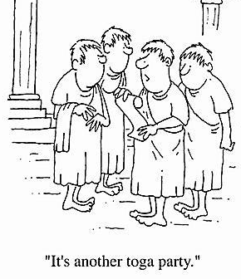
Thursday, November 3rd – 3rd Block
Can you use the word hackneyed to describe the picture at right?
Example: Julius found it a bit hackneyed that his friend Tiberius chose a toga party theme.
Now write your own sentence using the word hackneyed in a manner that illustrates your understanding of the word.

Slide 17
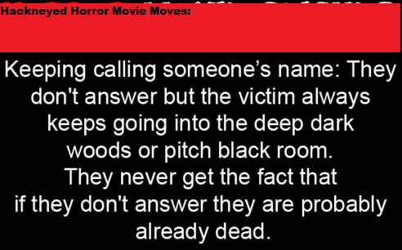
Thursday, November 3rd – 4th Block
Can you think of other hackneyed situations in books/movies?
Complete the analogy:
Hackneyed is to fresh, as troublesome is to _____.
Easy, helpful, nice, etc.
[Antonyms]

Slide 18
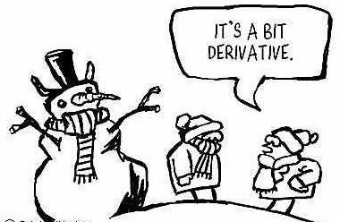
Friday, November 4th – 1st Block
What is the definition of the word derivative?
What part of speech is derivative?
From the Latin de- (from) + rivus (stream)
Other forms of the word include: derivatively (adv), derivativeness (noun)
“I believe that writing is derivative. I think good writing comes from good reading.”
-Charles Kuralt

Slide 19
Friday, November 4th - 2nd Block
derivative – adjective. Taken from something already existing; unoriginal
What is another word for derivative (synonym)?
Copied, imitative, emulative
What word or phrase means the opposite of derivative (antonym)?
Inventive, original, unique, unborrowed

Slide 20
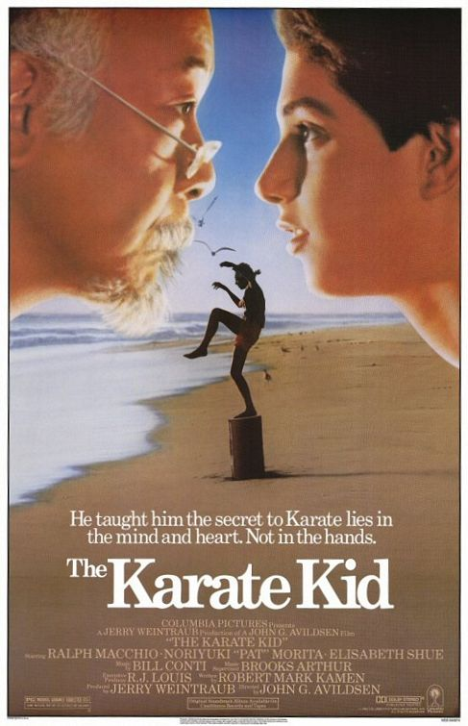
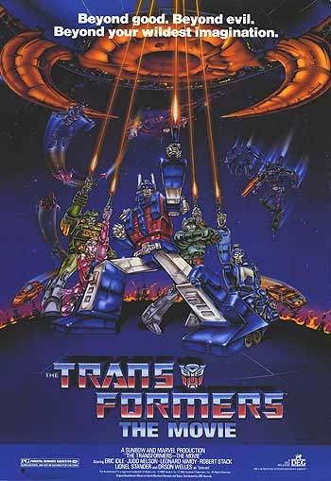
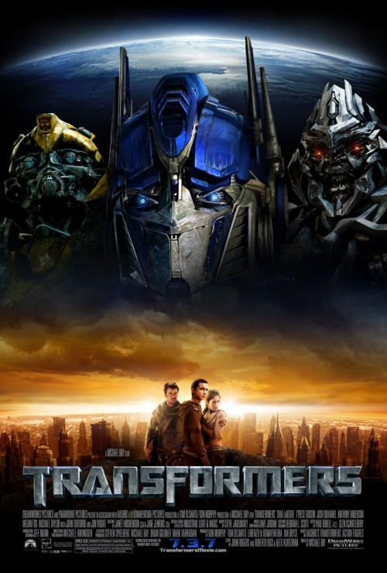
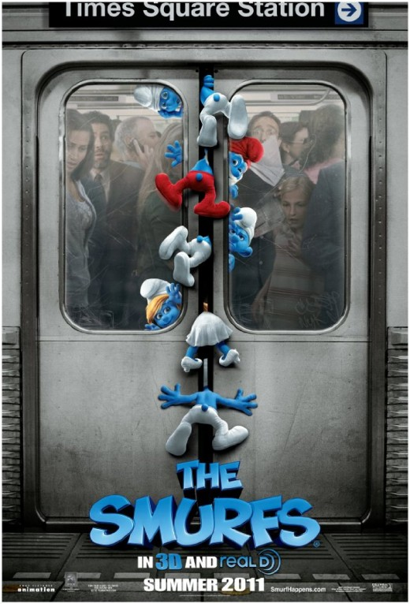
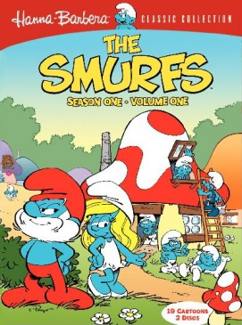
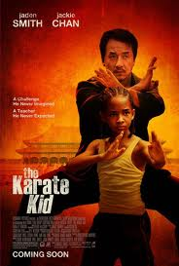
Friday, November 4th – 3rd Block
Can you use the word derivative to describe the picture at right?
Example: While nostalgic for many, the contemporary remake of 1980s movies is also quite derivative.
Now write your own sentence using the word derivative in a manner that illustrates your understanding of the word.

Slide 21
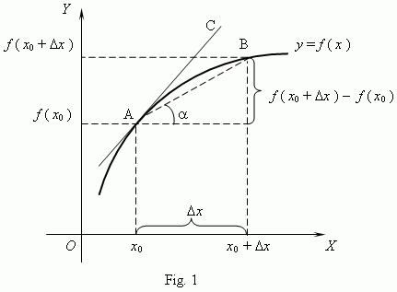
Friday, November 4th – 4th Block
How does the term derivative related to math, science, or other subjects?
Unscramble the analogy:
[Is To] [As] [Rehashed] [Solitary][,] [Unique] [Derivative][.]
Derivative is to rehashed, as solitary is to unique. [Synonyms]
Did You Know: In calculus, the derivative is a measure of how a function changes as its input changes. Loosely speaking, a derivative can be thought of as how much one quantity is changing in response to changes in some other quantity.

