Slide 1
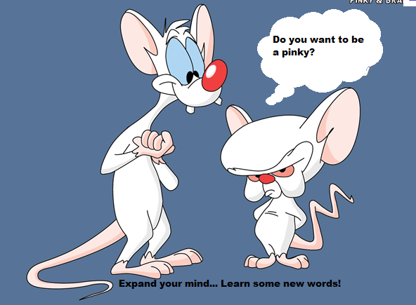
Word of the Day
Week of Monday, October 17th through Friday, October 21st

Slide 2
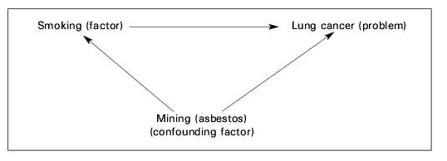
Monday, October 17th – 1st Block
What is the definition of the word confounding [kon-found-ing]?
What part of speech is confounding?
From the Latin com- (together) + fundere (to pour)
Other forms of the word include: confound (verb), confoundable (adj), confounder (noun), confoundingly (adv)
“There is nothing nobler or more admirable than when two people who see eye to eye keep house as man and wife, confounding their enemies and delighting their friends.” -- Homer

Slide 3
Monday, October 17th - 2nd Block
Confounding – adjective. Puzzling; baffling; throwing into increased confusion or disorder
What is another word for confounding (synonym)?
Bewildering, flabbergasted, amazing, perplexing
What word means the opposite of confounding (antonym)?
Clarify, clear up, enlighten, explained
*Vocabulary in Action: In statistics, a confounding variable is an external variable in a statistical model that relates with both the dependent variable and the independent variable. The methodologies of scientific studies therefore need to account for these variables, as they can be a major threat to the validity of a study.

Slide 4
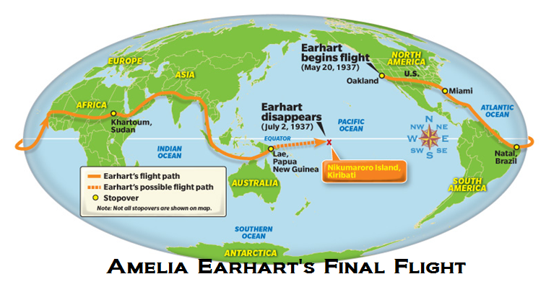
Monday, October 17th – 3rd Block
Can you use the word confounding to describe the picture to the right?
Example: The world was fascinated by the confounding disappearance of Amelia Earhart, a mystery still unsolved.
Now write your own sentence using the word confounding in a manner that illustrates your understanding of the word.

Slide 5
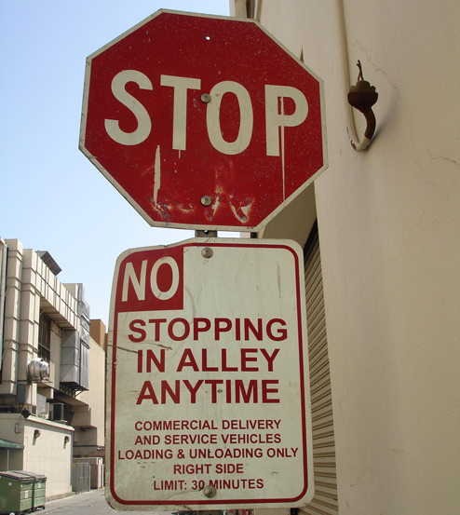
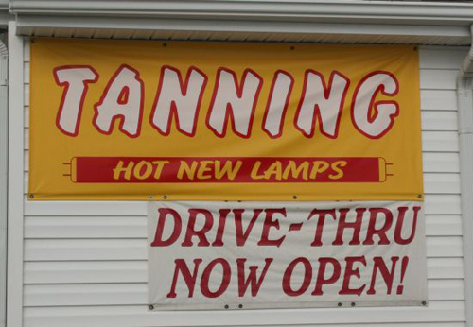
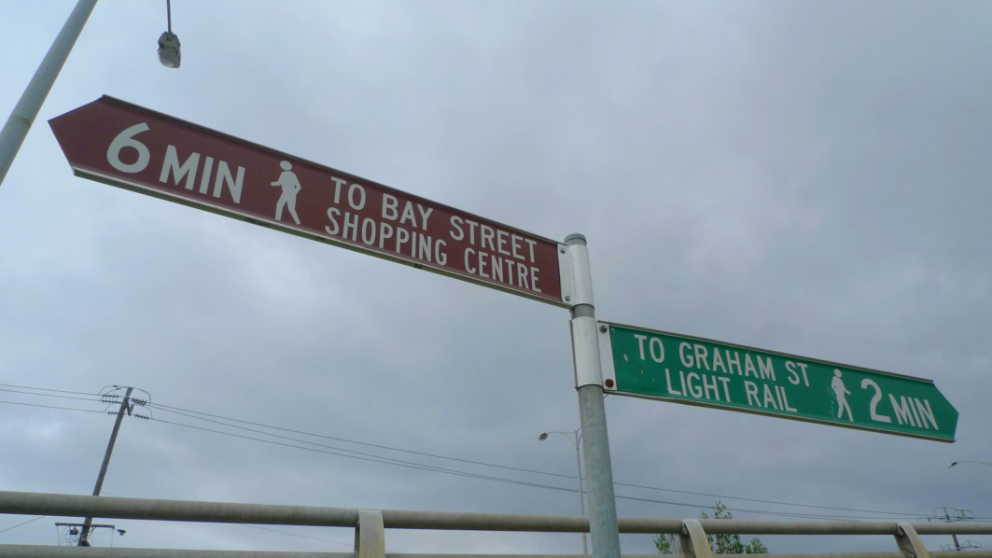
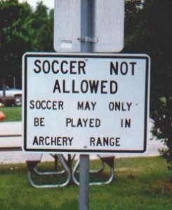
Monday, October 17th - 4th Block
Can you make sense of these confounding signs?
Which choice best fulfills the following analogy:
Confound is to rattle, as
_____ is to scare.
Confuse
Instigate
Startle
Hamper
C. Startle (Synonyms)

Slide 6
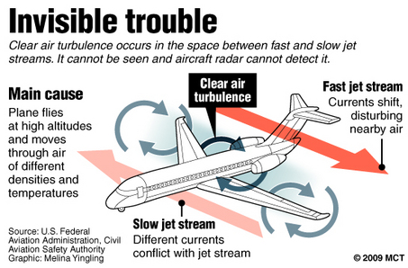
Tuesday, October 18th – 1st Block
What is the definition of the word turbulence [tur-byuh-luhns]?
What part of speech is turbulence?
From the Middle French turba (turmoil, crowd)
Other forms of the word include: turbulency (noun), turbulent (adj)
“In a time of turbulence and change, it is more true than ever that knowledge is power” -- John F. Kennedy

Slide 7
Tuesday, October 18th – 2nd Block
turbulence – noun. Great unrest; turmoil or disorder
What is another word for turbulence (synonym)?
Agitation, disturbance, commotion, frenzy
What word means the opposite of turbulence (antonym)?
Calmness, tranquility, quietness, stillness

Slide 8

Tuesday, October 18th – 3rd Block
Can you use the word turbulence to describe the pictures to the right?
Example: Unable to rechart the flight path, the pilot warned his passengers of impending turbulence as they headed into the storm.
While we often associate the term with flight, can you write your own sentence using the word turbulence in a different context?

Slide 9
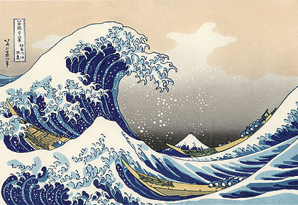
Tuesday, October 18th - 4th Block
Can you think of another image that relates to the term ?
Complete the following analogy:
Turbulence is to tranquility, as acceptance is to ______.
Denial, rejection, exclusion, disagreement, etc. (Antonyms)

Slide 10
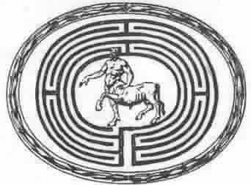
Wednesday, October 19th – 1st Block
What is the definition of the word labyrinth [lab-uh-rinth]?
What part of speech is labyrinth ?
From the Greek labyrinthos (maze, large building with intricate passages)
Other forms of the word include: labyrinths (plural)
“He, who every morning plans the transactions of the day, and follows that plan, carries a thread that will guide him through a labyrinth of the most busy life. “ -- Victor Hugo

Slide 11
Wednesday, October 19th – 2nd Block
labyrinth – noun. A maze from which it is very difficult to extricate or free oneself
What is another word for labyrinth (synonym)?
Intricacy, morass, snarl, complexity, knot
What word means the opposite of labyrinth (antonym)?
Organization, method, order, system
*Trivia of the Day: Today, labyrinth is generally synonymous with maze, but many contemporary scholars observe a distinction between the two: maze refers to a complex branching puzzle with choices of path and direction; while a labyrinth has only a single, non-branching path, which leads to the center. A labyrinth in this sense has a clear route to the center and back and is not designed to be difficult to navigate.

Slide 12
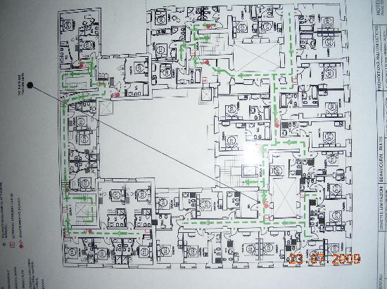
Wednesday, October 19th – 3rd Block
Can you use the word labyrinth to describe the picture to the right?
Example: The basement of the old dormitory was a labyrinth of tunnels, criss-crossing passageways, and dead ends in which it is easy to lose your way.
Now, try writing your own sentence using the word labyrinth as a metaphor.

Slide 13

Wednesday, October 19th – 4th Block
Can you think of another situation that left you feeling like you were in a labyrinth?
What’s wrong with the following analogy?
Labyrinth is to tangle, as turbulence is to dangerous.
Tangle is a synonym, while dangerous is merely a possible characteristic of turbulence.

Slide 14
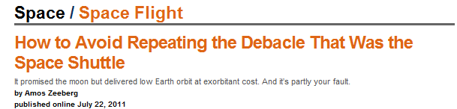
Thursday, October 20th – 1st Block
What is the definition of the word debacle [dey-bah-kuhl]?
What part of speech is debacle?
From the French des- (off ) + bacler (to bar)
Other forms of the word include: debacles (plural)
“A major power can afford a military debacle only when it looks like a political victory. A major power can afford a military debacle only when it looks like a political victory.”
-- Friedrich Durrenmatt

Slide 15
Thursday, October 20th - 2nd Block
debacle – noun. A failure or breakdown; a collapse that is often nonsensical
What is another word for debacle (synonym)?
Catastrophe, calamity, fiasco, flop, unholy mess
What word or phrase means the opposite of debacle (antonym)?
Success, wonder, blessing, miracle

Slide 16
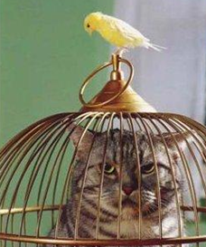
Thursday, October 20th – 3rd Block
Can you use the word debacle to describe the picture at right?
Example: The cat’s grand scheme to capture his prey turned into quite a debacle.
Now write your own sentence using the word debacle in a manner that illustrates your understanding of the word.

Slide 17
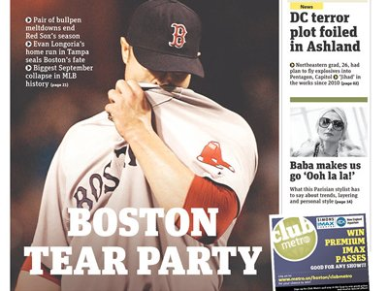
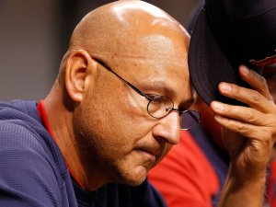
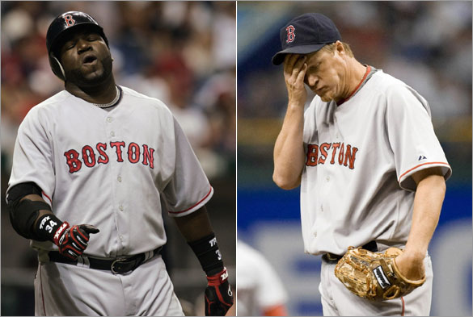
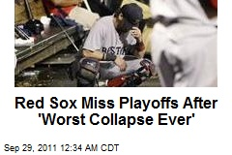
Thursday, October 20th – 4th Block
How does the image s below relate to the term debacle?
Complete the analogy:
Debacle is to winning an election, as grievance is to ___.
Being praised, receiving a compliment, etc. (Non-examples)

Slide 18
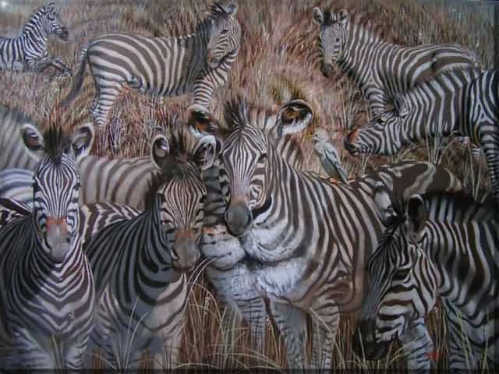
Friday, October 21st – 1st Block
What is the definition of the word cryptic [krip-tik]?
What part of speech is cryptic?
From the Greek kryptos (hidden)
Other forms of the word include: cryptically (adv), cryptical (adj)
“Bar codes have been cryptic for consumers. We've broken that code.” -- David Novak

Slide 19
Friday, October 21st - 2nd Block
cryptic – adjective. Hard to understand; hidden; mysterious, obscure
What is another word for cryptic (synonym)?
Abstruse, ambiguous, concealed, enigmatic, mystical
What word or phrase means the opposite of cryptic (antonym)?
Plain, evidence, obvious, apparent, straightforward, clear

Slide 20
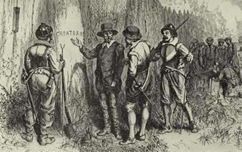
Friday, October 21st – 3rd Block
Can you use the word cryptic to describe the picture at right?
Example: In 1590, Sir Walter Raleigh returned to his settlement at Roanoake to find it abandoned with only the cryptic word “croatoan” engraved in a tree.
Now write your own sentence using the word cryptic in a manner that illustrates your understanding of the word.

Slide 21
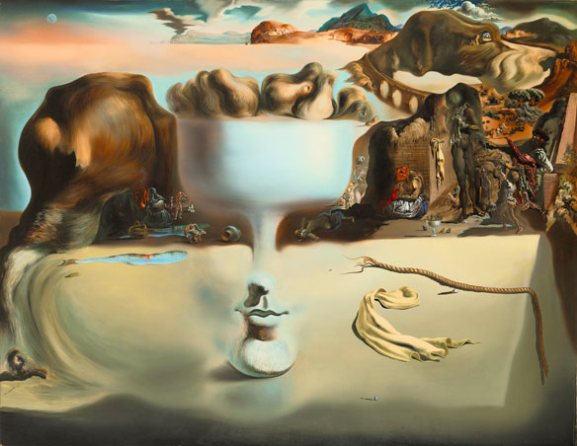
Friday, October 21st – 4th Block
How does the image below relate to the term cryptic?
Unscramble the analogy:
[cryptic] [sparing] [is to] [as] [is to] [abundant] [defined].
Cryptic is to defined, as sparing is to abundant. [Antonyms]
Fruit Dish on a Beach (1939) – Salvador Dali

