Slide 1
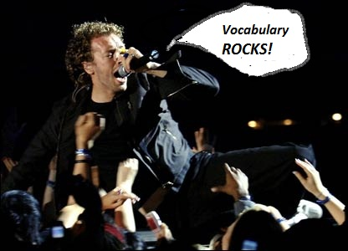
Word of the Day
Week of Monday, October 10th through Friday, October 14th

Slide 2
Word of the Day
Be sure to look for:
The Audio Links in each Block 1 slide - to help with word pronunciation;
Embedded Video & Audio links throughout.
Look for a follow-up e-mail related to “verbose”.

Slide 3

Monday, October 10th – 1st Block
What is the definition of the word verbose [ver bohs] ?
What part of speech is verbose?
From the Latin verbosus meaning full of words.
Other forms of the word include: verbosely (adv), verbosity (noun), verboseness (noun)
“Verily, this vichyssoise of verbiage veers most verbose. .”
- V

Slide 4
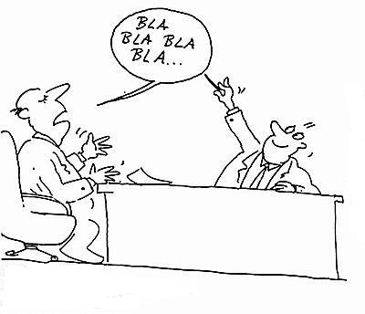
Monday, October 10th - 2nd Block
Verbose – adjective. Using to many words; wordy, long-winded.
What is another word for verbose (synonym)?
Bombastic, loquacious, gabby; long-winded
What word means the opposite of verbose (antonym)?
Concise, succinct, laconic

Slide 5
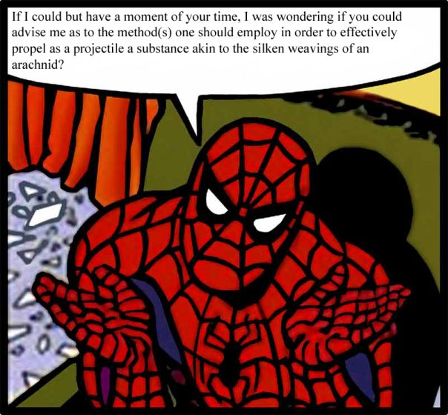
Monday, October 10th – 3rd Block
Can you use the word verbose to describe the picture at right?
Example: Spidey is hit with the King Pin’s Forget-a-Nizer Ray, which has a nasty side effect of excess verbosity.
Now write your own sentence using the word verbose in a manner that illustrates your understanding of the word.

Slide 6
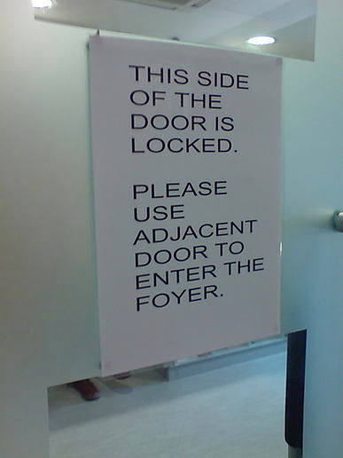
Monday, October 10th - 4th Block
Can you come up with a sign that expresses the same message in 5 words or less?
Unscramble the following analogy:
[cheerful] [is to] [Verbose] [succinct] [is to] [unhappy] [as] .
Verbose is to succinct as cheerful is to unhappy. [Antonyms]

Slide 7

Tuesday, October 11th – 1st Block
What is the definition of the word adversity [ad-vur-si-tee]?
What part of speech is adversity?
From the Old French ad- (to, toward) + vertere (to turn).
Other forms of the word include: adverse (adj)
“Adversity makes men.
Prosperity makes monsters.”
- Victor Hugo, French poet, playwright, novelist, artist, statesman, and human rights activist. 1802 - 1885

Slide 8
Tuesday, October 11th – 2nd Block
Adversity – noun. Great trouble or difficulty.
What is another word for adversity (synonym)?
Quagmire, calamity, catastrophe, challenge
What word means the opposite of adversity (antonym)?
Blessing, fortune, boon, prosperity, benefit
Adversidad is the Spanish translation of Adversity.

Slide 9
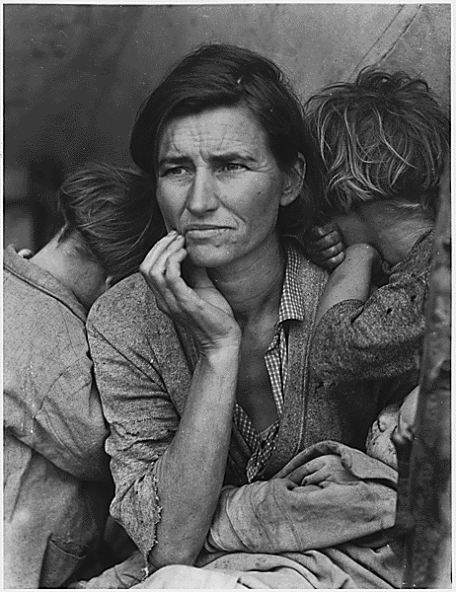
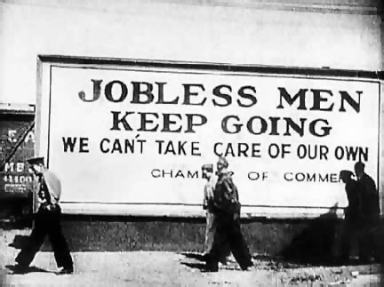
Tuesday, October 11th – 3rd Block
Can you use the word adversity to describe the pictures to the right?
Americans experienced adversity like never before during the Great Depression.
Now write your own sentence using the word adversity in a manner that illustrates your understanding of the word.

Slide 10
Tuesday, October 11th - 4th Block
Can you think of another image that relates to the term adversity?
Complete the following analogy:
Adversity is to suffering, as bewilder is to ___________.
Perplex, confound, confuse, etc.
  [Synonyms]

Slide 11
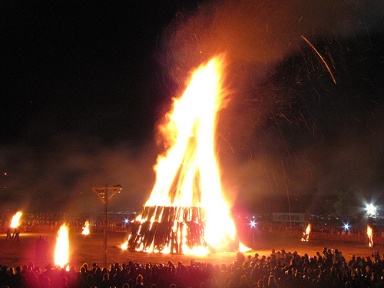
Wednesday, October 12th – 1st Block
What is the definition of the word conflagration [kon-fluh-grey-shuhn]?
What part of speech is conflagration?
From the Latin com- (with, together) + flagrare (to burn)
Other forms of the word include: conflagrative (adjective).
“The most intense conflicts, if overcome, leave behind a sense of security and calm that is not easily disturbed. It is just these intense conflicts and their conflagration which are needed to produce valuable and lasting results.” Carl Jung, psychiatrist

Slide 12
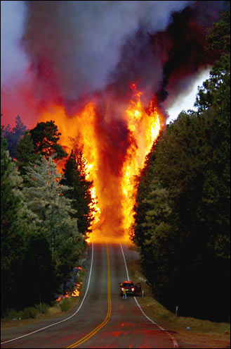
Wednesday, October 12th – 2nd Block
Conflagration – noun. A huge fire; an inferno.
What is another word for conflagration (synonym)?
Holocaust, blaze, pyre, bonfire, conflict
What word means the opposite of conflagration (antonym)?
Peace, ice, deep freeze

Slide 13
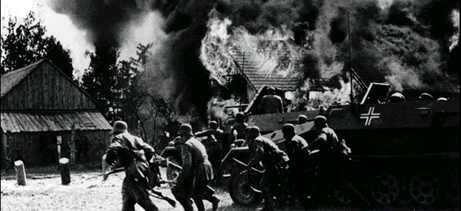
Wednesday, October 12th – 3rd Block
Can you use the word conflagration to describe the picture to the right?
The invasion of Poland by Nazi Germany in 1939 was the spark leading to the conflagration of World War II.
Now write your own sentence using the word conflagration.
Invasion of Poland 1939

Slide 14
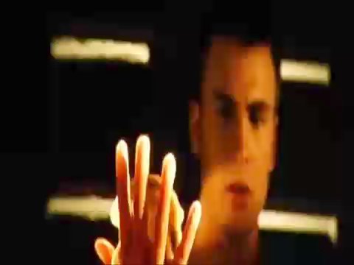
Wednesday, October 12th – 4th Block
Can you think of another character from literature, or media that epitomizes conflagration?
What’s wrong with the following analogy?
Conflagration is to bonfire, as pure is to filthy.
Conflagration & bonfire are synonyms. Pure is an antonym of filthy.
Video Clip

Slide 15
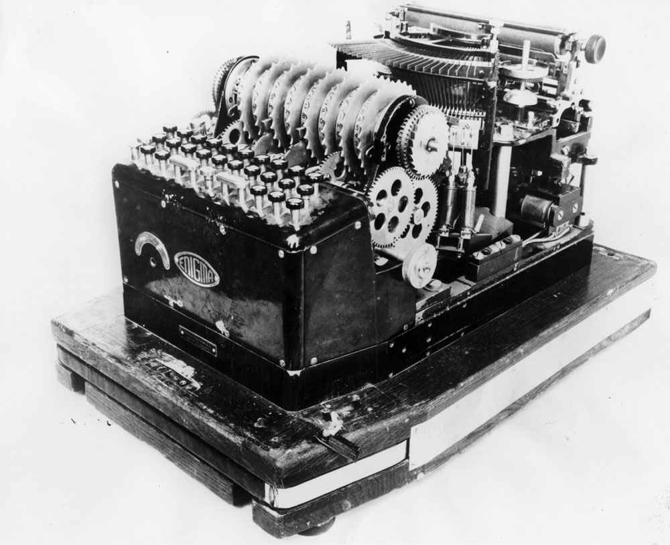
Thursday, October 13th – 1st Block
What is the definition of the word enigma [uh-nig-muh]?
What part of speech is enigma?
From the Latin aenigma (riddle)
Other forms of the word include: enigmatic (adj), enigmatically (adv), enigmatical (adj).
German Enigma machine WWII
“"I cannot forecast to you the action of Russia. It is a riddle, wrapped in a mystery, inside an enigma; but perhaps there is a key. That key is Russian national interest.“
- Winston Churchill 1939

Slide 16

Thursday, October 13th - 2nd Block
Enigma – noun. A riddle or mystery; a puzzling or baffling matter or person.
What is another word for enigma (synonym)?
Puzzle, conundrum, brain teaser, code.
What word or phrase means the opposite of enigma (antonym)?
Known, understood, clear, understandable.

Slide 17
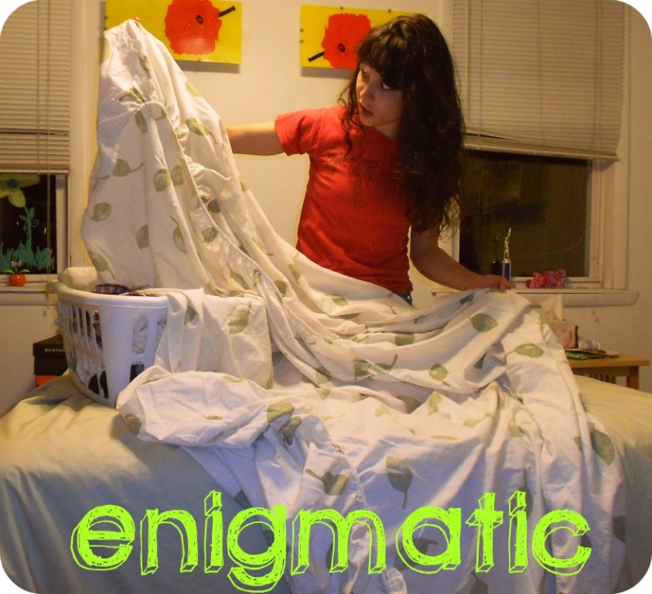
Thursday, October 13th – 3rd Block
Can you use the word enigma to describe the picture at right?
Example: Once you take it out of the package, refolding a contour sheet becomes quite the enigmatic endeavor.
Now write your own sentence using the word enigma in a manner that illustrates your understanding of the word.

Slide 18
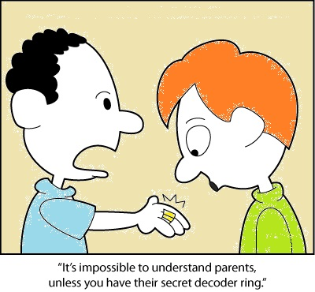
Thursday, October 13th – 4th Block
How does the image below relate to the term enigma?
Complete the analogy:
Understandable is to enigma, as turbulent is to ______________.
Calm, at peace, restful, tranquil, etc. [Antonyms]

Slide 19
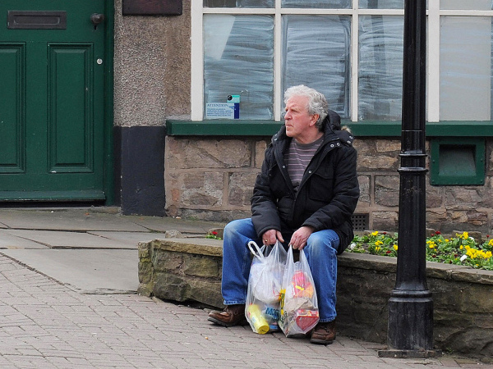
Friday, October 14th – 1st Block
What is the definition of the word quandary [kwon-duh-ree]?
What part of speech is quandary?
From the Latin quando (when). Does that sound familiar to those of you studying Spanish?
Other forms of the word include: quandaries (plural).
Quandary: If a man shops by himself, did a woman put him up to it?
That's one of the questions prompted by Helen Simpson's short story "Night Thoughts.“
- From National Public Radio.

Slide 20
Friday, October 14th - 2nd Block
Quandary – noun. An uncertain or confusing circumstance or situation; a dilemma.
What is another word for quandary (synonym)?
Plight, predicament, snarl, complicated situation, Pandora’s box, uncertainty, dilemma
What word or phrase means the opposite of quandary (antonym)?
Agreement, solution, calm, clear path, easy decision
Today’s Trivia: The Welsh translation of quandary is….
“cyfwng”

Slide 21
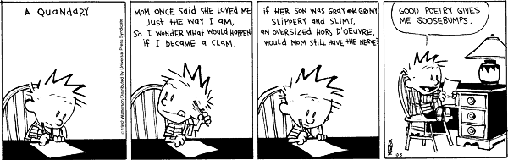
Friday, October 14th – 3rd Block
How does the word quandary relate to the comic strip below?
Calvin pondered through poetry the quandary of whether or not his mother would love him as a clam.
Teacher’s Choice: Write your own poetic quandary; or draw a cartoon/comic strip that illustrates the word in action.

Slide 22
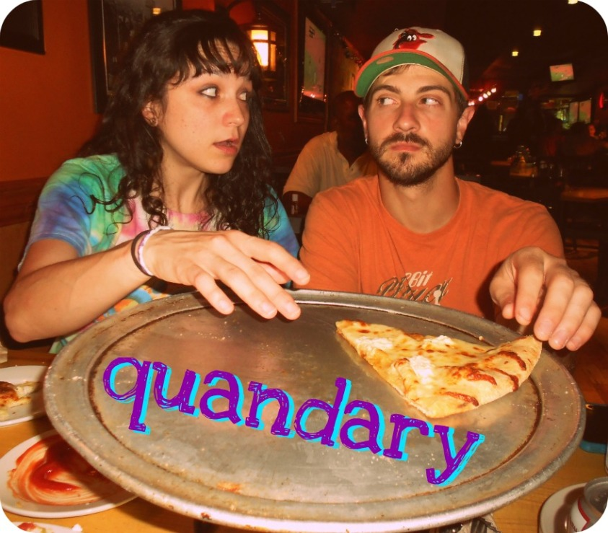
Friday, October 14th – 4th Block
How does the image below relate to the term quandary?
Complete the analogy:
Quandary is to an easy decision, as ____________ is to a famous musician.
Josh Freeman (Bucs QB), Mr. Naruta (awesome social studies teacher), President Lincoln (historical figure), Orlando Bloom (actor), etc. [Non-examples]
Their shared desire for the last slice of deliciousness created quite the quandary for Sarah and Chris.

