Slide 1
Word of the Day
Monday,
January 9th
through
Friday, January 13th

Slide 2
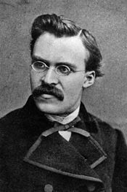
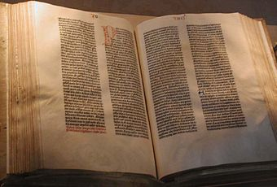
Monday, January 9th – 1st Block
What is the definition of the word exalt?
How do you pronounce the word exalt? [ig-zawlt]
What part of speech is exalt?
From the Latin ex – (out, up) + altus (high)
Other forms of the word include: exalter (noun), exalted (adj)
“Whoever shall exalt himself shall be abased, and he that humbles himself shall be exalted.”
- the Bible
“He that humbleth himself wishes to be exalted.”
- Friedrich Nietzsche, philosopher

Slide 3
Monday, January 9th – 2nd Block
Exalt – verb. To lift up in status, dignity, or power; to praise or glorify.
What is another word for exalt (synonym)?
Extol, acclaim, promote, commend, praise
What word means the opposite of exalt (antonym)?
Humble, depreciate, castigate, denounce

Slide 4
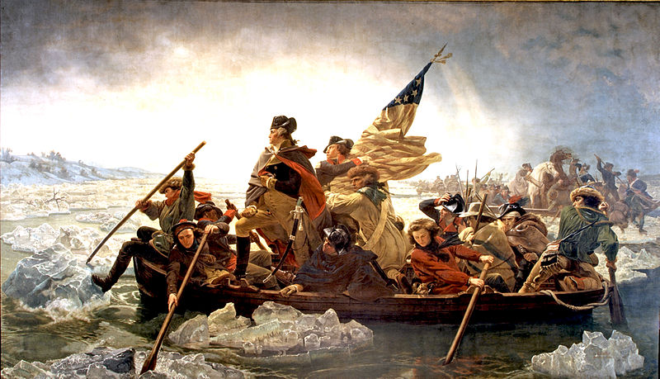
Monday, January 9th – 3rd Block
Use the word exalt to describe this painting.
Example: Washington Crossing the Delaware, the iconic painting by Emanuel Leutze, exalts America’s first president in a pose reminiscent of a Greek demi-god.
Now write your own sentence using the word exalt in a manner that illustrates your understanding of the word.

Slide 5
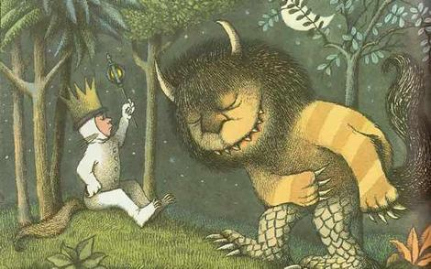
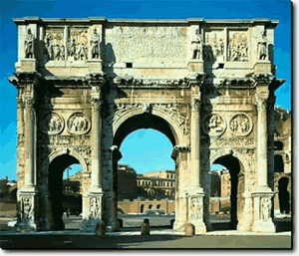
Monday, January 9th – 4th Block
Which picture relates best to the Word of the Day, exalt? Why?
Please complete the following analogy:
Exalt is to condemn, as strength is to _____________.
Weakness, weariness, etc.
  [Antonyms]
Constantine’s Arch, commemorating his victory over his rival, Maxentius.

Slide 6
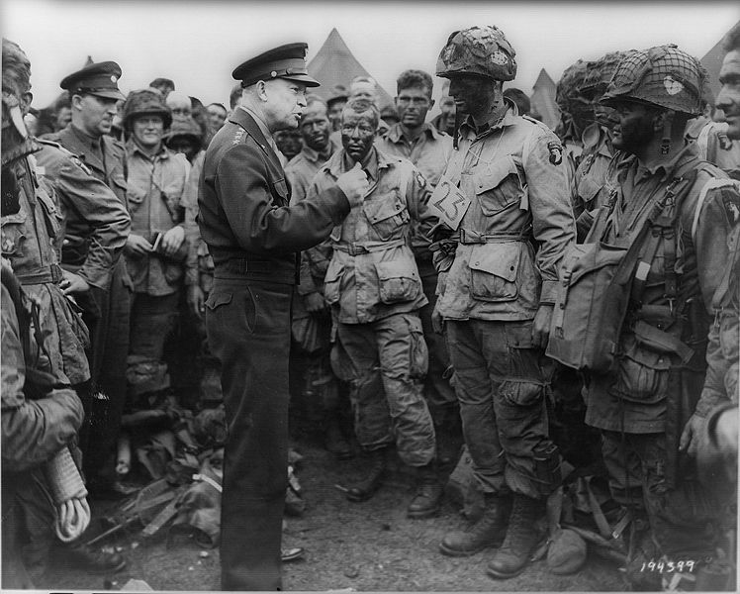
Tuesday, January 10th - 1st Block
What is the definition of the word acclaim?
How do you pronounce acclaim [uh-kleym] ?
What part of speech is acclaim?
From the Latin acclamare (to cry out at)
Other forms of the word include: acclaimer (noun), reacclaim (verb), unacclaimed (adj)
“Humility must always be the portion of any man who receives acclaim earned in the blood of his followers and the sacrifices of his friends.”
-- Dwight D. Eisenhower
Supreme Commander of the Allied Forces in Europe during World War II and 34th President of the United States

Slide 7
Tuesday, January 10th – 2nd Block
Acclaim – verb. To express strong approval or praise; hail; enthusiastic approval
Can you think of a synonym for acclaim?
Acclamation, exaltation, kudos, approbation, commendation, adulation
Can you think of an antonym for acclaim?
Criticism, beratement, jeering, disapproval

Slide 8
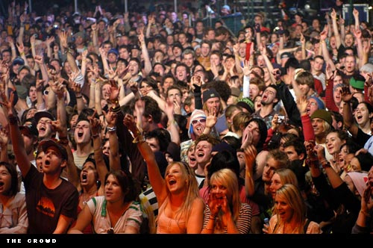
Tuesday, January 10th – 3rd Block
Can you describe the picture to the right using our Word of the Day, acclaim?
Answer: The wild acclaim of the concert crowd greeted the Black Eyed Peas.
Now use acclaim in a sentence of your own, illustrating your understanding of the word.

Slide 9
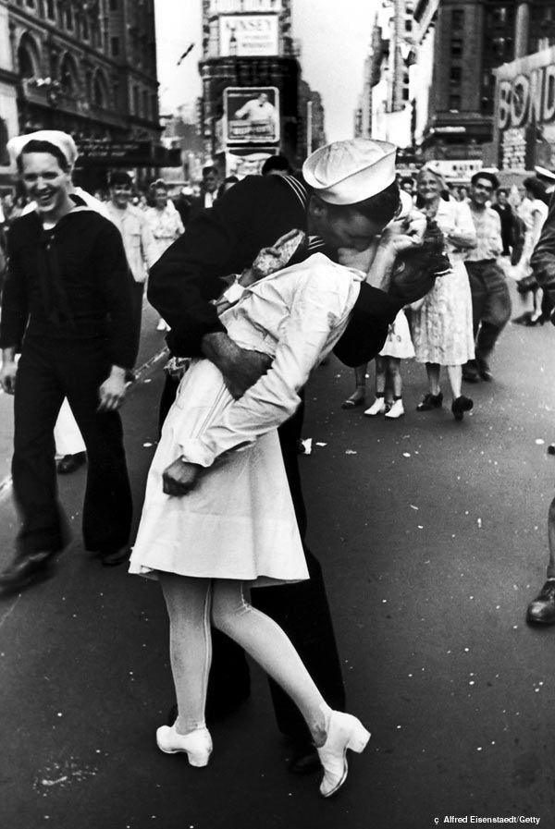
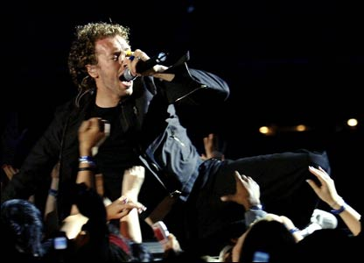
Tuesday, January 10th – 4th Block
Which picture do you think relates more closely to the Word of the Day, acclaim? Why?
Please complete the following analogy:
Acclaim is to adulation, as sufficient is to ________.
Plentiful, bountiful, ample, voluminous, etc.
[Synonyms]

Slide 10

Wednesday, January 11th – 1st Block
What is the definition of the word esteem?
How do you pronounce the word esteem? [ih-steem]?
What part of speech is esteem?
From the Latin aestimare (to valule, appraise)
Other forms of the word include: unesteemed (adj)
Related to: estimable (adj)
“That which we obtain too easily, we esteem too lightly.” -- Old Proverb

Slide 11
Wednesday, January 11th – 2nd Block
Esteem – verb. To value highly; to have great regard for.
What is another word for esteem (synonym)?
Revere, respect, appreciate, cherish, admire
What word means the opposite of esteem (antonym)?
Disdain, disrespect, dislike, ridicule

Slide 12
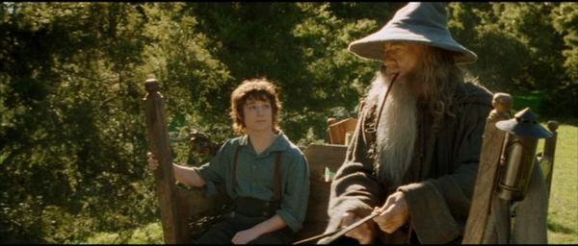
Wednesday, January 11th - 3rd Block
Can you use the word esteem to describe this picture?
Example: Frodo the hobbit held Gandalf in high esteem. The wizard certainly felt the same way toward the brave hobbit.
Now write your own sentence using the word esteem, to demonstrate your understanding of the word.

Slide 13
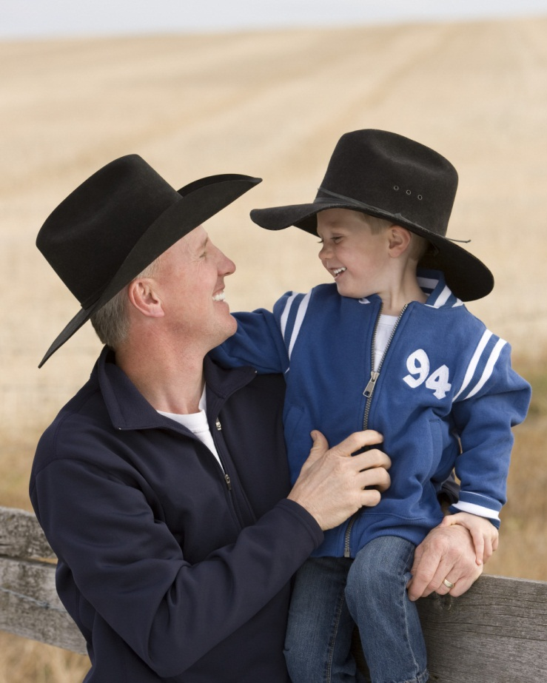
Wednesday, January 11th – 4th Block
Does the picture relate to our Word of the Day, esteem? Why?
Can you complete the following analogy:
Esteem is to admire, as ______ is to conflagration.
Roaring fire, bonfire, conflict, etc.
[Synonyms]

Slide 14
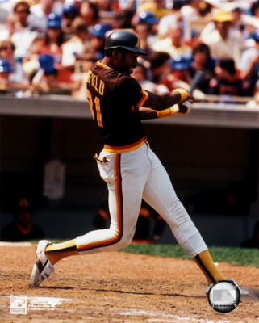
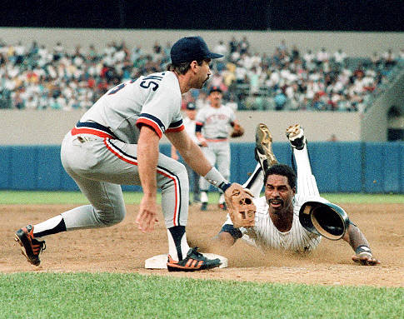
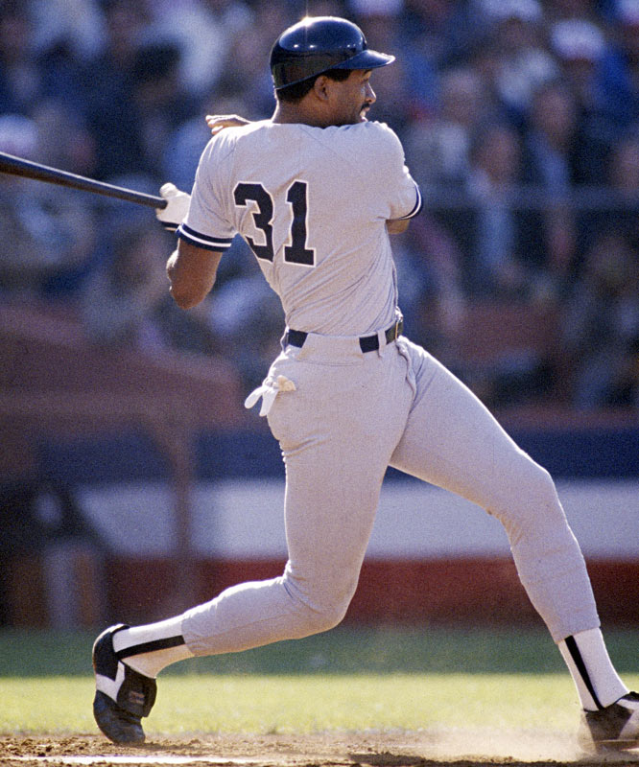
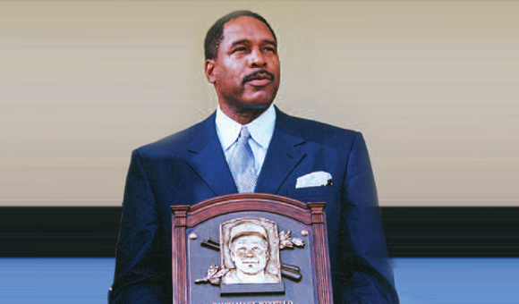
Thursday, January 12th – 1st Block
What is the definition of the word adulate?
How do you pronounce adulate [aj-uh-leyt]?
What part of speech is adulate?
From the Latin adulari (to flatter)
Other forms of the word include: adulation (noun), adulator (noun)
“The only players that are having fun are those having a good year, feasting on pitching or blowing down hitters and garnering all the adulation that goes with it.”
-- Dave Winfield,
baseball Hall of Famer

Slide 15
Thursday, January 12th – 2nd Block
Adulate – verb. To praise or flatter greatly; to fawn over; to show excessive devotion to.
What is another word (or phrase) for adulate (synonym)?
Fall all over, fawn, gush, praise, worship, blandish
What word or phrase means the opposite of adulate (antonym)?
Criticize, denounce, insult, condemn, castigate, belittle

Slide 16
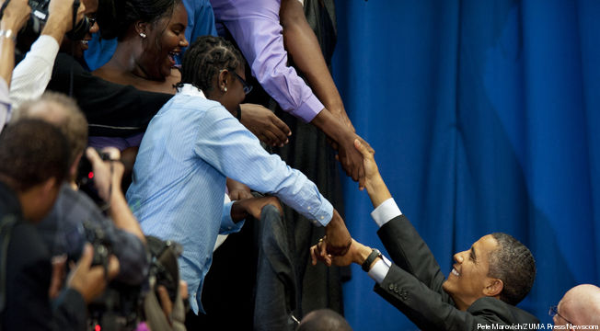
Thursday, January 12th – 3rd Block
Can you use the word adulate (or a form of the word) to describe this picture?
Example: The crowd of supporters at the rally were exuberant in their adulation for President Obama.
Now write your own sentence using the word adulate.

Slide 17
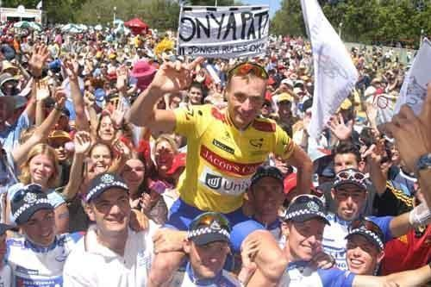
Thursday, January 12th – 4th Block
Can you think of another image that relates to the term adulate?
What’s wrong with the following analogy:
Adulate is to praise, as precarious is to certain.
Adulate and praise are synonyms, while precarious and certain are antonyms.
Cyclist Pat Jonker gets the adulation of the crowd.

Slide 18
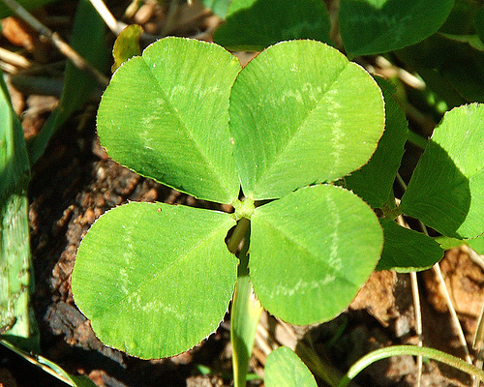
Friday the 13th! Did you know??
According to the folks at National Geographic, the superstitions surrounding Friday the 13th have their origins in Norse myth and Christian tradition.
Friday was considered unlucky by many because it was the day in which Jesus was crucified.
The Norse tell a story in which Loki, the god of mischief, was the 13th (uninvited) guest at a party which ultimately ended in the death of Balder, the god of Joy and Gladness. The earth grew dark and cold at his death.
Also, Judas Iscariot was considered the 13th guest at the Last Supper before he left to betray Jesus.
For those of you who suffer from friggatriskaidekaphobia – Fear of Friday the 13th - here’s a bit of Irish luck to see you through to Saturday.
(As my Geography students know, Friday is named for the Norse goddess Frigga.)
http://news.nationalgeographic.com/news/2004/02/0212_040212_friday13.html

Slide 19
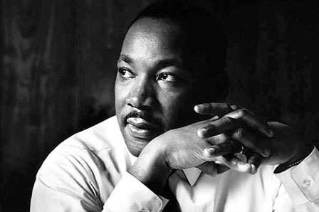
Friday, January 13th - 1st Block
What is the definition of the word laud?
How do you pronounce laud [lawd]?
What part of speech is laud?
From the Latin laudere (to praise)
Word variations: lauder (noun), laudatory (noun), unlauded (adj)
“The Rev. Martin Luther King Jr.’s legacy as a preacher of peace and tolerance was lauded yesterday…”
-- Errin Haines, Associated Press, January 18, 2011

Slide 20
Friday, January 13th - 2nd Block
Laud – verb. To praise; to extol.
What is another word (or phrase) for laud (synonym)?
Venerate, praise, glorify, extol, applaud
What word or phrase means the opposite of laud (antonym)?
Blame, castigate, criticize, speak harshly about

Slide 21
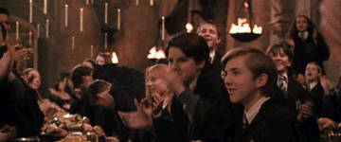
Friday, January 13th - 3rd Block
Can you use the word laud to describe this scene?
Example: The students of Hogwarts lauded the courage of Harry Potter.
Now write your own sentence using the word laud.

Slide 22
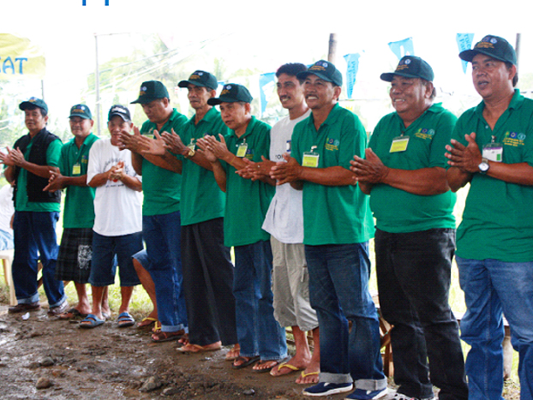
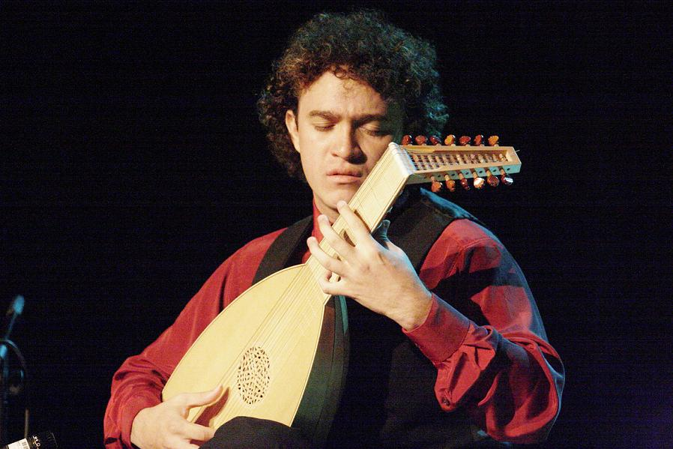
Friday, January 13th - 4th Block
Which image best relates to the term laud? Why?
Can you finish the following analogy:
Laud is to criticize, as meek is to ______.
Bold, courageous, dynamic, take charge, etc.
[Antonyms]
A laud is a musical instrument. This is an example of a homonym, a group of words that share the same spelling and pronunciation, but not the same meaning.

