Slide 1
Word of the Day
Thursday,
January 5th
through
Friday, January 6th

Slide 2

WELCOME BACK HURRICANES

Slide 3
January not-so trivial Trivia
January is the 1st month of the year in the Julian and Gregorian calendars.
On average, January is the coldest month of the year in the Northern Hemisphere (and the warmest in the Southern Hemisphere).
January is named after Janus, the Roman god of doorways. (In Latin – Ianuarius), as January is the “doorway” to a new year.
January was known as Ianuarius to the Romans for the reason mentioned above, and Wulf-monath (wolf month) to the Saxons because lean and hungry wolf packs were especially dangerous in the cold of winter. This month was named Wintarmanoth (winter month) by Charlemagne, king of the Franks and emperor of Europe.
Coptic and Russian Orthodox Christians celebrate Christmas on January 7.

Slide 4

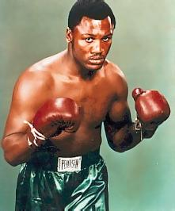
Thursday, January 5th – 1st Block
What is the definition of the word eulogize?
How do you pronounce the word eulogize? [yoo-luh-jahyz]
What part of speech is eulogize?
From the Greek eu – (well) + logia (speaking)
Other forms of the word include: eulogization (noun), eulogizer (noun), uneulogized (adj)
“… some will surely take the passing of Joe Frazier as a cue upon which to also eulogize the sport that made Frazier famous, to do so would be an injustice to both the man and the sport of which he was a proud and classy champion.”
- Johnny Walker, sports journalist

Slide 5
Thursday, January 5th – 2nd Block
Eulogize – verb. To say good things about; to praise, as in a eulogy or funeral speech
What is another word for eulogize (synonym)?
Extol, panegyrize, commend, laud, praise
What word means the opposite of eulogize (antonym)?
Condemn, criticize, rebuke, censure

Slide 6
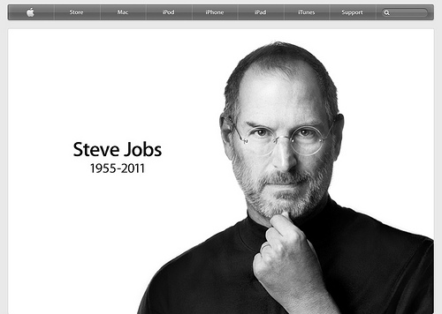
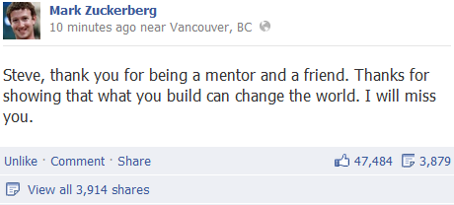
Thursday, January 5th – 3rd Block
Please use the word eulogize to describe these pictures.
Example: People from around the world were touched by Steve Jobs’ creativity and drive and eulogized the Apple co-founder.
Now write your own sentence using the word eulogize in a manner that illustrates your understanding of the word.

Slide 7
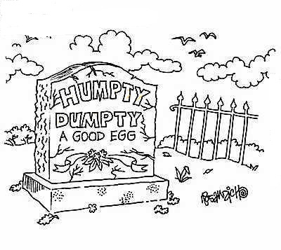
Thursday, January 5th – 4th Block
Create an epitaph eulogizing a figure from history or literature.
Please complete the following analogy:
Eulogize is to funeral, as commencement speech is to _____________.
Graduation or commencement ceremony
  [Appropriate venue for]

Slide 8
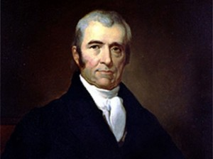
Friday, January 6th - 1st Block
What is the definition of the word panegyrize?
How do you pronounce panegyrize [PAN-i-juh-rahyz] ?
What part of speech is panegyrize?
From the Greek pan- (all) + agyris (place of assembly)
Other forms of the word include: panegyrise (verb), panegyric (noun), panegyrical (adj), panegyrically (adv)
John Marshall, 4th chief justice of the Supreme Court
“Judge Story was a profound admirer of Chief Justice Marshall, and could rarely hear his name mentioned without digressing to panegyrize his learning and intellectual power.”
-- William Matthews,
Hours with Men and Books

Slide 9
Friday, January 6th – 2nd Block
Panegyrize – verb. To praise a person or event in a formal speech or in writing; to praise highly
Can you think of a synonym for panegyrize?
Eulogize, give homage, toast, give tribute, honor
Can you think of an antonym for panegyrize?
Censure, criticize, reprimand, disapprove

Slide 10
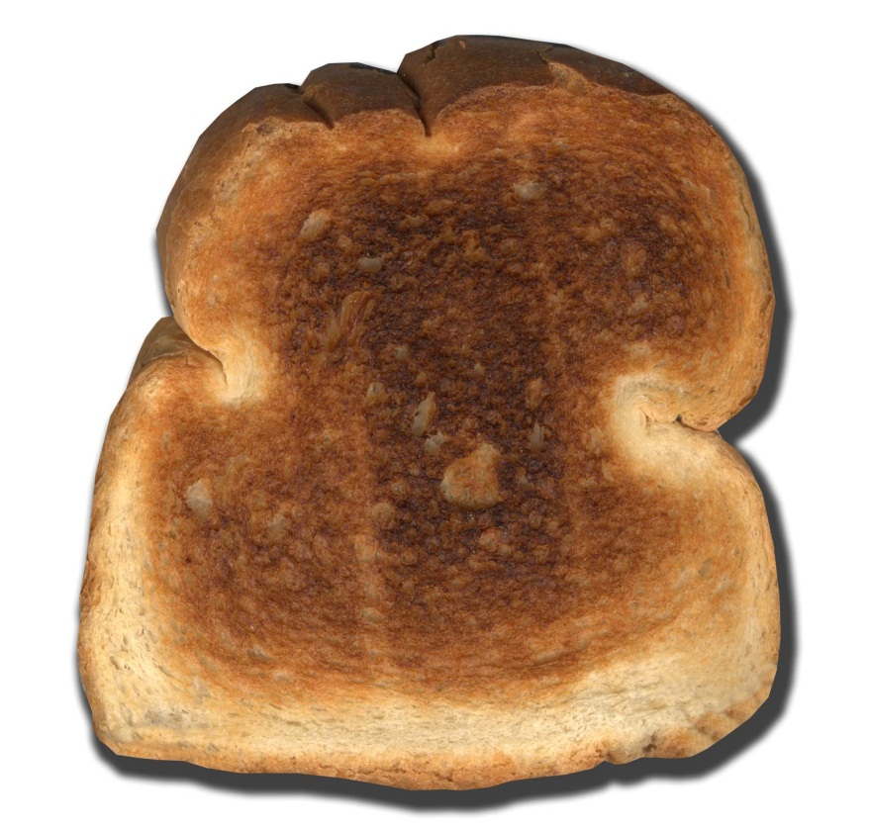
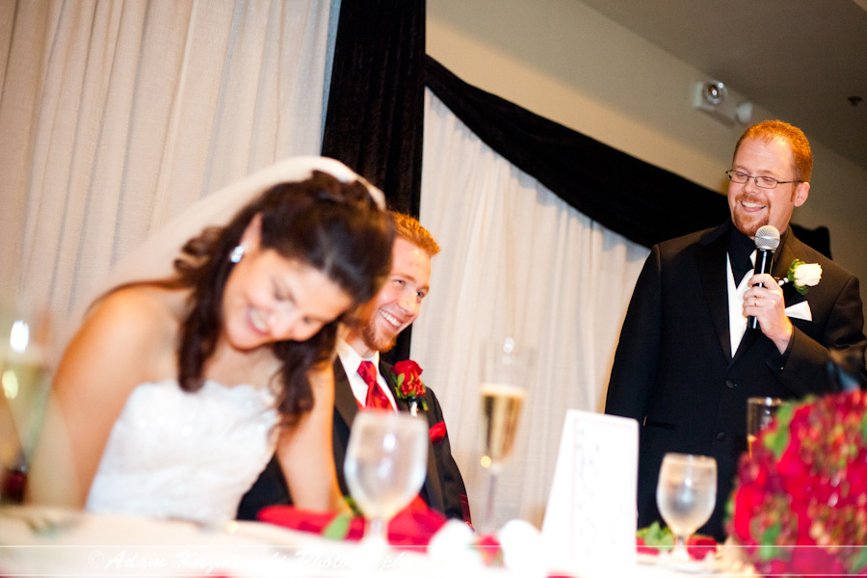
Friday, January 6th – 3rd Block
Is the picture to the right in any way related to our Word of the Day, panegyrize? How is it?
Answer: Toast can have different meanings. Words that sound the same and share the same spelling but have different meanings are called homonyms. Toast can also be a synonym of panegyrize.
Can you think of any other homonyms? How about any homophones (words that sound alike but might not be spelled alike)?
Plain White Toast – the favorite food of Elwood Blues

Slide 11
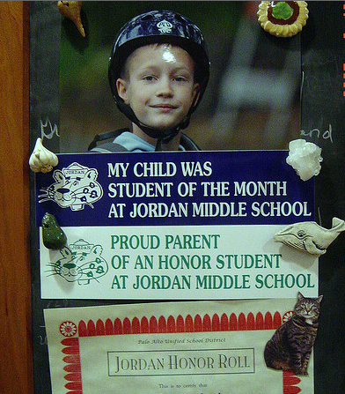
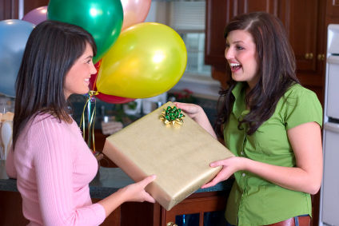
Friday, January 6th – 4th Block
Which picture do you think relates more closely to the Word of the Day, panegyrize? Why?
Please complete the following analogy:
Panegyrize is to eulogize, as smart is to __________.
Astute, sharp, shrewd, cagey, canny, clever, etc.
[Synonyms]

