Slide 1
Word of the Day
Week of Monday, March 19th through Friday, March 23rd

Slide 2
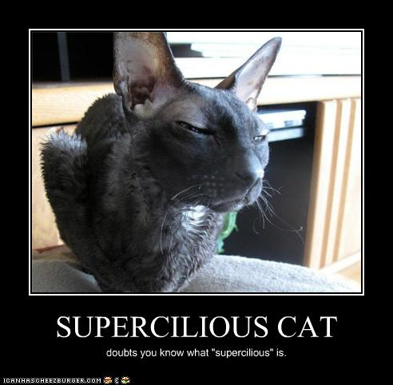
Monday, March 19th – 1st Block
What is the definition of the word supercilious [soo-per-sil-ee-uhs]?
What part of speech is supercilious?
From the Latin super (above) + cilium (eyelid)
Other forms of the word include: superciliously (adv.), superciliousness (noun)
“

Slide 3
Monday, March 19th - 2nd Block
supercilious – adj. Looking down on others; proud and scornful
What is another word for supercilious (synonym)?
Arrogant, condescending, snobby, vainglorious, egotistical
What word means the opposite of supercilious (antonym)?
Humble, modest, unconceited

Slide 4
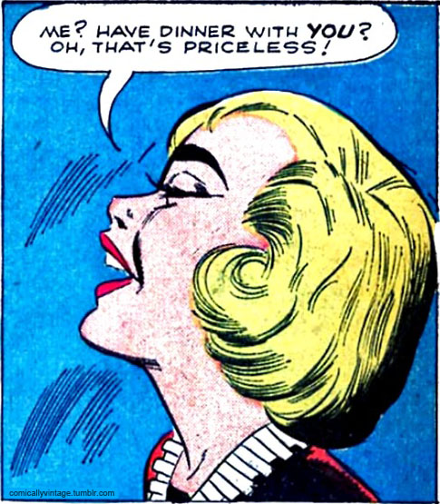
Monday, March 19th – 3rd Block
Can you use the word supercilious to describe the picture at right?
Example: Karen’s supercilious response to Bob’s courageous inquiry crushed his spirit.
Now write your own sentence using the word supercilious in a manner that illustrates your understanding of the word.

Slide 5
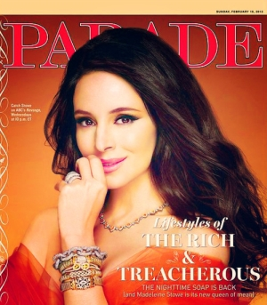
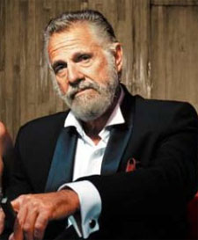
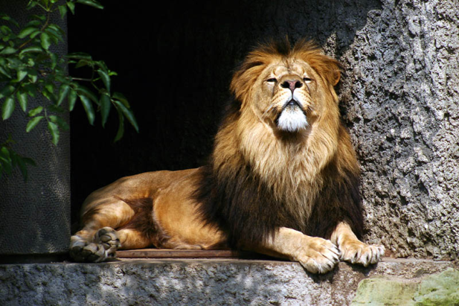
Monday, March 19th - 4th Block
Can you think of any other supercilious personalities?
Unscramble the following analogy:
[is to] [supercilious] [as] [bored] [egotistic] [is to] [spiritless]
Supercilious is to egotistic as bored is to spiritless. [Synonyms]

Slide 6
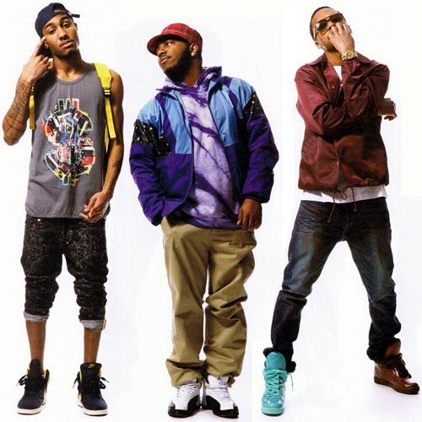
Tuesday, March 20th – 1st Block
What is the definition of the word swagger [swag-er]?
What part of speech is swagger?
From the Old English swingan (to swing)
Other forms of the word include: swaggerer (noun), outswagger (verb)
“I'm a very modest person. But I'm also extremely confident. And if you put me in the situation or in the moment, I'm gonna have some swagger, I'm gonna have some cockiness.”
-- Drew Brees

Slide 7
Tuesday, March 20th – 2nd Block
swagger – verb. To walk around in a proud, showy manner; to boast in a loud manner
What is another word for swagger (synonym)?
Saunter, strut, aggrandize, gloat
What word means the opposite of swagger (antonym)?
To be modest, depreciate

Slide 8
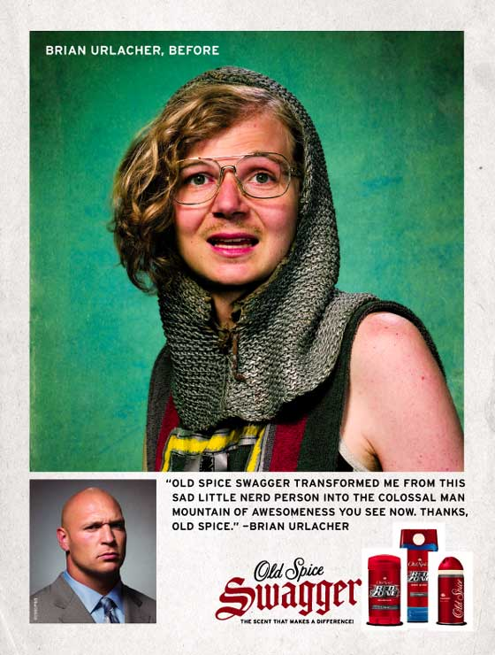
Tuesday, March 20th – 3rd Block
Can you use the word swagger to describe the pictures to the right?
Example: Recognizing that pleasant-smelling underarms might boost a person’s confidence, Old Spice chose to name it’s new line Swagger.
Now write your own sentence using the word swagger in a manner that illustrates your understanding of the word.

Slide 9
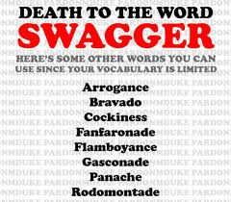
Tuesday, March 20th - 4th Block
Can you think of another image that relates to the term ?
Complete the following analogy:
Swagger is to Eeyore, as ______ is to Tigger.
Confidence, energy, enthusiasm, etc. [Examples]

Slide 10
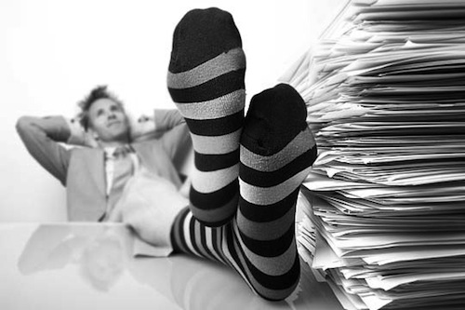
Wednesday, March 21st – 1st Block
What is the definition of the word complacent [kuhm-pley-suhnt]?
What part of speech is complacent ?
From the Latin com- (with, together) + placer (to place)
Other forms of the word include: complacently (adverb), complacency (noun)
“History and experience tell us that moral progress comes not in comfortable and complacent times, but out of trial and confusion.” -- Gerald Ford

Slide 11
Wednesday, March 21st – 2nd Block
complacent – adjective. Self-satisfied; smug
What is another word for complacent (synonym)?
Egotistic, conceited, superior
What word means the opposite of complacent (antonym)?
Humble, meek, unsure

Slide 12
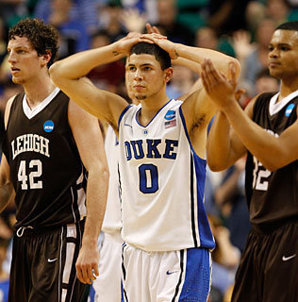
Wednesday, March 21st – 3rd Block
Can you use the word complacent to describe the picture to the right?
Example: Perhaps too complacent in their game plan, the second-seeded Duke Blue Devils were upset by the fifteenth-seeded Lehigh Mountain Hawks.
Now write your own sentence using the word complacent.

Slide 13
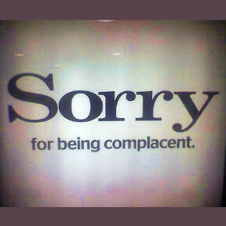
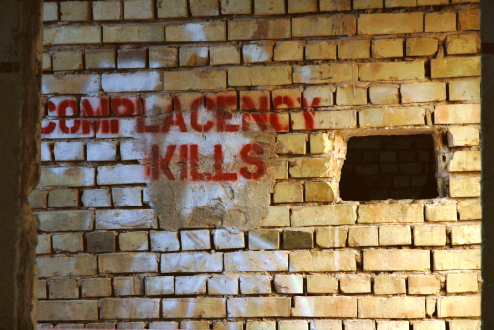
Wednesday, March 21st – 4th Block
What other connotations should be associated with being complacent?
What’s wrong with the following analogy?
Complacent is to concerned, as hungry is to satiated.
Nothing… both identify antonym relationships.

Slide 14
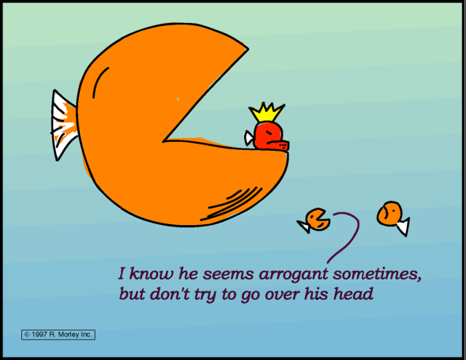
Thursday, March 22nd – 1st Block
What is the definition of the word arrogant [ar-uh-guhnt]?
What part of speech is arrogant?
From the Latin ad- (to) + rogare (ask, propose)
Other forms of the word include: arrogance (noun), arrogantly (adverb)
“I'm good at what I do, but I wouldn't be so bold and arrogant as to say something disrespectful about, say, Eminem. He's talented and he's good at what he does.”
-- LL Cool J

Slide 15
Thursday, March 22nd - 2nd Block
arrogant – adjective. Overbearing; proud; haughty
What is another word for arrogant (synonym)?
Imperious, brash, hubristic, condescending
What word or phrase means the opposite of arrogant (antonym)?
Humble, servile, meek, modest

Slide 16
Thursday, March 22nd – 3rd Block
Can you use the word arrogant to describe the picture at right?
Example: The doctor’s confidence in his skills bordered on outright arrogance.
Now write your own sentence using the word arrogant in a manner that illustrates your understanding of the word.

Slide 17
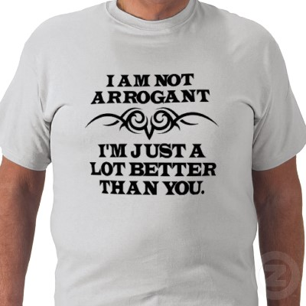
Thursday, March 22nd – 4th Block
Can you think of another “T-Shirt-style slogan” using the word arrogant?
Complete the analogy:
Arrogant is to humble, as bold is to _____.
Cowardly, meek, timid, etc. [Antonyms]

Slide 18
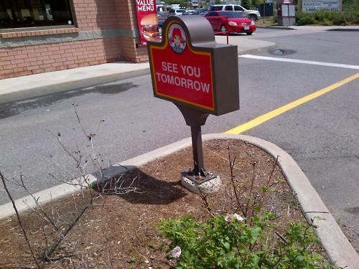
Friday, March 23rd– 1st Block
What is the definition of the word presumptuous [pri-zuhmp-choo-uhs]?
What part of speech is presumptuous ?
From the Latin pre- (before) + sumere (to take)
Other forms of the word include: presumptuously (adverb), presumptuousness (noun)
“We are so presumptuous that we think we can separate our personal interest from that of humanity, and slander mankind without compromising ourselves.”
-- Marquis de Vauvenargues

Slide 19
Friday, March 23rd- 2nd Block
presumptuous – adjective. Too forward or bold; overstepping proper bounds
What is another word for presumptuous (synonym)?
Impertinent, audacious, arrogant, bold
What word or phrase means the opposite of presumptuous (antonym)?
Modest, unassuming

Slide 20
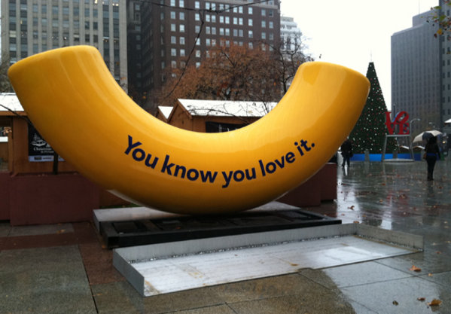
Friday, March 23rd– 3rd Block
Can you use the word presumptuous to describe the picture to the right?
Example: For their joint marketing venture, the pasta and dairy industries took a presumptuous approach to marketing their products through macaroni and cheese.
Now you try writing your own sentence using the word presumptuous.

Slide 21
Friday, March 23rd– 4th Block
What else are people often presumptuous about?
Complete the analogy:
Presumptuous is to pompous, as required is to ____.
Obligatory, mandatory, requisite, etc. [Synonyms]

