Slide 1
Word of the Day
Week of April 2nd through April 5th

Slide 2
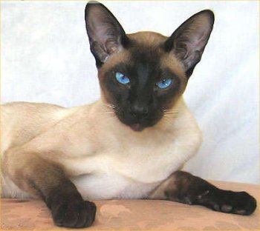
Monday, April 2nd – 1st Block
Can you guess what the word disdainful [dis-deyn-fuhl] means?
Disdainful is an adjective. Can you make it a noun?
From the Old French des- (do the opposite of) + deignier (treat as worthy)
Other forms include: disdainfully (adverb); disdainfulness (noun)

Slide 3
Monday, April 2nd – 2nd Block
disdainful – adjective. Full of bitter scorn or pride; aloof
What other words mean the same as disdainful (synonyms)?
Contemptuous, insolent, condescending, haughty
What words mean the opposite of disdainful (antonyms)?
Respectful, praising

Slide 4
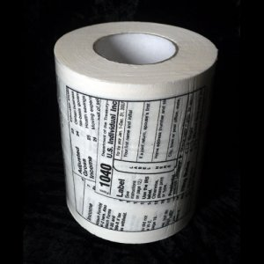
Monday, April 2nd – 3rd Block
Can you use the word disdainful in a sentence to describe the picture to the right?
Example: Aware of American’s disdain toward paying taxes, the manufacturer began playfully screening a tax form on his toilet paper.
Now try writing your own sentence using the term disdainful.

Slide 5
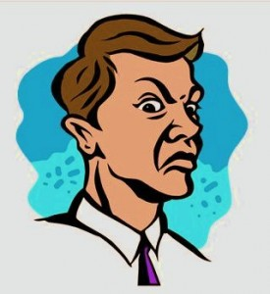
Monday, April 2nd – 4th Block
What other images would you associate with being disdainful?
Complete the following analogy:
Disdainful is to despising, as mournful is to _____.
Sad, heartbroken, forlorn, etc. (Synonyms)

Slide 6
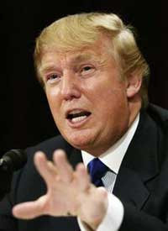
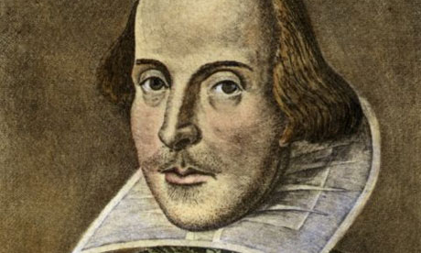
Tuesday, April 3rd – 1st Block
What do you think the word bombastic [bom-bas-tik] means?
What part of speech is bombastic (or any word ending in –ic)?
From the Old French bombace (cotton wadding) + -ic (having to do with).
Other forms include: bombastically (adverb), bombast (noun)
“What has a writer to be bombastic about? Whatever good a man may write is the consequence of accident, luck, or surprise, and nobody is more surprised than an honest writer when he makes a good phrase or says something truthful.” - Edward Dahlberg

Slide 7
Tuesday, April 3rd – 2nd Block
bombastic – adjective. Using language in a pompous, showy way; speaking to impress others
What is a synonym for the word bombastic?
Grandiloquent, pompous, histrionic
What word means the opposite of bombastic?
Humble, reserved, aureate, restrained

Slide 8
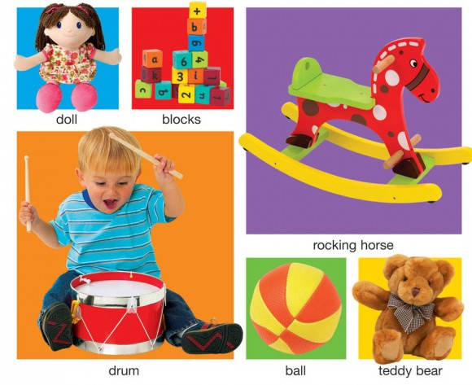
Tuesday, April 3rd – 3rd Block
Can you use the word bombastic to describe the image to the right?
Example: The descriptions in the children’s book were a bit too bombastic for my taste.
Now try writing your own sentence using the term bombastic.
effigy
Hexahedrons
Oscillating Equine
Reverberation Chamber
Cavorting Sphere
Satiated
Companion

Slide 9
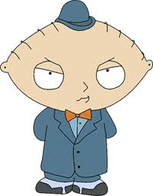
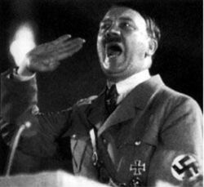
Tuesday, April 3rd – 4th Block
Who else would you describe as bombastic?
Can you complete the analogy:
Bombastic is to unassuming, as cautious is to ____.
Reckless, wild, unrestrained, etc. (Antonyms)

Slide 10
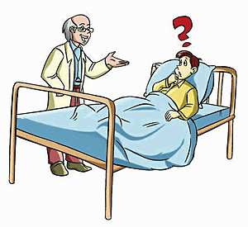
Wednesday, April 4th – 1st Block
What does circumlocution [sur-kuhm-loh-kyoo-shuhn] mean?
If circumlocution is a noun, how can you make it a verb?
From Greek circum (around) + locutio ( a speaking)
Other forms: circumlocutory (adjective), circumlocutional (adjective), “circumlocutionary (adjective)
“Circumlocution, n. A literary trick whereby the writer who has nothing to say breaks it gently to the reader. “ -- Ambrose Bierce

Slide 11
Wednesday, April 4th – 2nd Block
circumlocution – adjective. Speaking in circles; round-about speech
What is another word for circumlocution (synonym)?
Rambling, meandering, verbosity, prolixity
What word means the opposite of circumlocution?
Conciseness, directness, straightforwardness, terseness

Slide 12
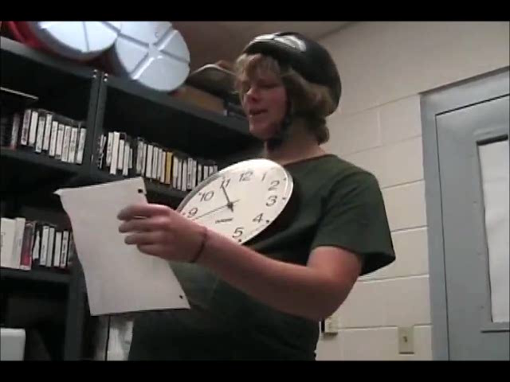
Wednesday, April 4th – 3rd Block
Can you use the word circumlocution to describe the video to the right?
Example: Eddie’s circumlocution left Jenny completely baffled.
Now, write your own dialogue using circumlocution.

Slide 13
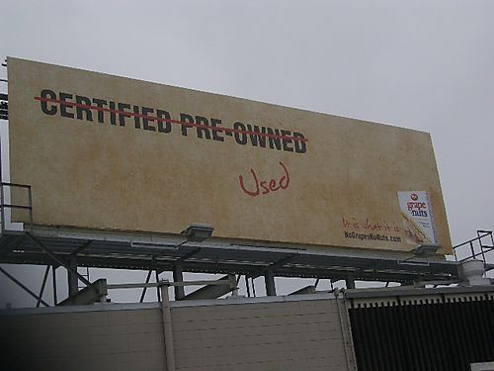
Wednesday, April 4th – 4th Block
Can you think of other situations when people turn to circumlocution?
Can you complete the analogy?
Circumlocution is to deceptive, as brevity is to _____.
Quick, succinct, direct, etc. (Quality each may be trying to achieve)

Slide 14
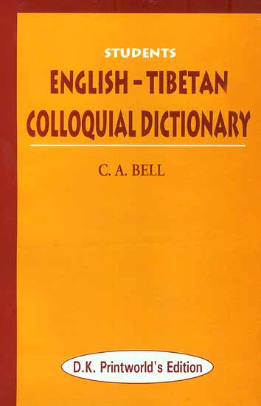
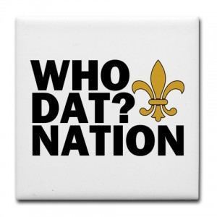
Thursday, April 5th – 1st Block
What do you think colloquial [kuh-loh-kwee-uhl] means?
What part of speech is colloquial?
From the Latin com- (together) + loquium (speaking)
Other forms: colloquially (adverb); colloquialness (noun); colloquiality (noun)
“Mormon colonization south of this point in early times was characterized as "going over the Rim," and in colloquial usage the same phrase came to connote violent death.”
- State of Utah (Park Sign)

Slide 15
Thursday, April 5th – 2nd Block
colloquial – adjective . Pertaining to common everyday speech; conversational
What is another word for colloquial (synonym)?
Vernacular, dialectal, informal, folksy
What word means the opposite of colloquial?
Formal, correct, standard

Slide 16
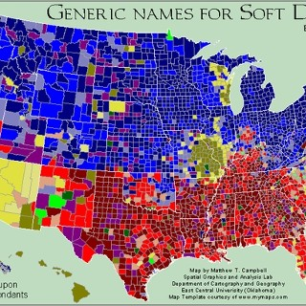
Thursday, April 5th – 3rd Block
Can you write a sentence describing the picture to the right using the term colloquial?
Example: While traveling the countryside, order a carbonated beverage and you will quickly discover the variety of colloquialisms.
Can you think of some local colloquial expressions?
Sasparilla
Pop
Coke
Soda

Slide 17
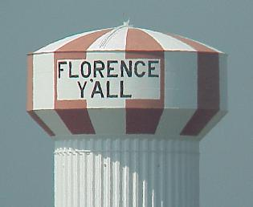
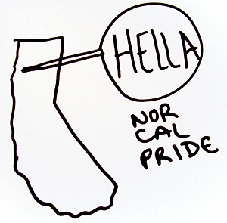
Thursday, April 5th – 4th Block
Can you think of any other examples of colloquial terms?
Complete the following analogy:
“There is more than one way to skin a cat” is to colloquial, as _______ is to circumlocutional.
“Kindly relocate your posterior onto the proximate reclining apparatus” (Please have a seat)

