Slide 1
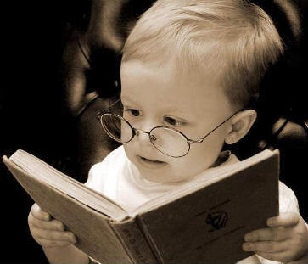
Word of the Day
"'Remember it's a sin to kill a mockingbird.' That was the only time I ever heard Atticus say it was a sin to do something, and I asked Miss Maudie about it."
Tuesday, April 10th through
Friday, April 13th, 2012
What book is Sylvester reading?
To Kill a Mockingbird
by Harper Lee

Slide 2
Let’s eat Grandpa.
Let’s eat, Grandpa.
Punctuation saves lives.

Slide 3
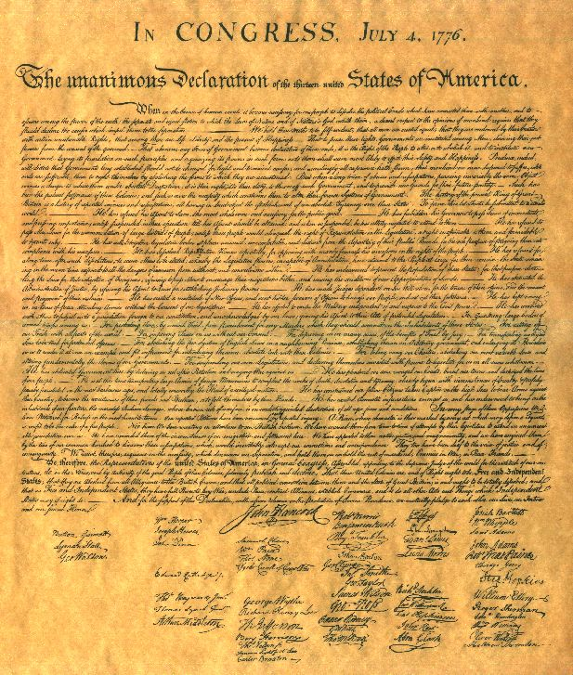
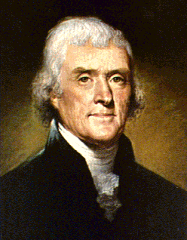
Tuesday, April 10th - 1st Block
What do you think the word allay [uh-ley] means?
What part of speech is allay?
From the German a- (down, aside) + lecgan (to lay)
Other forms include: allayer (noun); unallayed (adjective)
“The animosities of sovereigns are temporary, and may be allayed; but those which seize the whole body of people, and of a people too, dictate their own measures, produce calamities of long duration”
– Thomas Jefferson, 3rd President of the United States, architect of the Declaration of Independence.

Slide 4
Tuesday, April 10th – 2nd Block
Allay – verb. To lessen fear; to calm; to relieve pain
What is a synonym for the term allay?
Abate, alleviate, assuage, mitigate, relieve
What word is an antonym for the term allay?
Excite, provoke, stir, intensify

Slide 5
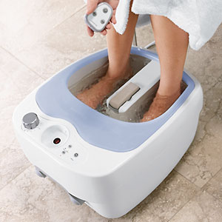
Tuesday, April 10th – 3rd Block
Can you use the word allay to describe the picture?
Example: After a long day of saving the world in high heeled boots, Wonder Woman used the official Justice League Aqua Foot Massage to allay the pain in her tootsies.
Use “allay” in a sentence demonstrating your knowledge of the word.

Slide 6
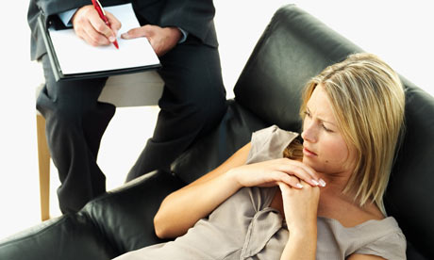
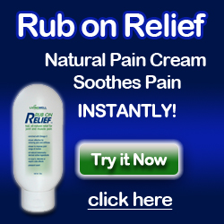
Tuesday, April 10th – 4th Block
Which picture best relates to the word of the day, allay? Why?
What’s wrong with the following analogy:
Allay is to relief, as ostentatious is to restrained.
Allay and relief are synonyms, but ostentatious and restrained are antonyms.

Slide 7

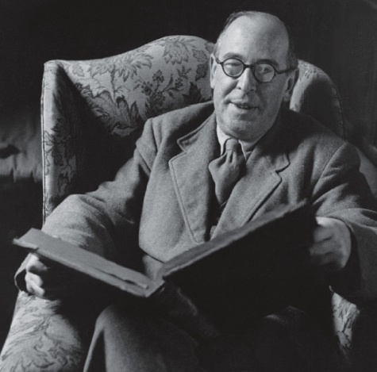

Wednesday, April 11th - 1st Block
What do you think alleviate [uh-lee-vee-eyt] means?
What part of speech is alleviate?
From the Latin ad- (to) + levis (light)
Other forms include: alleviation (noun); alleviative (adj); alleviator (noun)
“ We have discovered that the scheme of 'outlawing war' has made war more like an outlaw without making it less frequent and that to banish the knight does not alleviate the suffering of the peasant”.”
-- C.S. Lewis, British author and scholar, 1898-1963

Slide 8
Wednesday, April 11th – 2nd Block
Alleviate – verb. To lessen pain or discomfort.
What word or phrase means the same as alleviate (synonym)?
Diminish, abate, assuage, lighten
What is the opposite of alleviate (antonym)?
Increase, strengthen, intensify

Slide 9

Wednesday, April 11th – 3rd Block
Describe the picture using the word, alleviate.
Example: The product promises to alleviate one’s stress while at the same time affirming one’s sense of well being and purpose in the universe.
Now, write your own sentence using alleviate.

Slide 10
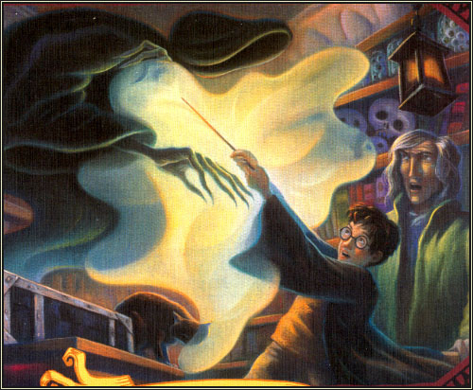
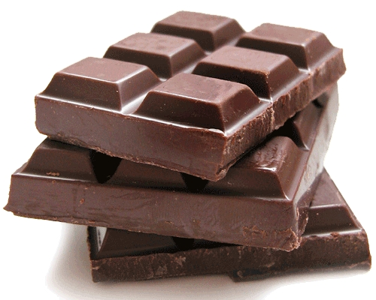
Wednesday, April 11th – 4th Block
Does the picture relate to the word of the day, alleviate?
Unscramble the analogy:
is to alleviate as pretentious assuage pompous is to.
Pretentious is to pompous, as alleviate is to assuage. (Synonyms)
Of course! It’s a well known fact that chocolate eases, or alleviates, the symptoms of exposure to dementors.

Slide 11
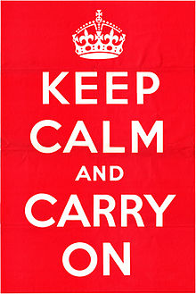
Thursday, April 12th - 1st Block
What do you think ameliorate means?
What part of speech is ameliorate?
From the Old French a- (to) + meillior (to better)
Other forms include: amelioratory (adj), ameliorator (noun), ameliorant (noun)
Keep Calm and Carry On was a propaganda poster produced by the British government at the beginning of World War II, intended to raise the morale of the British public in the event of invasion and ameliorate their fears.
“I believe it is incumbent upon Congress to act aggressively to ameliorate fear and help our country take the essential steps that will make our communities and lives safer.”
-- Paul Gillmor, U.S. congressman,
1939-2007

Slide 12
Thursday, April 12th– 2nd Block
Ameliorate - verb. To make better; to lessen pain, difficulty, fear, or tension
What word or phrase means the same as ameliorate (synonym)?
Alleviate, mitigate, amend, upgrade
What is the opposite of ameliorate (antonym)?
Worsen, hinder, deteriorate

Slide 13
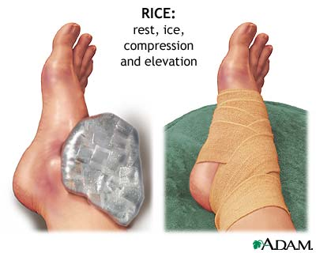

Thursday, April 12th– 3rd Block
Can you use the word of the day, ameliorate, to describe these pictures?
Example: Both the RICE and FAST methods claim to ameliorate the pain and swelling that accompanies a sprained ankle.
Now use the word of the day in a sentence of your own.

Slide 14

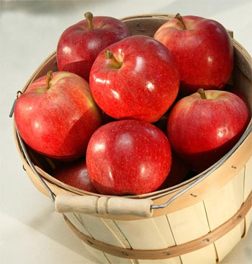
Thursday, April 12th– 4th Block
Which picture best exemplifies the word of the day, ameliorate? Why?
Complete the following analogy:
Ameliorate is to worsen, as ____ is to pompous.
Humble, reserved, restrained, etc. (antonyms)

Slide 15
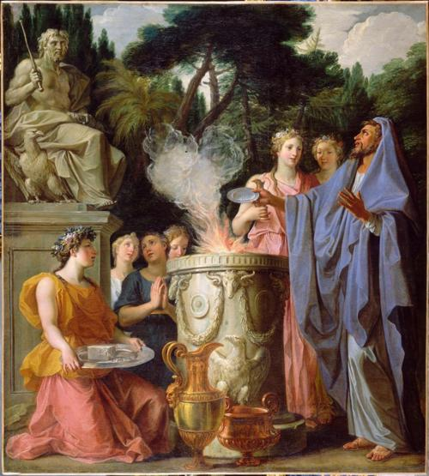
Friday, April 13th - 1st Block
What do you think appease means?
What part of speech is appease?
From the Old French a- (to) + pais (peace)
Other forms include: appeasable (adj), appeaseableness (noun), appeasement (noun)
Noel Coypel, Sacrifice to Jupiter, early 18th century
“Gifts, believe me, captivate both men and gods. Jupiter himself was won over and appeased by gifts.”
-- Ovid, Roman poet,
43 B.C. – A.D. 17

Slide 16
Friday, April 13th– 2nd Block
Appease - verb. To make tranquil or quiet, especially by giving into another’s demands; to pacify
What word or phrase means the same as appease (synonym)?
Allay, assuage, calm
What is the opposite of appease (antonym)?
Enrage, arouse, aggravate, incite

Slide 17
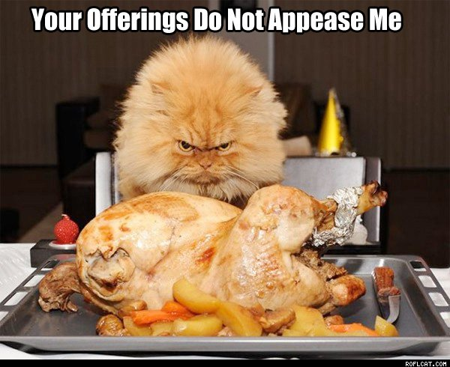
Friday, April 13th– 3rd Block
Can you create a caption for this picture using the word of the day, appease?
Example: The pompous kitty is not appeased by the puny offerings of her human servants.
Now use the word of the day in a sentence of your own.

Slide 18
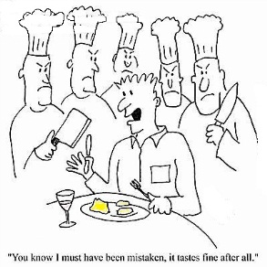
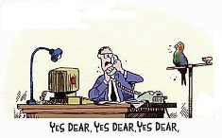
Friday, April 13th– 4th Block
Which cartoon best exemplifies the word of the day, appease? Why?
Complete the following analogy:
Appease is to _____, as pretentious is to conceited.
Allay, assuage, calm, etc. (synonyms)

