Slide 1
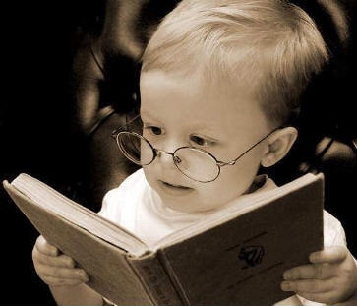
Word of the Day
Effie Trinket crosses the podium, smoothes the slip of paper, and reads out the name in a clear voice. And it’s not me.
It’s Primrose Everdeen.
Monday, March 26th through
Friday, March 30th,
2012
What book is Sylvester reading?

Slide 2
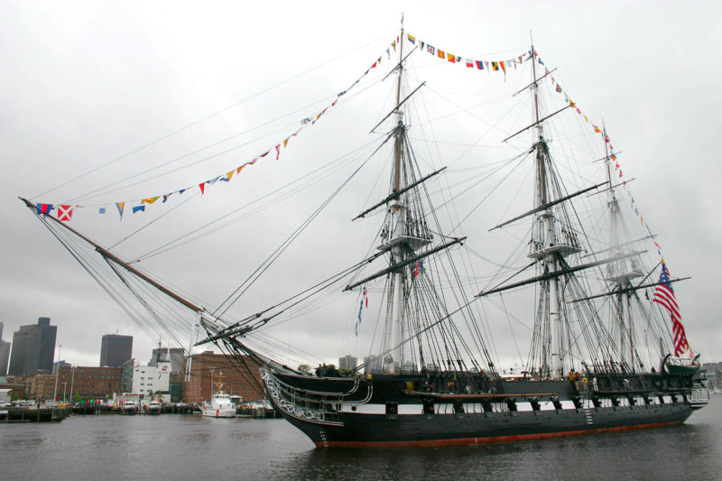
This Week in History, March 26 through March 30
Mar 26, 1885 - Eastman Film Co. manufactures the first commercial motion picture film
March 27, 1794 - The United States Government establishes a permanent navy and authorizes the building of six frigates.
Mar 28, 1979 - Nuclear accident at Three Mile Island
Mar 29, 1973 - U.S. withdraws from Vietnam
Mar 30, 1981 - President Reagan shot
Source: www.history.com, March 24, 2012;
www.brainyhistory.com, March 24, 2012
The USS Constitution, one of the original six frigates in the US Navy.

Slide 3
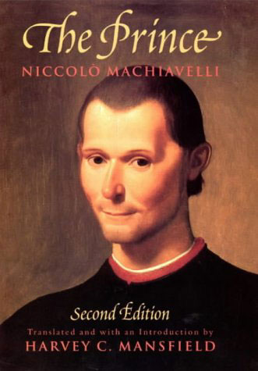
Monday, March 26th – 1st Block
Do you know what the word contemptuous [kuhn-temp-choo-uhs] means?
What part of speech is contemptuous ?
From the Latin com- (with, together) + temnere (to slight, scorn)
Other forms include: contemptuously (adverb), contemptuousness (noun)
“I consider it a mark of great prudence in a man to abstain from threats or any contemptuous expressions, for neither of these weaken the enemy, but threats make him more cautious, and the other excites his hatred, and a desire to revenge himself.” -- Niccolo Machiavelli, Italian writer and statesman, Florentine patriot, author of 'The Prince', 1469-1527

Slide 4
Monday, March 26th – 2nd Block
Contemptuous – adj. Lacking respect; scornful
Can you think of another word for contemptuous (synonym)?
Disdainful, sneering, supercilious, arrogant
What word means the opposite of contemptuous (antonym)?
Respectful, humble, polite

Slide 5
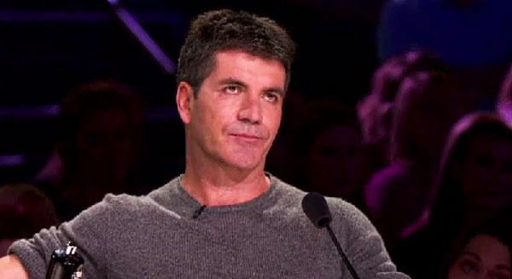
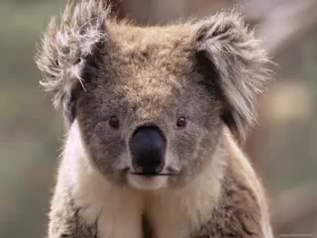
Monday, March 26th – 3rd Block
Use “contemptuous” to describe the picture to the right.
Example: Simon Cowell doesn’t even try to hide his contempt for many of the contestants on his show, X-Factor.
Now show your understanding of the word by using it in a sentence of your own.

Slide 6
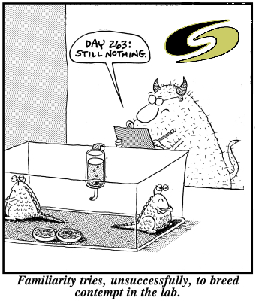
Monday, March 26th – 4th Block
What does the phrase, “familiarity breeds contempt” mean?
Complete the following analogy:
Contemptuous is to ________, as partition is to divider.
Disdainful, sneering, supercilious, arrogant, etc. [Synonyms]

Slide 7
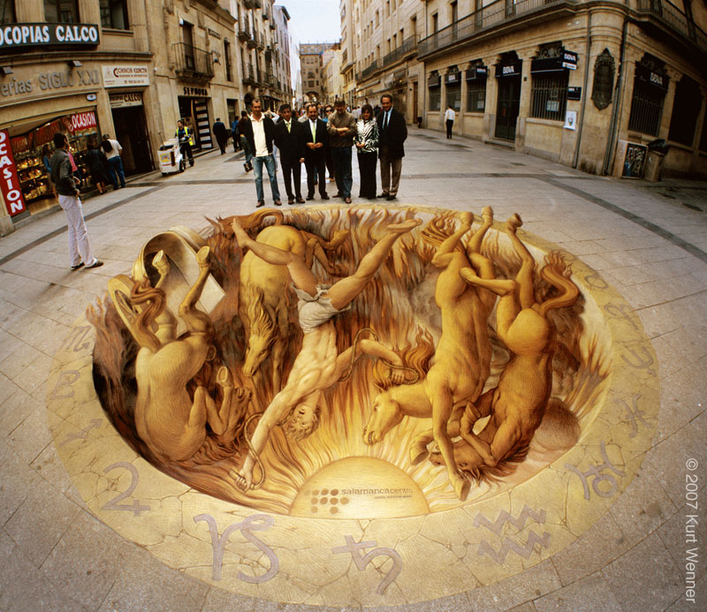
Tuesday, March 27th – 1st Block
Can you guess what the term haughty [haw-tee] means?
What part of speech is the word haughty?
From the Old French haute (high in one’s own estimation)
Other forms of the word include: haughtiness (noun), haughtily (adverb)
The Fall of Phaeton
“Pride goes before destruction and a haughty spirit before a fall.” - Proverbs 16:18

Slide 8
Tuesday, March 27th – 2nd Block
Haughty – adjective. Having great pride in oneself and dislike for others; snobbish
What other word or phrase means the same thing as haughty (synonym)?
Supercilious, cavalier, disdainful, imperious
What is the opposite of haughty (antonym)?
Humble, unpretentious, unassuming
Unrelated Joke of the Day:
There are 10 types of people in the world;
those who understand binary and those who don't.

Slide 9
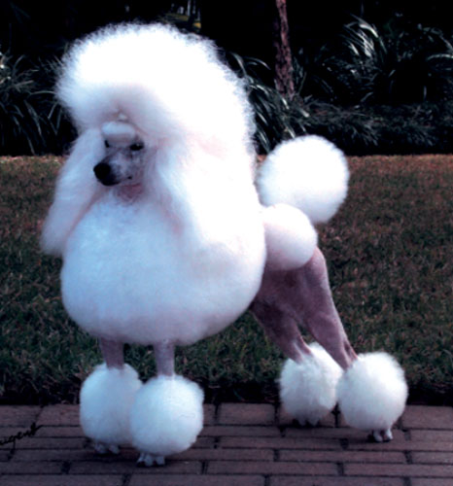
Tuesday, March 27th – 3rd Block
Can you use the word “haughty” to describe this picture?
Example: The haughty demeanor of Princess (and the grooming) causes heads to turn as she walks the park.
Now it’s your turn. Write a sentence using the word haughty in a manner that properly illustrates its meaning.

Slide 10
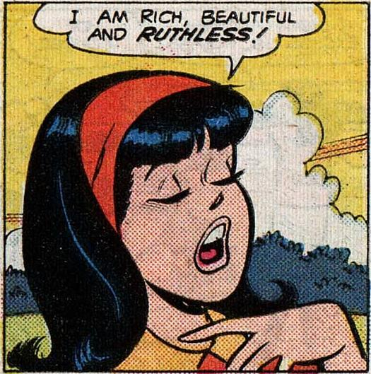
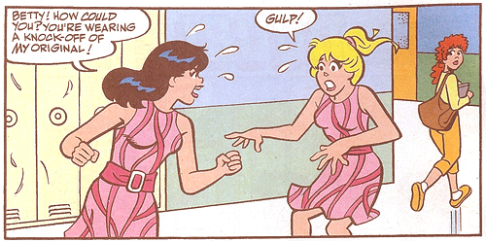
Tuesday, March 27th – 4th Block
Could Veronica Lodge be described as haughty? If so, why?
Complete the following analogy:
Haughty is to humble, as expert is to _____.
Novice, fledgling, beginner, etc. (Antonyms)

