Slide 1
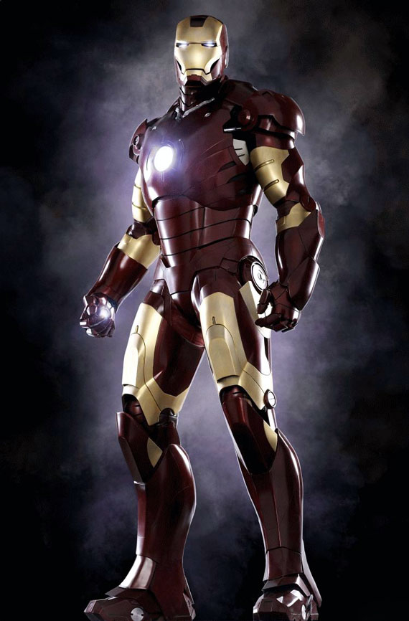
Word of the Day
Word of the Day gives me the vocabulary power I need to dialogue with the most verbose super villains !
Wednesday, February 8th through
Friday, February 10th

Slide 2
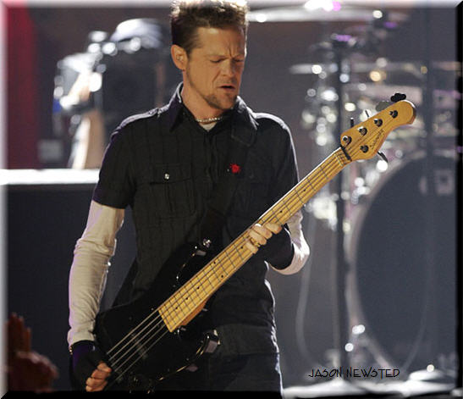
Wednesday, February 8th - 1st Block
What is the definition of the word raucous [raw-kuhs]?
What part of speech is raucous?
From the Latin raucus (hoarse)
Other forms of the word: raucousness (noun), raucously (adv), raucity (noun)
“I’m busier than a busy person. People aren’t scared to play this raucous, harsh music over the radio speakers, so I think it’s the perfect time to get in with some real serious, heavy bands.”
-- Jason Newsted, bass guitarist

Slide 3
Wednesday, February 8th – 2nd Block
Raucous – adjective. Coarse-sounding; loud and unruly
What is another word for raucous (synonym)?
Cacophonous, hoarse, braying, jarring, strident, raspy
What word means the opposite of raucous (antonym)?
Calm, quiet, mellow, dulcet, soft

Slide 4
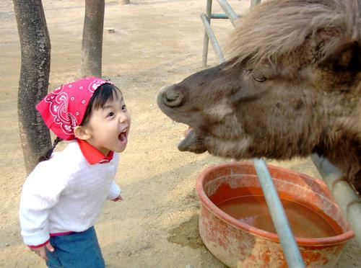
Wednesday, February 8th – 3rd Block
Can you use the word raucous to describe this picture?
Example: Anna Beth joined in the cacophony at the raucous petting zoo.
Now use your knowledge of the word to write your own sentence using raucous.

Slide 5
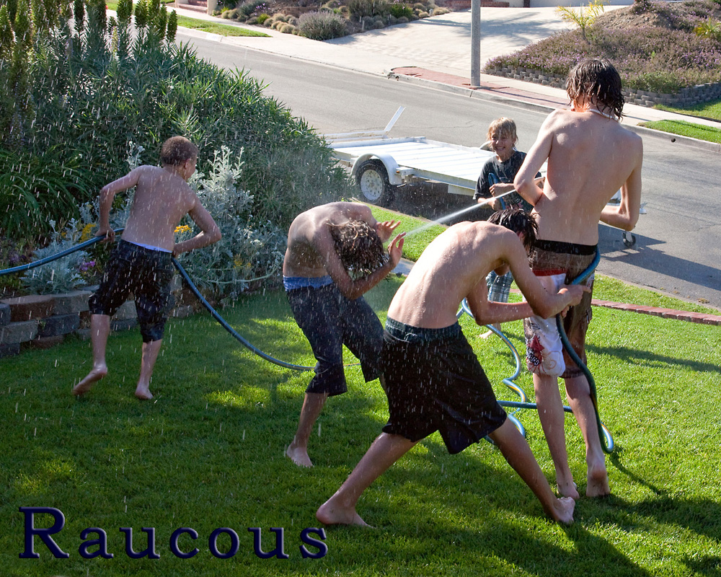
Wednesday, February 8th – 4th Block
Can you think of an image that epitomizes the “word of the day”, raucous?
Complete this analogy:
Raucous is to loud, as _____________ is to mellifluous.
Dulcet, mellow, resonant, honeyed, harmonic. [Synonyms]

Slide 6
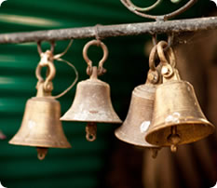
Thursday, February 9th - 1st Block
What is the definition of the word euphony [yoo-fuh-nee]?
What part of speech is euphony?
From the Greek eu- (good) + phone (sound, voice)
Other forms of the word: euphonic (adj), euphonically (adv), euphonicalness (noun)
“Oh, from out the sounding cells,
What a gush of euphony voluminously wells!
How it swells!
How it dwells
On the Future! how it tells
Of the rapture that impels
To the swinging and the ringing
Of the bells, bells, bells,..
To the rhyming and the chiming of the bells!”
-- Edgar Allen Poe, excerpt from The Bells

Slide 7
Thursday, February 9th – 2nd Block
Euphony - noun. Pleasing sound.
What is another word for euphony (synonym)?
Harmonious, melodious
What word means the opposite of euphony (antonym)?
Disharmony, cacophony

Slide 8
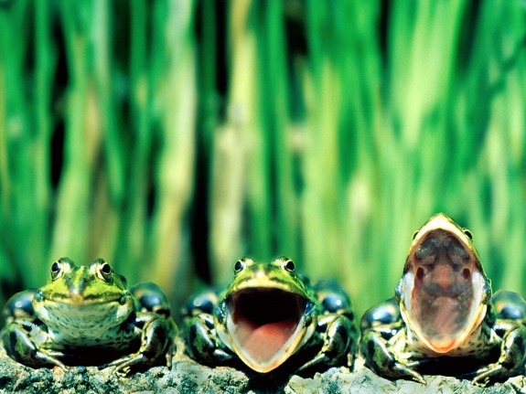
Thursday, February 9th – 3rd Block
Can you use the word euphony to describe this picture?
Example: The frogs created a surprisingly pleasing euphony of sound.
Now take a moment to write your own sentence using euphony.

Slide 9
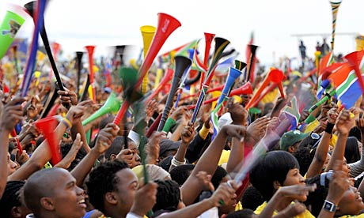
Thursday, February 9th – 4th Block
How does this picture relate to the word of the day, euphony?
Complete the analogy:
Euphony is to sweet sound, as cacophony is to ____.
Dissonance, caterwauling, fracus, etc. [Synonyms]
The vuvuzelas common at soccer tournaments create the exact opposite of an euphony. They create a cacophony.

Slide 10
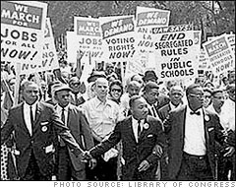
Friday, February 10th - 1st Block
What is the definition of the word clamor [klam-ur]?
What part of speech is clamor?
From the Latin clamare (to cry out)
Other forms of the word: clamorer (noun), clamorously (adv), clamorist (noun)
“History will have to record that the greatest tragedy of this period of social transition was not the strident clamor of the bad people, but the appalling silence of the good people.”
– Martin Luther King, Jr.,
Civil Rights Leader

Slide 11
Friday, February 10th – 2nd Block
Clamor - noun. Unpleasant sound; noise
What is another word for clamor (synonym)?
Racket, caterwauling, fracas, dissonance, cacophony
What word(s) mean the opposite of clamor (antonym)?
Peace, calm, silence, harmony
Click HERE for the Vocabahead Video Link

Slide 12
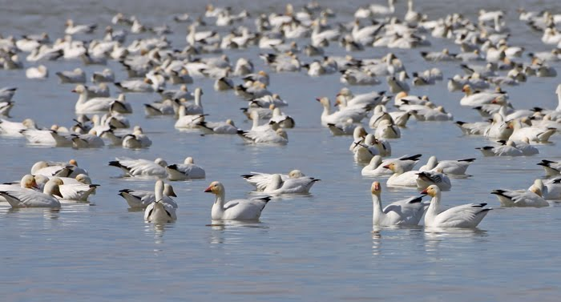
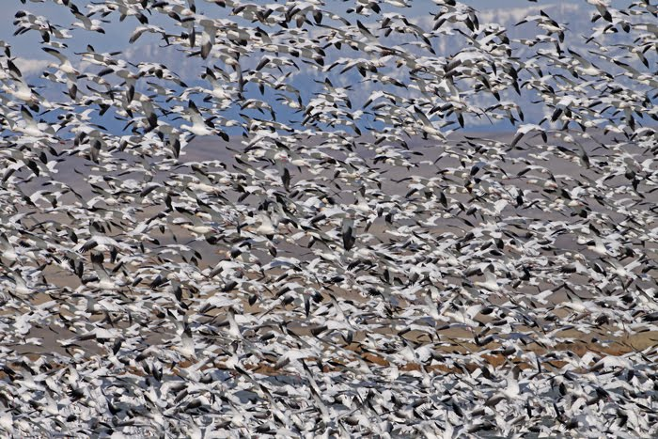
Friday, February 10th - 3rd Block
Can you use the word clamor to describe this picture sequence?
Example: For some unknown reason, the entire flock rose from the water in a roaring clamor before settling back to the lake.
Now, create your own sentence using the word clamor. It does not have to be related to these images.

Slide 13
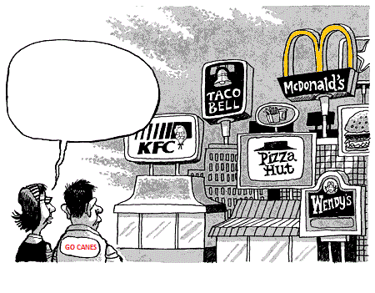
Friday, February 10th – 4th Block
Complete the dialogue bubble below. Make sure your dialogue uses or relates to clamor.
Complete the analogy:
Clamor is to pep rally, as _________ is to FCAT testing.
Calm, quiet, focus, etc. [nouns that describe the event’s atmosphere]

Slide 14
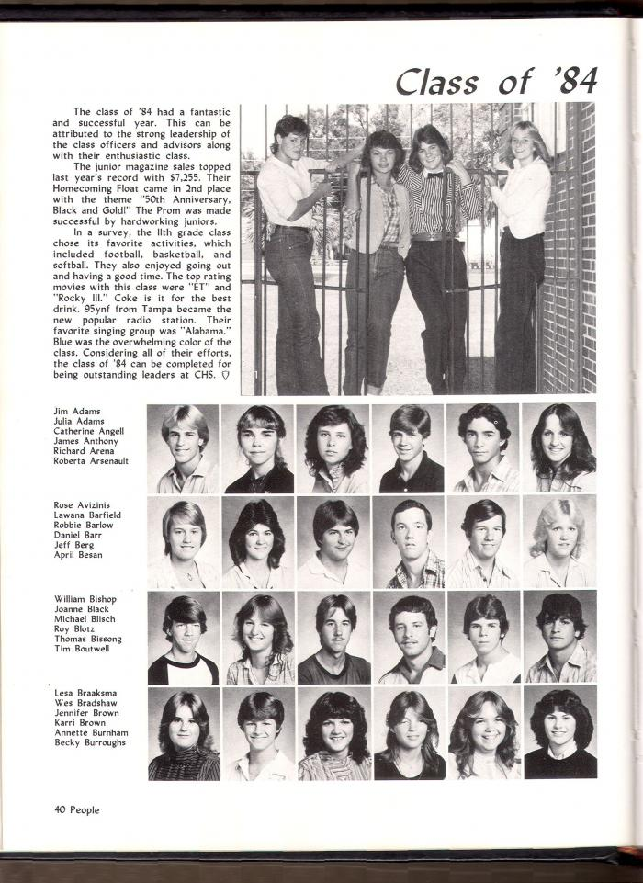
Word of the Day
Can you find the Citrus High Teacher among these Class of ’84 alumni?
Have a safe and fun-filled weekend Hurricanes!

