Slide 1
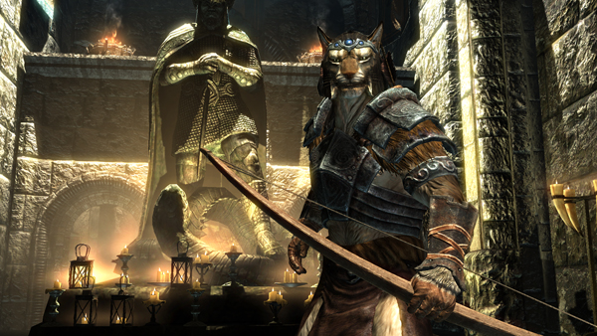
Word of the Day
Monday, February 6th through
Tuesday, February 7th
Word of the Day brings out my inner KHAJIIT !

Slide 2
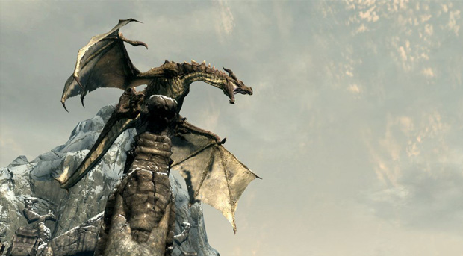
Skyrim, Elder Scrolls V trivia:
Released November 11, 2011
By December 11, 2011, shipped 10 million copies - equivalent of $650 million in retail sales.
Most played video game of 2011.
According to Zenimax, “Skyrim has outsold all other PC games by a factor of 3 to 1”.
Source: http://www.joystiq.com/2011/12/15/skyrim-ships-10-million-copies-already-outsells-other-pc-titles/, accessed February 4, 2012

Slide 3
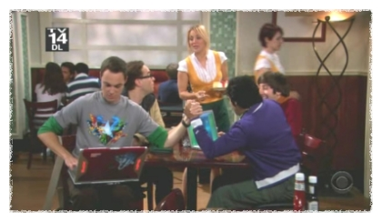
MONDAY, February 6th – 1st Block
What is the definition of the word cacophony [kuh-kof-uh-nee]?
What part of speech is cacophony?
From the Greek kakos (together) + phone (voice)
Other forms: cacophonic (adj), cacophonous (adj)
Scene: The Cheesecake Factory. Raj and Sheldon are arm wrestling while playing Tetris. There is a cacophony of cries such as “take him down” and “he’s got you, Sheldon.”
--- The Big Bang Theory, Episode 16

Slide 4
MONDAY, February 6th – 2nd Block
Cacophony – noun. Lack of harmony; loud and unpleasant noise or sound; a racket
What is another word for cacophony (synonym)?
Dissonance, disharmony, caterwaul, fracas
What word means the opposite of cacophony (antonym)?
Resonance, harmony, quiet

Slide 5
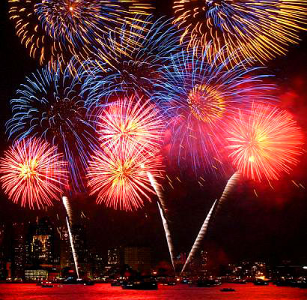
MONDAY, February 6th - 3rd Block
Can you use the word cacophony to describe the picture to the right?
Example: The fireworks show was a cacophony of sound.
Now write your own sentence using the word cacophony.

Slide 6
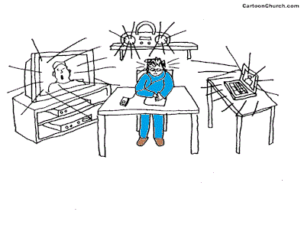
MONDAY, February 6th – 4th Block
Can you create dialogue for this cartoon using the Word of the Day, cacophony?
What’s wrong with the following analogy?
Cacophony is to racket, as copious is to scarce.
Cacophony and racket are synonyms, but copious and scarce are antonyms.

Slide 7
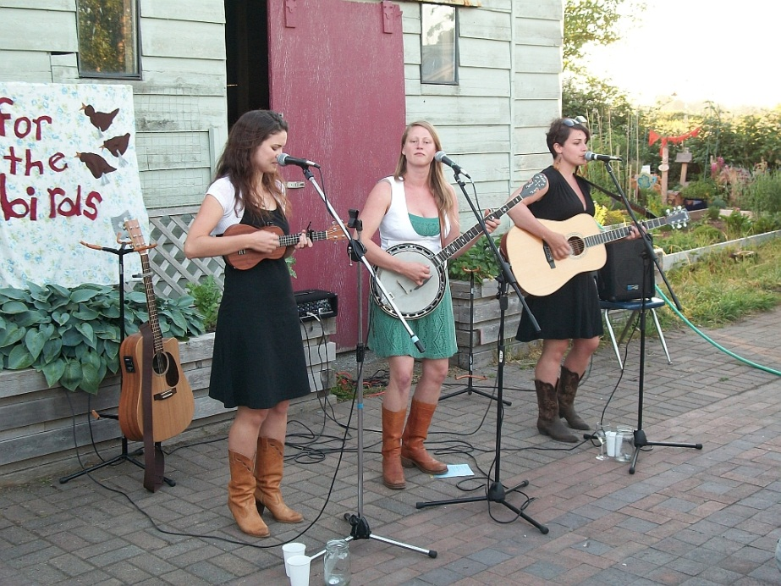
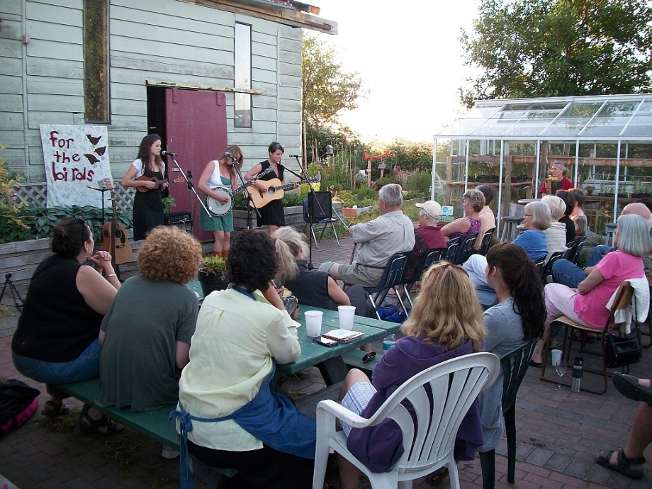
Tuesday, February 7th - 1st Block
What is the definition of the word mellifluous [muh-lif-loo-uhs]?
What part of speech is mellifluous?
From the Latin mellis (honey) + fluus (flowing)
Other forms of the word include: mellifluously (adv), mellifluousness (noun)
“Hats off to Aspen Switzer, Genevieve Rainey, and Elaine Ryan for a truly melodious, mellifluous, magnificent and memorable experience.” – From the Feed the Bees fundraising campaign.

Slide 8
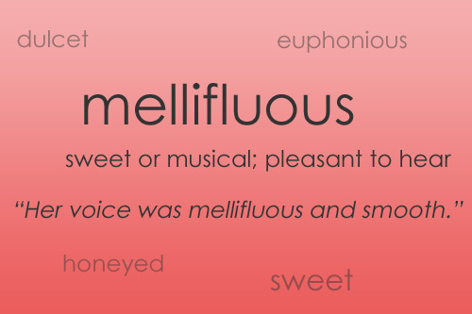
Tuesday, February 7th – 2nd Block
Mellifluous – adjective. Sweet and smooth sounding
What is another word for mellifluous (synonym)?
Dulcet, mellow, resonant, honeyed, harmonic
What word or phrase means the opposite of mellifluous (antonym)?
Cacophonous, discordant, dissonant disagreeable, inharmonious.

Slide 9
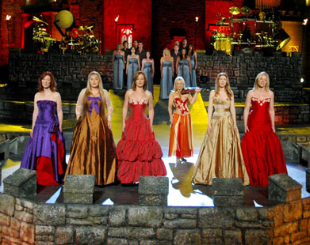
Tuesday, February 7th – 3rd Block
Can you use the word mellifluous to describe the picture at right?
Example: The mellifluous voices of the Celtic Woman group attracts fans from around the world.
Now write your own sentence using the word mellifluous in a manner that illustrates your understanding of the word.

Slide 10
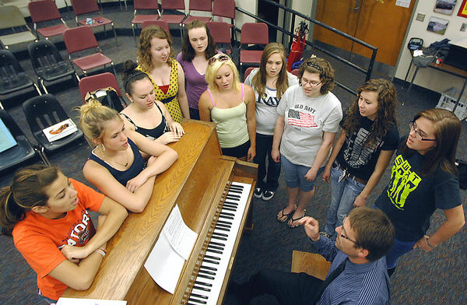
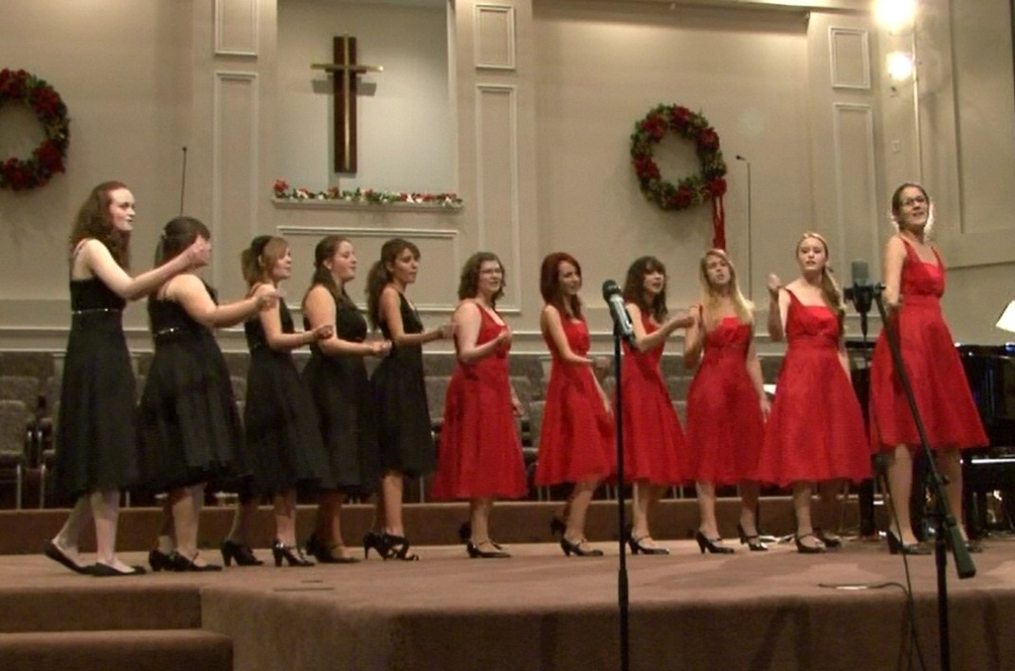
Tuesday, February 7th – 4th Block
Can you think of an image that epitomizes the “word of the day”, mellifluous?
Complete the analogy:
Mellifluous is to Category 5, as ______ is to Lady ‘Canes Basketball.
Successful, talented, hard-working, skillful, etc. [descriptive adjectives]

