Slide 1
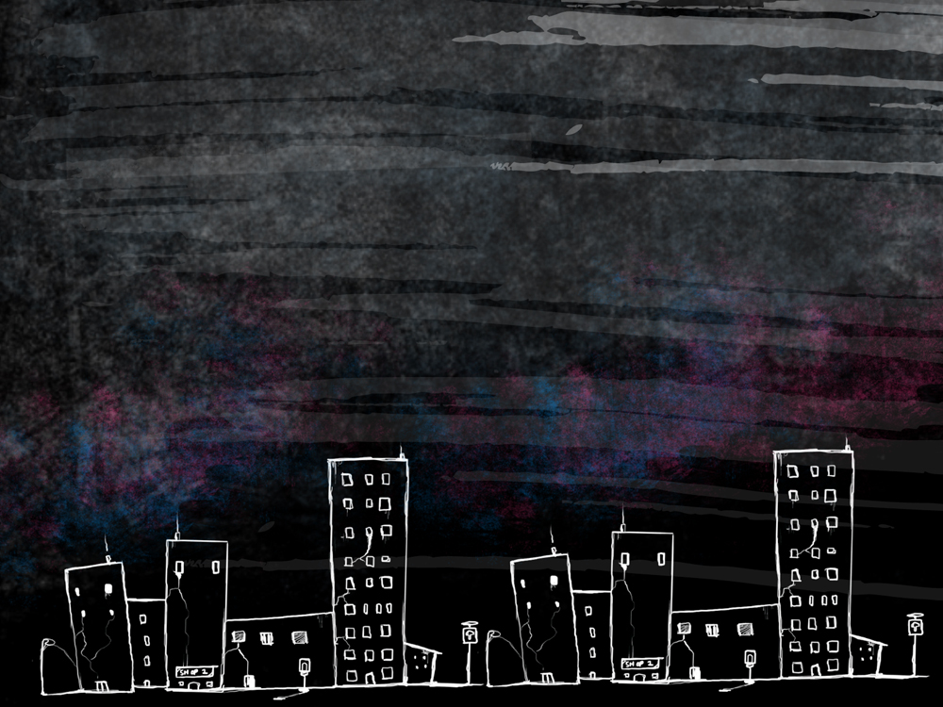
Word of the Day
Monday, February 27th through Friday, March 2nd

Slide 2
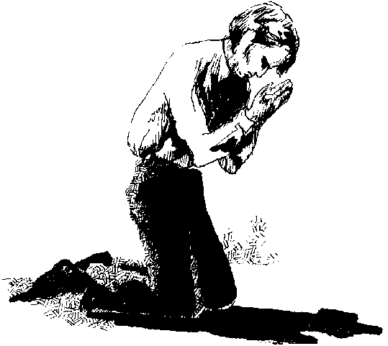
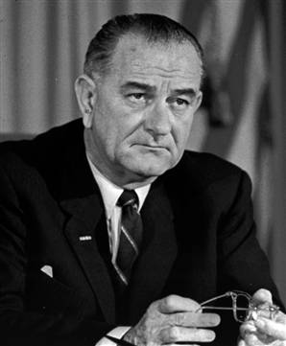
Monday, February 27th – 1st Block
What does the word fervent [fur-vuhnt] mean?
If fervent is an adjective, that what part of speech is ferventness?
Noun
From the Latin fervere (boiling, hot, glowing)
“My most fervent prayer is to be a President who can make it possible for every boy in this land to grow to manhood by loving his country - instead of dying for it.” -- Lyndon Johnson

Slide 3
Monday, February 27th – 2nd Block
Fervent – adjective. Filled with passion or intensity
What words mean the same as fervent (synonyms)?
Intense, vehement, fervid, impassioned, passionate, zealous
What words mean the opposite of fervent (antonyms)?
Dispirited, uncaring, unenthusiastic, unexcited, impassive

Slide 4
Monday, February 27th – 3rd Block
Can you use the word fervent to describe the picture?
Example: Fervent in her desire to win, Anya gave every ounce of her focus to returning her opponent’s commanding serve.
Now try writing your own sentence using the word fervent in a manner that illustrates your understanding of the word.

Slide 5
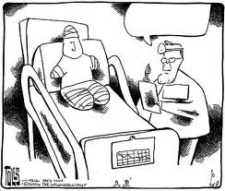
Monday, February 27th – 4th Block
Use the word fervent to write a caption for the cartoon below.
Complete the following analogy:
Fervent is to ecstatic, as weary is to ____.
Exhausted, spent, wiped, etc. {synonyms}

Slide 6
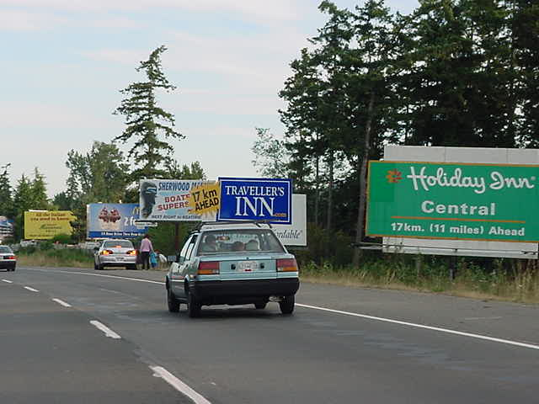
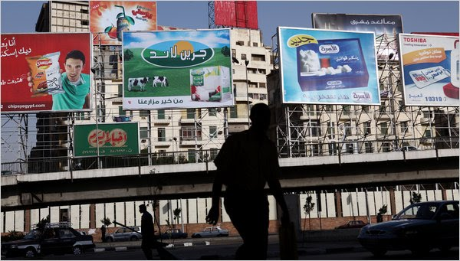
Tuesday, February 28th – 1st Block
What do you think the word discordant [dis-kawr-dnt] means?
If discordantly is an adverb, what part of speech is discordant?
Adjective
From the Latin dis- (apart) + cor (heart)
“The sterile, arid environment created by truly jarring and discordant signage and gargantuan billboards is a turnoff. “ --- Jonathan Katz

Slide 7
Tuesday, February 28th – 2nd Block
Discordant – adjective. Lacking harmony or agreement
What other words mean the same thing as discordant (synonyms)?
Cacophonous, antagonistic, contrary, divergent, inharmonious
What words mean the opposite of discordant (antonyms)?
Agreeable, concordant, harmonious, cooperating

Slide 8


Tuesday, February 28th – 3rd Block
Can you use the word discordant to describe the sound or image to the right?
Example: The discordant sound of screeching breaks echoed in her head, constantly reminding her of the trauma of her accident.
Now try writing your own sentence using the term discordant.

Slide 9
Tuesday, February 28th – 4th Block
What image comes to mind when you think of the word discordant?
Complete the following analogy:
Discordant is to agreeing, as rigid is to _____.
Soft, flexible, lenient, etc. [Antonyms]

Slide 10
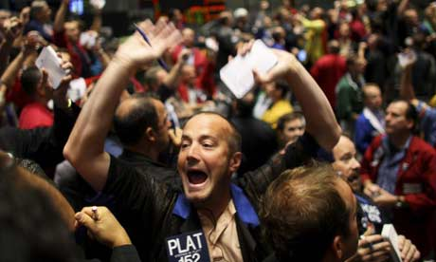
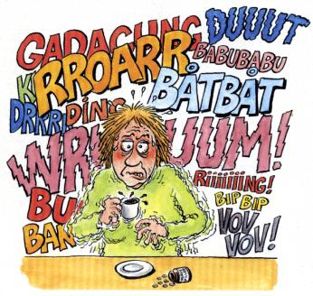
Wednesday, February 29th – 1st Block
What do you think the word din [din] means?
If din is a noun, what would the past-tense verb form of din be?
Dinned
From the Old English dyne (to make noise)
“Leadership is about doing what you know is right - even when a growing din of voices around you is trying to convince you to accept what you know to be wrong.” - Robert Ehrlich

Slide 11
Wednesday, February 29th – 2nd Block
Din – noun. Ongoing loud sound; noise
What words mean the same as the word din (synonyms)?
Brouhaha, hullabaloo, uproar, pandemonium, clamor
What words mean the opposite of din (antonyms)?
Quiet, silence, peacefulness

Slide 12
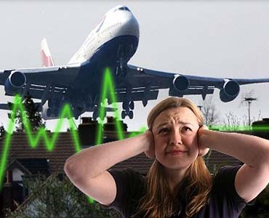
Wednesday, February 29th – 3rd Block
Can you use the word din to describe the image to the right?
Example: The constant din of air traffic often leads to lower property values near airports.
Now try writing your own sentence using the word din.

Slide 13
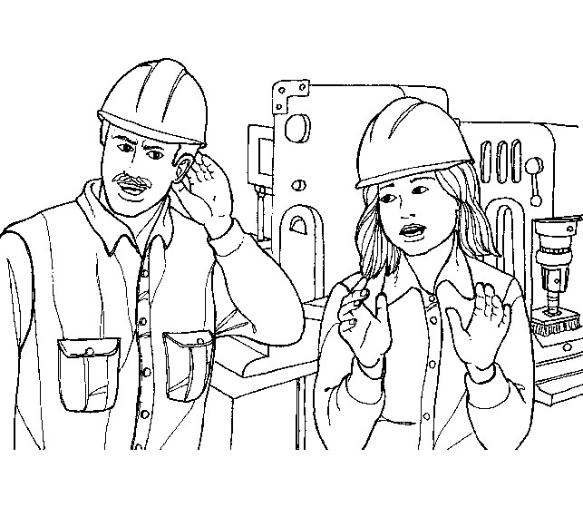
Wednesday, February 29th – 4th Block
What image reminds you of the word din?
Complete the following analogy:
Din is to traffic, as relaxation is to ____.
Hammock, beach, massage, etc. [examples]

Slide 14
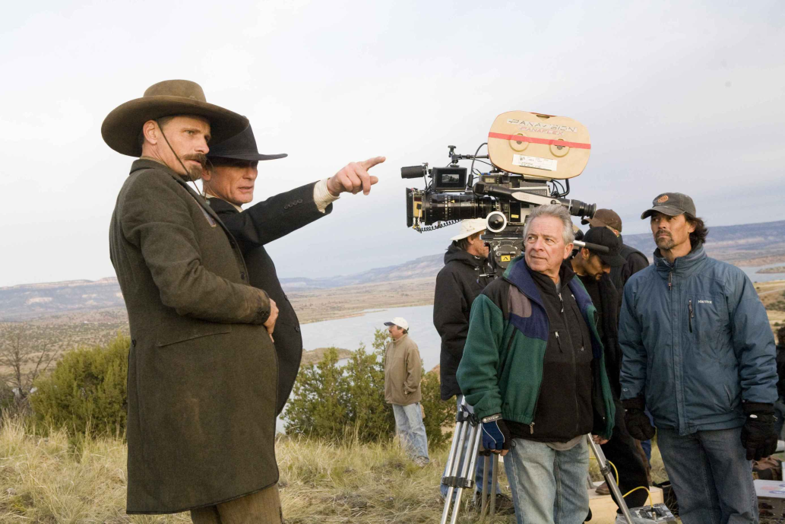

Thursday, March 1st – 1st Block
“The making of a picture ought surely to be a rather fascinating adventure. It is not; it is an endless contention of tawdry egos, some of them powerful, almost all of them vociferous, and almost none of them capable of anything much more creative than credit-stealing and self-promotion.” – Raymond Chandler
What do you think the word vociferous [voh-sif-er-uhs] means?
What other words can you think of that end in –ous? What part of speech are they all?
Adjectives (“Full of…”)
From the Latin vox (voice) + ferre (to care)
Word Variations: vociferously (adv), vociferousness (noun)

Slide 15
Thursday, March 1st – 2nd Block
Vociferous – adjective. Loud and noisy regarding one’s own voice, especially shouting; demandingly clamorous
What words are synonyms of vociferous?
Clamorous, boisterous, deafening, obstreperous
What words are antonyms of vociferous?
Quiet, silent, calm, restrained

Slide 16
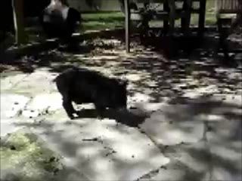
Thursday, March 1st – 3rd Block
Can you describe the video clip using the term vociferous?
Example: Truffles the pig spends most of his waking hours bellowing out vociferous rants.
Now, write your own sentence using the term vociferous.

Slide 17
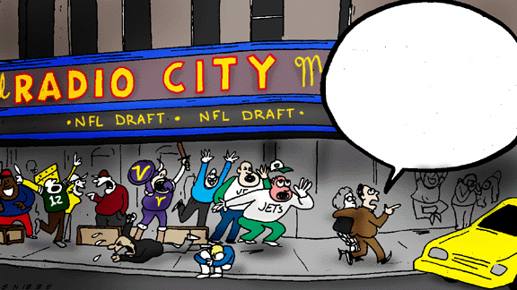
Thursday, March 1st – 4th Block
Add a comment to the cartoon below using the word vociferous.
Complete the following analogy:
Vociferous is to mute, as angry is to _____.
Calm, collected, content, etc. [Antonyms]

Slide 18
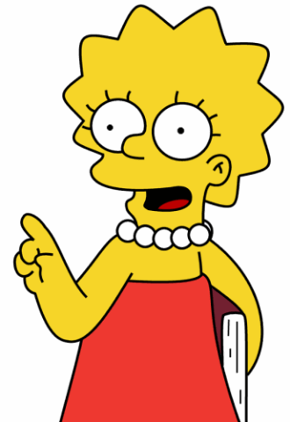
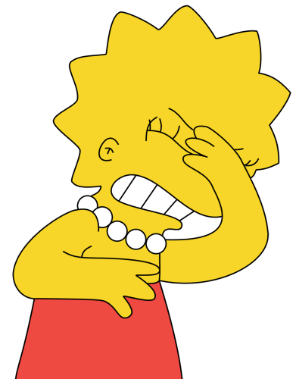
Friday, March 2nd – 1st Block
What does the word strident [strahyd-nt] mean?
If strident is an adjective, what would the noun form of the word be?
Stridency, stridence
From the French stridere (utter an inarticulate sound or screech)
Lisa Simpson: “I've never been called ‘fierce’ before. ‘Strident.’ ‘Hectoring’ has been tossed around.”

Slide 19
Friday, March 2nd – 2nd Block
Strident – adjective. Shrill; high-pitched
What words mean the same as strident (synonyms)?
Clamorous, screechy, grating, discordant
What words are antonyms of strident?
Low, mild, soft, moderate

Slide 20
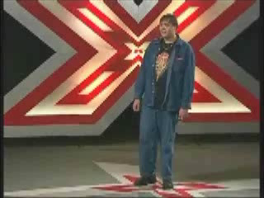
Friday, March 2nd – 3rd Block
How does the video to the right exemplify the term strident?
Example: The auditions phase of The X-Factor often unearths some of the most strident voices around the world. Far from legitimate contenders, these people do make for entertaining television.
Can you write your own sentence using the term strident?

Slide 21
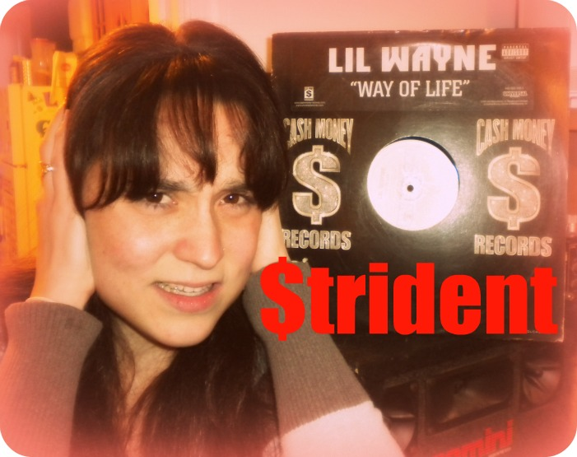
Friday, March 2nd – 4th Block
What music would you consider strident?
What is wrong with the following analogy?
Strident is to pleasing, as lanky is to tall.
Strident and pleasing are antonyms, but lanky and tall are synonyms.

