Slide 1
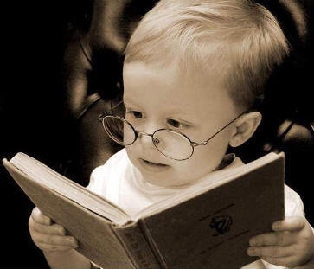
Word of the Day
Reading opens up the whole
world to me. It’s better than
tapioca pudding!
Tuesday, February 21st through
Friday, February 24th

Slide 2
PRESIDENT’S DAY TRIVIA
President’s Day is more than just a big furniture close-out sale
The federal holiday celebrated on the third Monday in February is not officially called Presidents' Day. Instead, it is Washington's Birthday. There was an attempt in 1968 to officially name it Presidents' Day. However, this suggestion died in committee. Many states, however, choose to call their own celebration on this day "Presidents' Day."
George Washington’s birthday was celebrated widely across the newly formed United States while he was still alive. However, it wasn't until 1885 that Chester Arthur signed the bill that made it a federal holiday.
Even though many states celebrate Abraham Lincoln’s birthday concurrently with Washington's birthday, it is not a federally designated holiday.
On February 22nd of almost every year since 1888, Washington's Farewell Address has been read in the US Senate. While this does not happen on Presidents' Day, it is an annual celebration of Washington's Birthday that stems from 1862 when the Address was read as a way to boost morale during the Civil War. This address was and is so important because it warns of political factionalism, geographical sectionalism, and interference by foreign powers in the nation's affairs. Washington stressed the importance of national unity over sectional differences.
Sources: http://www.senate.gov/artandhistory/history/minute/Washingtons_Farewell_Address.htm, http://en.wikipedia.org/wiki/Presidents_Day_(United_States), http://americanhistory.about.com/od/holidays/tp/presidents_day.htm.

Slide 3

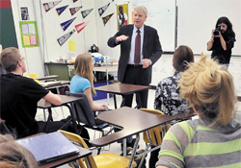
Tuesday, February 21st - 1st Block
What is the definition of the word avid [av-id]?
What part of speech is avid?
From the French avidus (longing eagerly, to desire eagerly)
Other forms of the word: avidly (adv), avidness (noun)
“They’re always pushing me to do my best,” she said. “I don’t know what I would do without them.”
-- Tenth-grader Angelica Baltazar, speaking of the AVID teachers at West Brunswick High, Fayetteville.

Slide 4
Tuesday, February 21st – 2nd Block
Avid– adjective. Showing enthusiam; ardent
  AVID is also a well known acronym signifying Advancement Via Individual Determination
What is another word for avid (synonym)?
Zealous, enthusiastic, keen, devoted
What word means the opposite of avid (antonym)?
Indifferent, reluctant, apathetic, uninspired, unmotivated

Slide 5
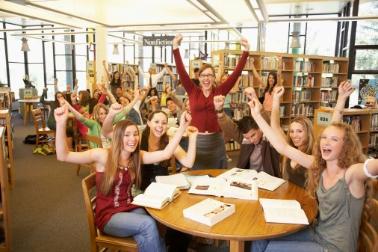
Tuesday, February 21st – 3rd Block
Can you use the word avid to describe this picture?
Example: The English students were avid readers.
Now use your knowledge of the word to write your own sentence using avid.

Slide 6
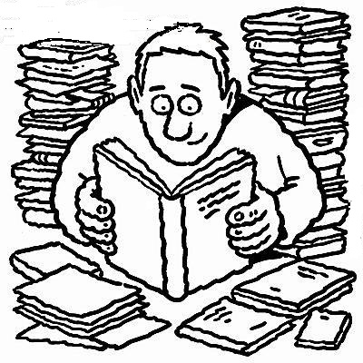
Tuesday, February 21st - 4th Block
Can you use the “word of the day”, avid, to describe this cartoon?
Complete this analogy:
Avid is to zealous, as _____________ is to apathetic.
Reluctant, indifferent, uncaring. [Synonyms]

Slide 7

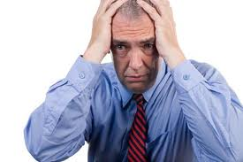
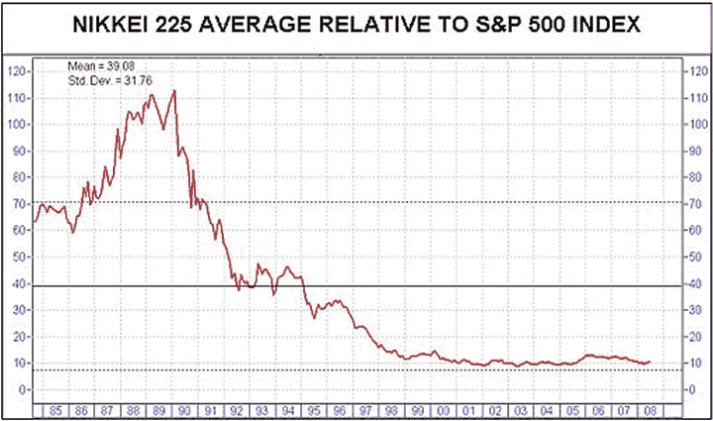
Wednesday, February 22nd - 1st Block
What is the definition of the word ebullient [ih-buhl-yuhnt]?
What part of speech is ebullient?
From the Latin ex- (out) + bullire (to bubble)
Other forms of the word: ebulliency (noun), ebulliently (adv), ebullience (noun).
“Business investment is going to be one of the principal drivers of growth in 2006. The consumer will still be there… (but) certainly won’t be as ebullient as the last four years.” – Brian Bethune

Slide 8
Wednesday, February 22nd - 2nd Block
Ebullient - adj. Filled with bubbly excitement; as if boiling over with excitement
What is another word for ebullient (synonym)?
Gushing, effusive, elated, exuberant, enthusiastic, profuse
What word means the opposite of ebullient (antonym)?
Apathetic, disinterested, unenthusiastic

Slide 9
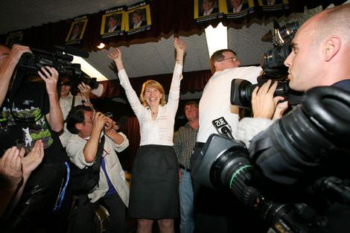
Wednesday, February 22nd – 3rd Block
Can you use the word ebullient to describe this picture?
Example: The candidate was ebullient at the early exit poll results.
Now take a moment to write your own sentence using ebullient.

Slide 10
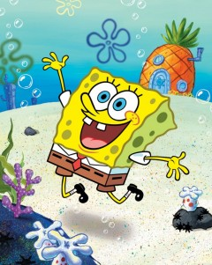
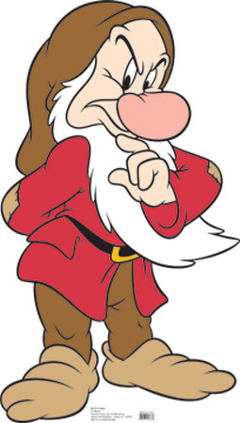
wednesday, February 22nd – 4th Block
Which character can best be described as ebullient?
Complete the analogy:
Ebullient is to apathetic, as mellifluous is to ____.
Cacophonous, dissonant, discordant, inharmonious, etc. [Antonyms]

Slide 11
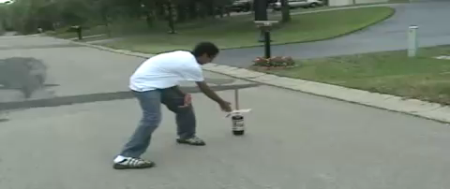
thursday, February 23rd - 1st Block
Video Clip
What is the definition of the word effervescent [ef-er-ves-uhnt]?
What part of speech is effervescent?
From the Latin ex- (out) + fervescere (begin to boil)
Other forms of the word: effervescently (adverb), effervescence (noun)
“I just marvel at her optimism and her ability to get things done. She just can’t be contained. She’s bubbly beyond effervescence.”
– Vin Scully, sportscaster, describing Mary Lou Retton, not this effervescent fountain of Diet Coke and Mentos.

Slide 12
thursday, February 23rd – 2nd Block
Effervescent – adjective. Lively; full of uplifted spirit; vivacious
What is another word for effervescent (synonym)?
Animated, bubbling, dynamic, perky, buoyant
What word(s) mean the opposite of effervescent (antonym)?
Flat, dull, listless, apathetic

Slide 13
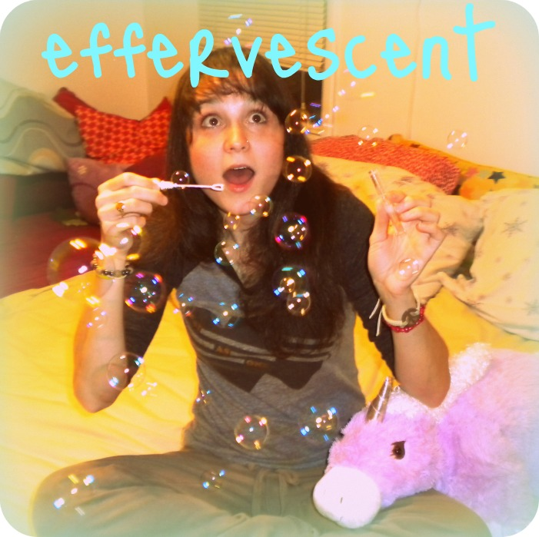
thursday, February 23rd - 3rd Block
Can you use the word effervescent to describe this picture?
Example: The bubbles (and Charlie the Unicorn) only enhanced her already effervescent demeanor.
Now, create your own sentence using the word effervescent. It does not have to be related to this image.

Slide 14
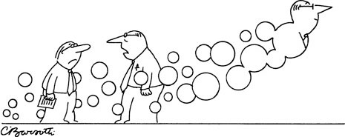
thursday, February 23rd – 4th Block
Create a dialogue bubble for the cartoon. Make sure your dialogue uses or relates to effervescent.
Complete the analogy:
Effervescent is to lively, as _________ is to dull.
Listless, emotionless, flat, robot-like, etc. [Synonyms]
My suggestion: “How can he be so effervescent? Quarterly reports are due tomorrow!

Slide 15
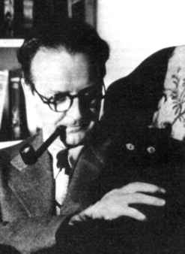
friday, February 24th - 1st Block
What is the definition of the word fanatical [fuh-nat-i-kuhl]?
What part of speech is fanatical?
From the Latin fanaticus (excessive enthusiasm, mad)
Other forms of the word: fanatically (adv), fanaticalness (noun)
“I said something which gave you to think I hated cats. But gad, sir, I am one of the most fanatical cat lovers in the business.”
– Raymond Chandler, American novelist and screenwriter

Slide 16
friday, February 24th – 2nd Block
Fanatical - adjective. Full of great enthusiasm or devotion
What is another word for fanatical (synonym)?
Overenthusiastic, radical, zealous, rabid, frenzied, fervent
What word(s) mean the opposite of fanatical (antonym)?
Disinterested, dispassionate, impartial, unenthusiastic

Slide 17
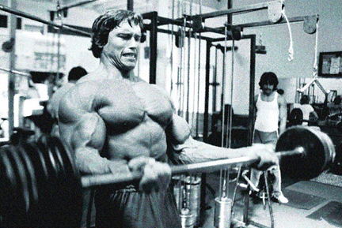
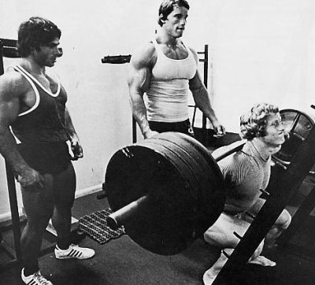
Friday, February 24th - 3rd Block
Can you use the word fanatical to describe these pictures?
Example: The dedication of bodybuilders such as Arnold Schwarzenegger and Franco Columbu can only be called fanatical.
Now, create your own sentence using the word fanatical. It does not have to be related to this image.

Slide 18
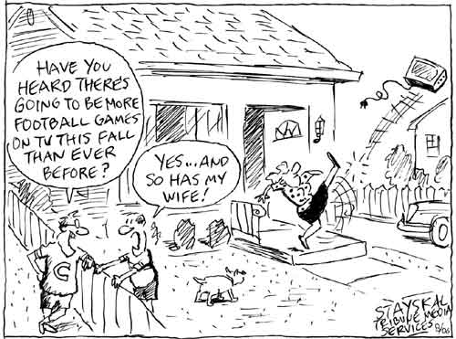
Friday, February 24th – 4th Block
How does the cartoon relate to the word, fanatical?
Complete the analogy:
Fanatical is to Gator Nation, as talented is to ___________.
The thespians of Ms. Neander’s theatre productions. [Descriptive adjective]

Slide 19

Word of the Day
Have a safe and fun-filled weekend Hurricanes!

