Slide 1
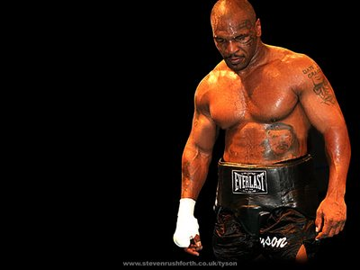
Word of the Day
Words are Powerful: "I probably have a 20,000-word vocabulary. I'll match my wits with anyone on literature, science and the arts." -- Mike Tyson
Monday, February 13th through
Friday, February 17th

Slide 2
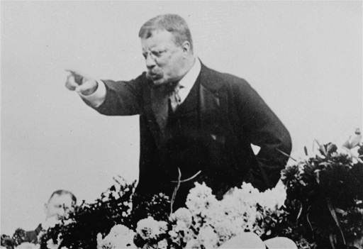
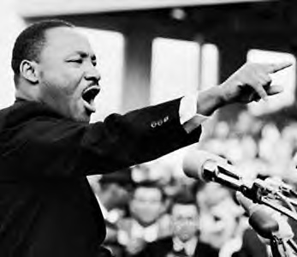
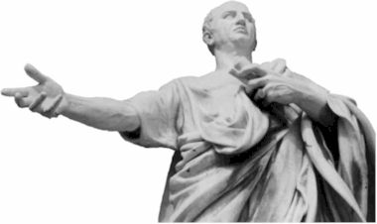
MONDAY, February 13th – 1st Block
What is the definition of the word impassioned [im-pash-uhnd]?
What part of speech is impassioned ?
From the Italian im- (in, into) + passion (passion)
Other forms: impassionedly (adv), impassionedness (noun)
“A good orator is pointed and impassioned.” - Marcus Tullius Cicero

Slide 3
MONDAY, February 13th – 2nd Block
Impassioned – adjective. Talkative; loquacious; excessively talking in a rambling, roundabout manner
What is another word for impassioned (synonym)?
Amorous, enamored, doting, affectionate
What word means the opposite of impassioned (antonym)?
Indifferent, unfriendly, cold, frigid

Slide 4
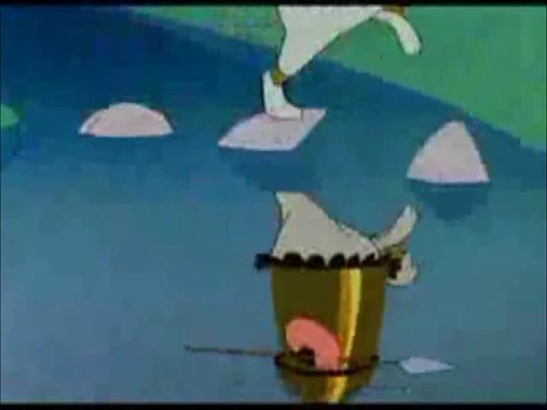
MONDAY, February 13th - 3rd Block
Can you use the word impassioned to describe the video clip?
Example: With impassioned zeal, Elmer Fudd tracked his favorite target.
Now write your own sentence using the word impassioned.
(Click image to play video clip)

Slide 5
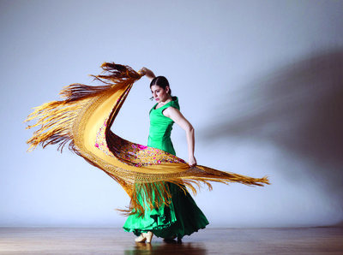
MONDAY, February 13th – 4th Block
How does this image relate to the term impassioned ?
Complete the following analogy:
Impassioned is to apathetic, as jumpy is to _____.
Composed, collected, laid-back, etc. [Antonyms]

Slide 6

Tuesday, February 14th - 1st Block
What is the definition of the word ardent [ahr-dnt]?
What part of speech is ardent?
From the Latin ardentem (glowing, fiery, hot ablaze)
Other forms of the word include: ardently (adv), ardentness (noun), ardency (noun)
“The ardent golfer would play Mount Everest if somebody would put a flagstick on top.” -- Pete Dye

Slide 7
Tuesday, February 14th – 2nd Block
Ardent – adjective. Full of passion and emotion
What is another word for ardent (synonym)?
Amatory, amorous, lovesick, fervent, agog
What word or phrase means the opposite of ardent (antonym)?
Indifferent, dispassionate, frigid, unenthusiastic, cold

Slide 8

Tuesday, February 14th – 3rd Block
Can you use the word ardent to describe the picture at right?
Example: Captain Jack Sparrow had an ardent desire to evade the cannibal tribe.
Now write your own sentence using the word ardent in a manner that illustrates your understanding of the word.

Slide 9
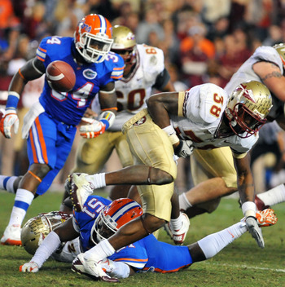
Tuesday, February 14th – 4th Block
Can you think of an image that epitomizes the “word of the day”, ardent?
Complete the analogy:
Ardent is to vehement, as poignant is to ____.
Intense, moving, touching, etc. [Synonyms]

Slide 10
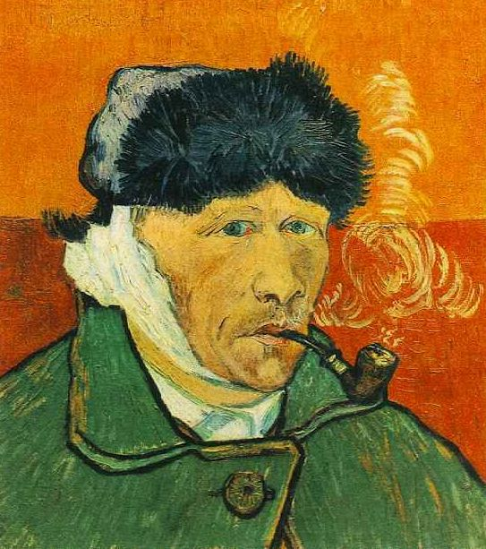

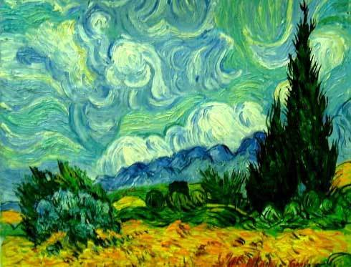
Wednesday, February 15th - 1st Block
What is the definition of the word vibrant [vahy-bruhnt]?
What part of speech is vibrant?
From the Latin vibrare (move to and fro).
Other forms of the word: vibrancy (noun), vibrantly (adv), vibrance (noun)
“The more ugly, older, more cantankerous, more ill and poorer I become, the more I try to make amends by making my colors more vibrant, more balanced and beaming.” -- Vincent Van Gogh

Slide 11
Wednesday, February 15th – 2nd Block
Vibrant – adjective. Lively; full of vitality
What is another word for vibrant (synonym)?
Dynamic, vivacious, vivid, zesty
What word means the opposite of vibrant (antonym)?
Colorless, dull, pale

Slide 12
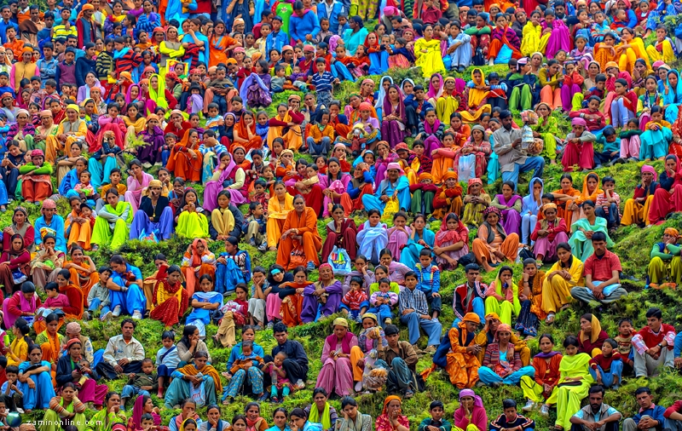
Wednesday, February 15th – 3rd Block
Can you use the word vibrant to describe this picture?
Example: Long the producers of fine textiles, the Indian people are famous for the vibrant colors of their saris.
Now use your knowledge of the word vibrant to write your own sentence using .

Slide 13

Wednesday, February 15th – 4th Block
Can you think of an image that epitomizes the “word of the day”, vibrant?
Complete this analogy:
Vibrant is to flamboyant, as vague is to ______.
Ambiguous, muddy, obscure, unclear, etc. [Synonyms]

