Slide 1
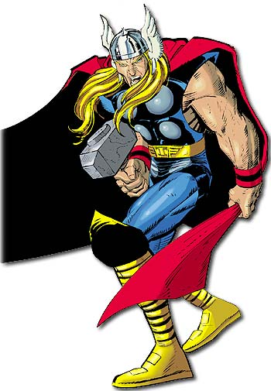
Word of the Day
Knowledge is
Power!
Wednesday, October 26th
through
Friday, October 28th

Slide 2
Word of the Day
Be sure to look for:
The Audio Links in each Block 1 slide - to help with word pronunciation;
Embedded Video & Audio links throughout.

Slide 3
Wednesday, October 26th – 1st Block
What is the definition of the word revulsion [ri-vuhl-shuhn]?
What part of speech is revulsion?
From the Latin re- (away) + vellere (to tear, pull)
Other forms of the word include: revulsionary (adjective).
“… words simply cannot express the horror, the shock, and the revulsion we all feel over what took place in this nation on Tuesday morning.” (September 11, 2001 ) Billy Graham, American evangelist

Slide 4
Wednesday, October 26th – 2nd Block
Revulsion– noun. A strong feeling of repugnance, distaste or dislike; a sudden and unpleasant violent reaction in feeling, especially one of extreme loathing.
What is another word for revulsion (synonym)?
Disgust, repulsion, loathing, abhorrence, aversion, antipathy
What word means the opposite of revulsion (antonym)?
Liking, love, fondness, affection, admiration

Slide 5
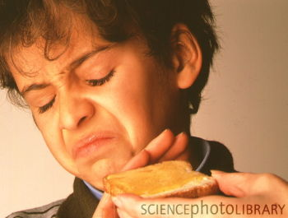
Wednesday, October 26th – 3rd Block
Can you use the word revulsion to describe the picture to the right?
The boy’s dislike of honey on toast bordered on revulsion.
Now write your own sentence using the word revulsion.

Slide 6
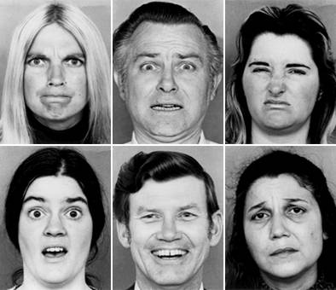
Wednesday, October 26th – 4th Block
Which facial expression best expresses revulsion?
What’s wrong with the following analogy?
Revulsion is to love, as spooky is to scary.
Revulsion & love are antonyms. Spooky & scary are synonyms.

Slide 7
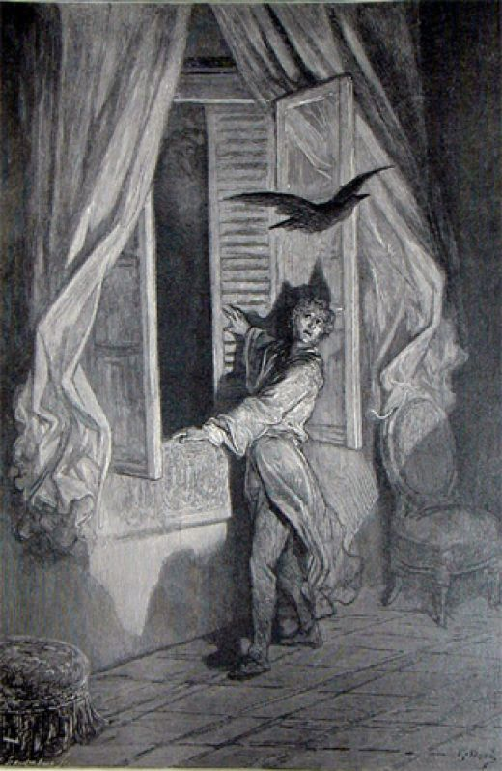
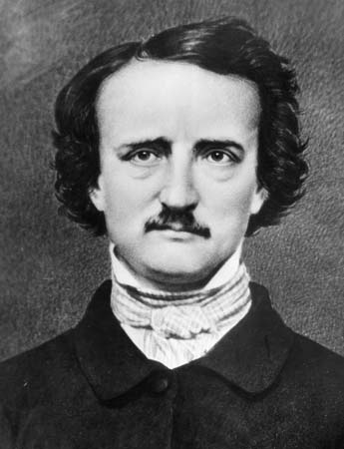
Thursday, October 27th – 1st Block
What is the definition of the word haunting [hawn-ting]?
What part of speech is haunting?
From the Old French hanter (to frequent, be familiar with)
Other forms of the word include: haunt (noun), hauntingly (adv), haunt (verb), haunted (adj).
“There is something haunting in the light of the moon; it has all the dispassionateness of a disembodied soul, and something of its inconceivable mystery.“
- Joseph Conrad, novelist

Slide 8
Thursday, October 27th - 2nd Block
Haunting – adj. Not quickly forgotten; remaining in the consciousness; a habitual visitation
What is another word for haunting (synonym)?
Memorable, linger, persistently, obsessing.
What word or phrase means the opposite of haunting (antonym)?
Forgotten.

Slide 9
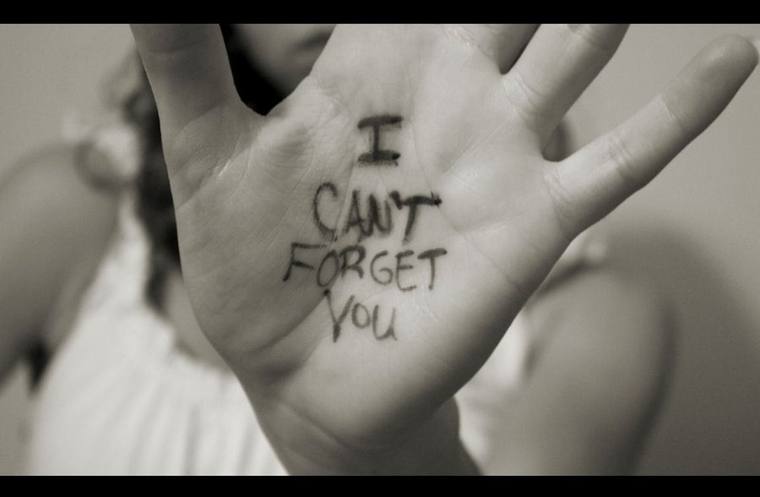
Thursday, October 27th – 3rd Block
Can you use the word haunting to describe the picture at right?
Example: Haunting memories of her ex-boyfriend made it hard for Kate to move on.
Now write your own sentence using the word haunting in a manner that illustrates your understanding of the word.

Slide 10
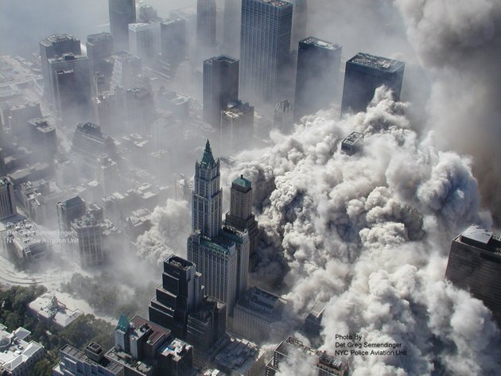
Thursday, October 27th – 4th Block
How does the image below relate to the term haunting?
Unscramble the analogy:
[is to] [Forgettable] [Understandable] [as] [Enigma] [is to] [.] [Haunting]
Forgettable is to haunting, as enigma is understandable. [Antonyms]
Manhattan from above. The morning of September 11, 2001.

Slide 11
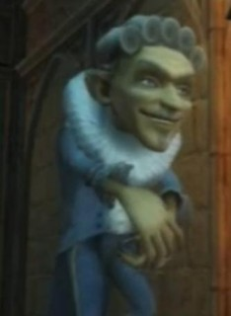
Friday, October 28th – 1st Block
What is the definition of the word poltergeist [pohl-ter-gahyst]?
What part of speech is poltergeist?
From the German polter (make a noise) + geist (ghost )
“Peeves,” Percy whispered to the first-years. “A poltergeist.” He raised his voice, “Peeves – show yourself.”
A loud, rude sound, like the air being let out of a balloon, answered.
“Do you want me to go to the Bloody Baron?”
There was a pop and a little man with wicked dark eyes and a wide mouth appeared, floating cross-legged in the air, clutching the walking sticks.
“Oooooooh!” he said, with an evil cackle. “Ickle firsties! What fun!”
- Harry Potter and the Philosopher’s Stone

Slide 12
Friday, October 28th - 2nd Block
Poltergeist – noun. A ghost or spirit said to manifest its presence by making noises, knockings, etc, also by acts of mischief such as moving furniture.
What is another word for poltergeist (synonym)?
Specter, spook, ghost, haunter, spirit
What word means the opposite of poltergeist (antonym)?
Real, corporeal, living being
Today’s Trivia: Some paranormal investigators believe that a poltergeist is not a ghost at all, but rather the manifestations of a troubled young mind expressing itself through telekinesis, sometimes subconsciously. What do you think?

Slide 13
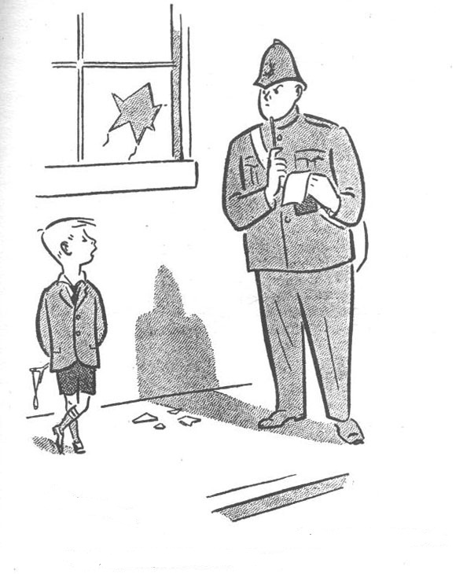
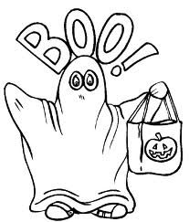
Friday, October 28th – 3rd Block
Can you create dialogue relating to the word poltergeist for this cartoon?
Example: Little Boy - It was a poltergeist officer. Honest!

Slide 14
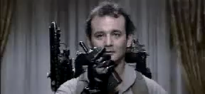
Friday, October 28th – 4th Block
Can you think of another example of ‘poltergeist’ in film or literature?
Complete the analogy:
Poltergeist is to creepy noises, as ______________ is to heat and light.
Fire, conflagration, bonfire, etc.
[Causes of]
Video Clip

Slide 15
Word of the Day
Have a safe and fun-filled
Halloween weekend Hurricanes!
[Halloween – All Hallows Eve, the night before All Hallows Day, or All Saints Day.]

