Slide 1
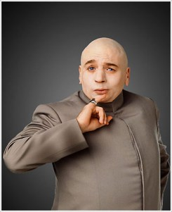
Word of the Day
Without WOD, how could I win at Words with Friends?
Monday, January 30th through Friday, February 3rd

Slide 2
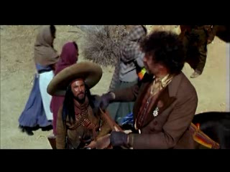
MONDAY, January 30th – 1st Block
What is the definition of the word plethora [pleth-er-uh]?
What part of speech is plethora?
From the Greek plethore (fullness)
Other forms: plethoric (adj),plethorically (adv)
(Click video to play)

Slide 3
MONDAY, January 30th – 2nd Block
plethora – noun. Excess; abundance
What is another word for plethora (synonym)?
Deluge; glut; profusion; surfeit; barrage; surplus
What word means the opposite of plethora (antonym)?
Few; lack; scarcity; dearth

Slide 4
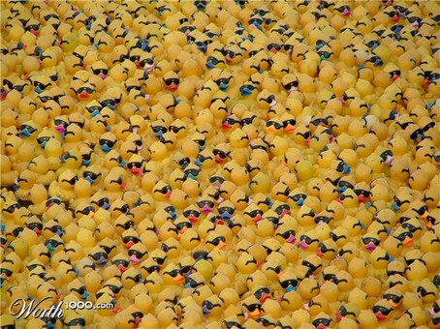
MONDAY, January 30th – 3rd Block
Can you use the word plethora to describe the picture to the right?
Example: The carnival game relied on the statistical unlikelihood that a person would select a winner from the plethora of rubber ducks floating in the pool.
Now write your own sentence using the word plethora.

Slide 5
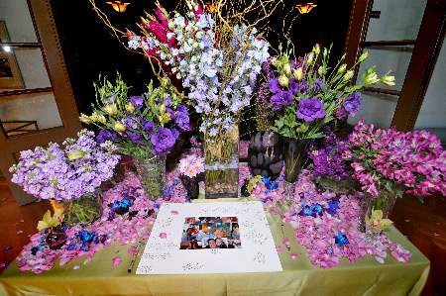
MONDAY, January 30th – 4th Block
What other images illustrate the term plethora?
What’s wrong with the following analogy?
Plethora is to overabundance, as institution is to Citrus High School.
Plethora and overabundance are synonyms, but Citrus High School is an example of an institution.

Slide 6
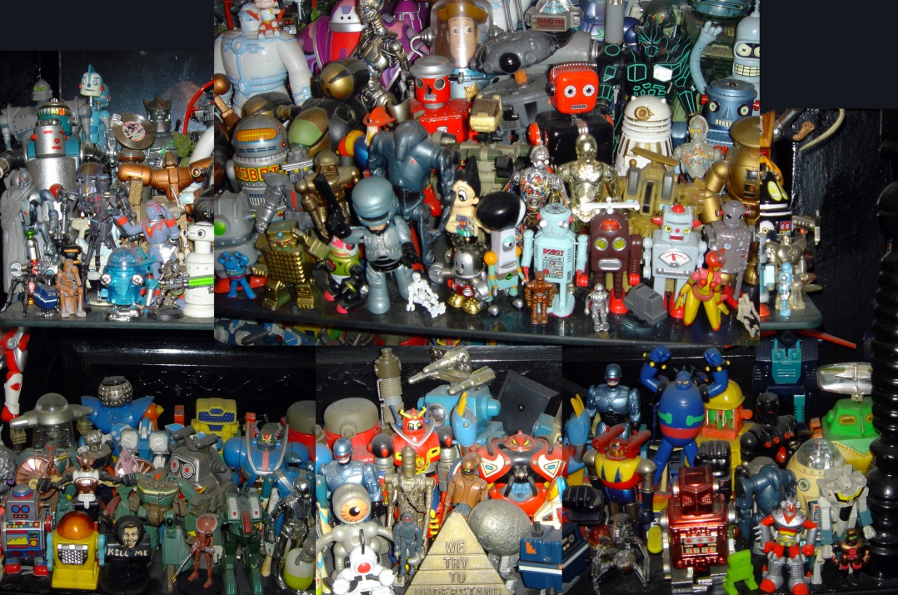
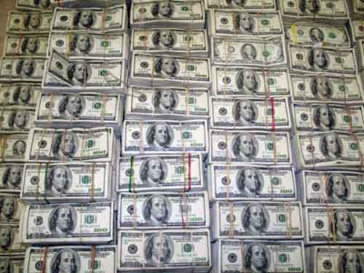
Tuesday, January 31st – 1st Block
What is the definition of the word copious [koh-pee-uhs]?
What part of speech is copious?
From the Latin com- (with) and ops (power, wealth, resources)
Other forms of the word include: copiously (adv), copiousness (noun), copiosity (noun)
““EMOTION, n. A prostrating disease caused by a determination of the heart to the head. It is sometimes accompanied by a copious discharge of hydrated chloride of sodium from the eyes.” -- Ambrose Bierce

Slide 7
Tuesday, January 31st – 2nd Block
copious – adjective. Much; plentiful; abundant
What is another word for copious (synonym)?
Ample; exuberant; profuse
What word or phrase means the opposite of copious (antonym)?
Meager, lacking, scarce, wanting, needy

Slide 8
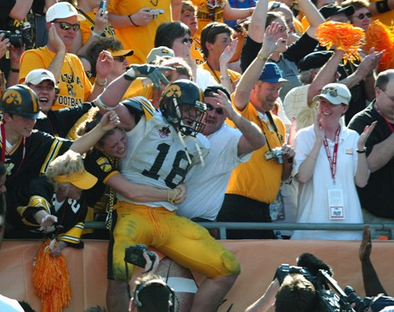
Tuesday, January 31st – 3rd Block
Can you use the word copious to describe the picture at right?
Example: Winning on the road is difficult in athletics due to the copious amount of support given by the home crowd.
Now write your own sentence using the word copious in a manner that illustrates your understanding of the word.

Slide 9
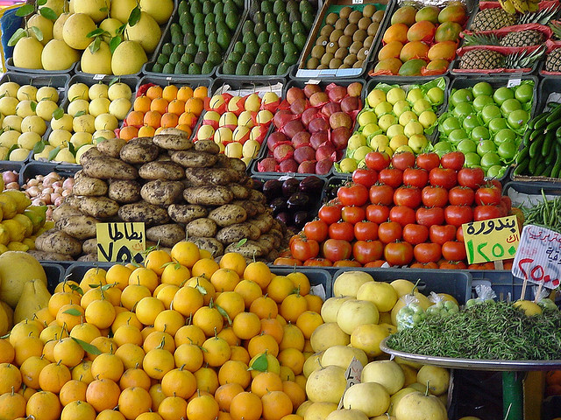
Tuesday, January 31st – 4th Block
Can you think of an image that epitomizes the “word of the day”, copious?
Complete the analogy:
Copious is to rare, as defiant is to _____.
Respectful, obedient, etc. [Antonyms]

Slide 10
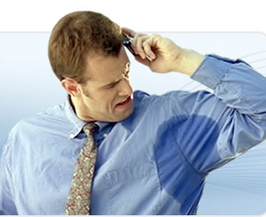
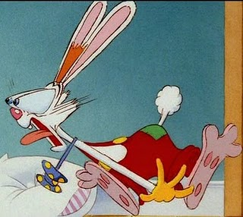
Wednesday, February 1st - 1st Block
What is the definition of the word profuse [pruh-fyoos]?
What part of speech is profuse?
From the Latin pro- (forth) and fundere (to pour)
Other forms of the word: profusely (adv), profuseness (noun)
“Hail to thee, blithe spirit! Bird thou never wert, That from Heaven, or near it, Pourest thy full heart In profuse strains of unpremeditated art.” -- Percy Shelley, British Poet

Slide 11
Wednesday, February 1st – 2nd Block
profuse – adjective. More than enough; abundant
What is another word for profuse (synonym)?
Abounding, ample, copious
What word means the opposite of profuse (antonym)?
Lacking, sparse, wanting

Slide 12
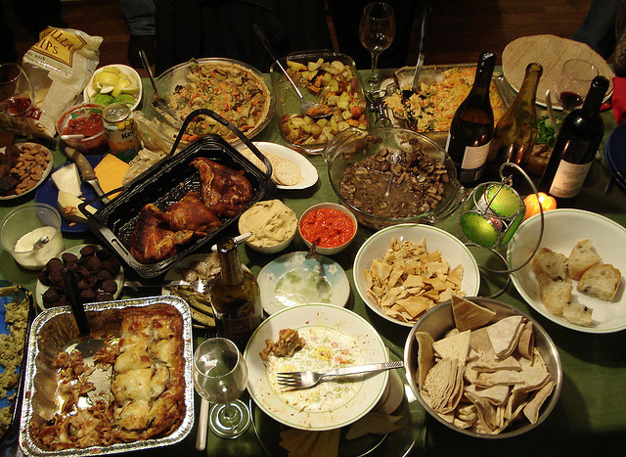
Wednesday, February 1st – 3rd Block
Can you use the word profuse to describe this picture?
Example: For a party of only four people, the table seemed profusely spread with food and drink.
Now use your knowledge of the word to write your own sentence using profuse.

Slide 13
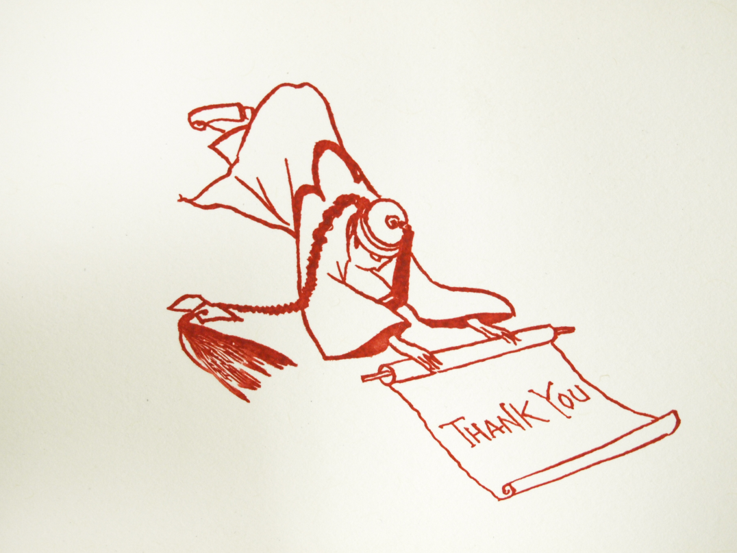
Wednesday, February 1st – 4th Block
Can you think of an image that epitomizes the “word of the day”, profuse?
What’s wrong with this analogy?
Profuse is to bleeding, as obedient is to rock.
A person’s bleeding can be profuse, but a rock cannot be obedient.

Slide 14
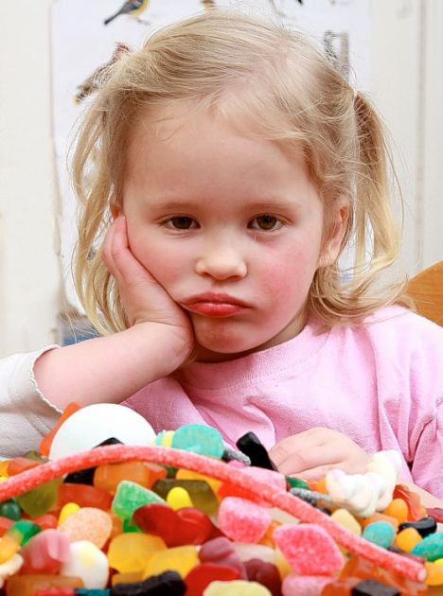
Thursday, February 2nd - 1st Block
What is the definition of the word surfeit [sur-fit]?
What part of speech is surfeit?
From the French sur- (over) and faire (do)
Other forms of the word: surfeiter (n), unsurfeited (adj), unsurfeiting (adj)
“A surfeit of the sweetest things the deepest loathing of the stomach brings” -- William Shakespeare

Slide 15
Thursday, February 2nd – 2nd Block
surfeit – noun. An oversupply
What is another word for surfeit (synonym)?
Bellyful, glut, profusion, surplus
What word means the opposite of surfeit (antonym)?
Lack, need, necessity

Slide 16
Thursday, February 2nd – 3rd Block
Can you create dialogue relating to the word surfeit for this cartoon?
Example: Flight Attendant: “Don’t you think that might be a surfeit of luggage?”
Passenger: “Oh, this? This is just my makeup. At $50 a bag, I couldn’t afford to pack heavy.”

Slide 17
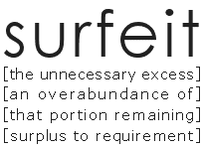
Thursday, February 2nd – 4th Block
How does this picture relate to the word of the day, surfeit?
Complete the analogy:
Surfeit is to overkill, as diagram is to ____.
Sketch, design, blueprint, etc. [Synonyms]

Slide 18
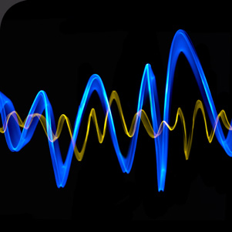
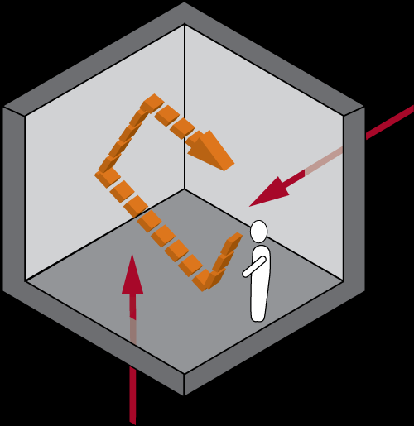
Friday, February 3rd - 1st Block
What is the definition of the word acoustics [uh—koo- stiks]?
What part of speech is acoustics?
From the Greek akouein (to hear sound quality)
Other forms of the word: acoustical (adj), acoustically (adv)
“I prefer to sing in the shower 'cause the acoustics are really, really good, I mean, when you're singing against the tile walls then you really hear yourself, hear your voice, you know, throwing itself back at you.” – Thia Megia

Slide 19
Friday, February 3rd – 2nd Block
Acoustics – noun. The quality of sound, pertaining to how it is heard based on the quality and structure of the room
What is another word for acoustics (synonym)?
Echo, noise, sound qualities
Did You Know? Today, acoustic engineers can earn up to $120,000/yr. Acoustics majors rely heavily on course work in physics, calculus, and engineering.

Slide 20
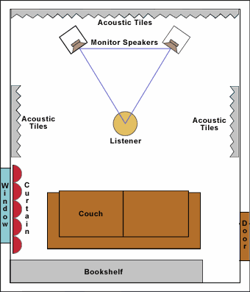
Friday, February 3rd – 3rd Block
How does this diagram relate to the word acoustics ?
Example: To create the perfect home theater system, Todd meticulously considered the acoustics of his room.
What does it mean when a musical performance is done acoustically?

Slide 21
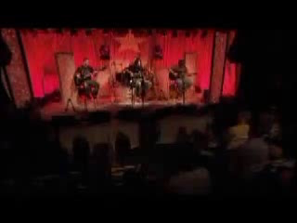
Friday, February 3rd – 4th Block
What does it mean when a musical performance is done acoustically?
Complete the analogy:
Acoustics is to hearing, as optics is to _____.
Seeing, vision, etc. [Related fields]
Video Clip

Slide 22
Word of the Day
Have a safe and fun-filled weekend Hurricanes!

