Slide 1
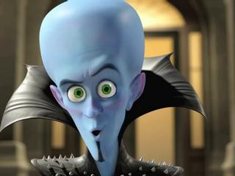
Word of the Day
Knowledge
is
POWERFUL Stuff
Monday, January 23 through Friday, January 27, 2012

Slide 2
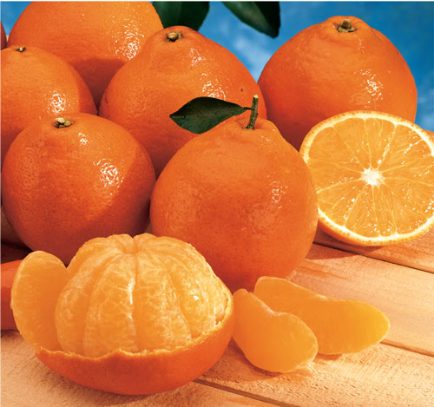
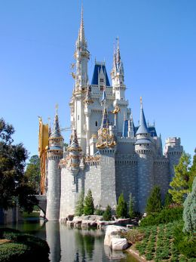
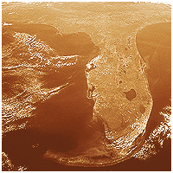
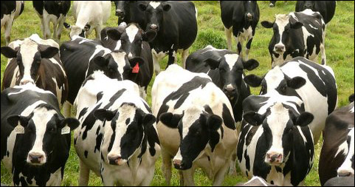
MONDAY, January 23rd – 1st Block
What is the definition of the word ample [am-puhl]?
What part of speech is ample?
From the Latin amphis (large, spacious); from which the word amphitheater comes.
“We have ample resources to meet whatever comes.” Jeb Bush, former Florida governor

Slide 3
MONDAY, January 23rd – 2nd Block
Ample– noun. Plenty; abundant; more than enough.
What is another word for ample (synonym)?
Sufficient, plentiful, bountiful, voluminous, lavish, plenteous, overflowing, liberal
  Is that an ample number of synonyms for you?
What word means the opposite of ample (antonym)?
Scanty, meager, lacking, sparse, insufficient
Click this link – ample – for the VOCABAHEAD audio/visual tutorial.

Slide 4
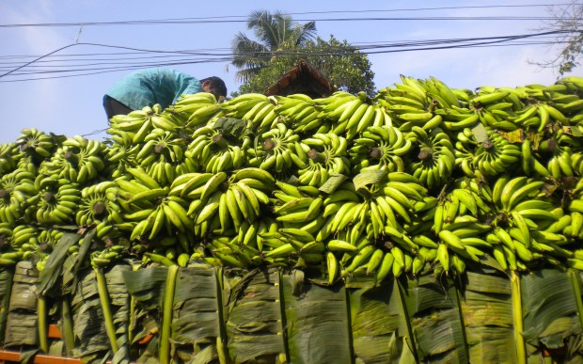
MONDAY, January 23rd – 3rd Block
Can you use the word ample to describe the picture to the right?
The ample banana harvest brought much needed money to the farmers.
Now write your own sentence using the word ample.

Slide 5
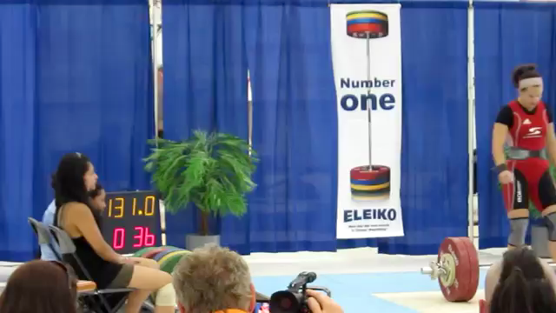
MONDAY, January 23rd – 4th Block
Use “ample” to describe Christine Girard’s successful “clean and jerk” lift in 2011, British Columbia
What’s wrong with the following analogy?
Ample is to lacking, as revere is to honor.
Ample and lacking are antonyms. Revere and honor are synonyms.
Math students: Christine lifted 131 kilograms. Can you convert that to pounds?
288.805563 pounds! Wow!

Slide 6
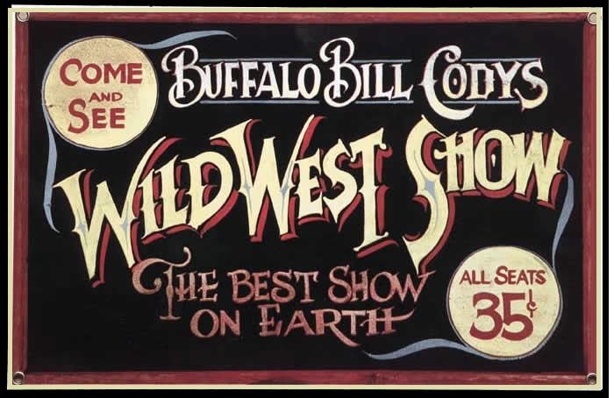
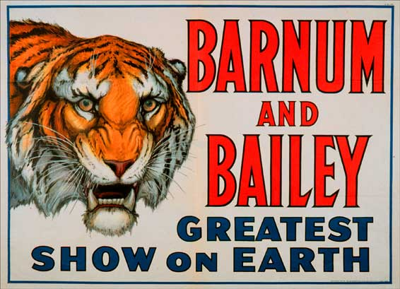
Tuesday, January 24th – 1st Block
What is the definition of the word lavish [lav-ish]?
What part of speech is lavish?
From the French lavache (torrent of rain, deluge)
Other forms of the word include: lavishly (adv), lavishness (noun), lavishment (noun)
“We [Americans] are the lavishest and showiest and most luxury-loving people on earth;..”
- Mark Twain, American author

Slide 7
Tuesday, January 24th – 2nd Block
Lavish– adj. In excess; using or giving in great amounts; abundant.
What is another word for lavish (synonym)?
Profuse, ample, teeming, abounding, bounteous.
What word or phrase means the opposite of lavish (antonym)?
Lacking, economical, sparse, scanty.
To view the VOCABAHEAD video on lavish, click here.

Slide 8
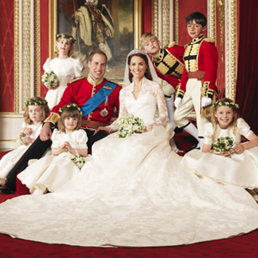
Tuesday, January 24th – 3rd Block
Can you use the word lavish to describe the picture at right?
Example: Royal weddings are lavish affairs.
Now write your own sentence using the word lavish in a manner that illustrates your understanding of the word.

Slide 9
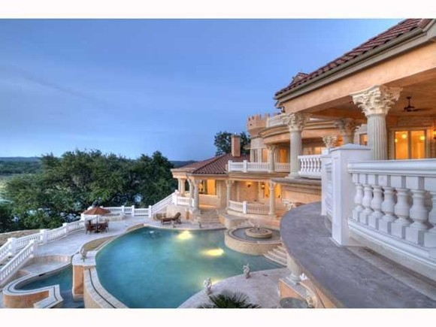
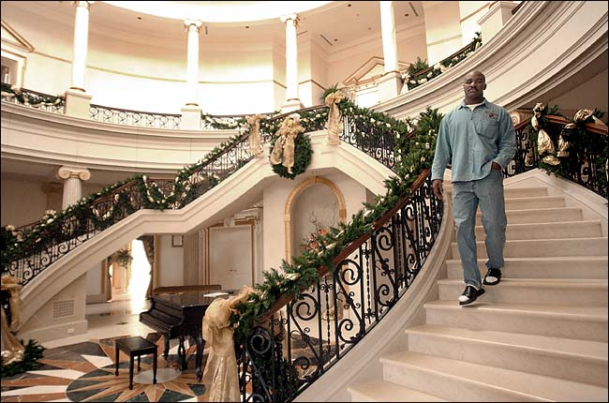
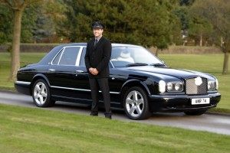
Tuesday, January 24th – 4th Block
Can you think of an image that epitomizes the “word of the day”, lavish?
Complete the analogy:
Lavish is to bounteous, as accolade is to _____.
laurels, kudos, distinction, honor, etc.
[synonyms]

Slide 10
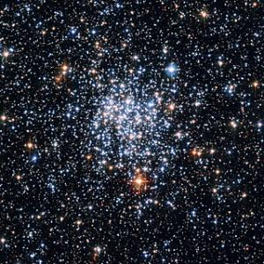
Wednesday, January 25th - 1st Block
What is the definition of the word myriad [mir-ee-uhd]?
What part of speech is myriad?
From the Greek myrios (innumerable; countless)
Other forms of the word: myriadly (adv)
“I see myriad worlds of the universe as small seeds of fruit, and the greatest lake on Earth as a drop of oil on my foot.”
- the Buddha
5th century B.C.

Slide 11
Wednesday, January 25th – 2nd Block
Myriad – adjective or noun. Countless; a very large number.
What is another word for myriad (synonym)?
Infinite, multitudinous, plethora, gobs
What word means the opposite of myriad (antonym)?
Finite, dearth, calculable, limited

Slide 12
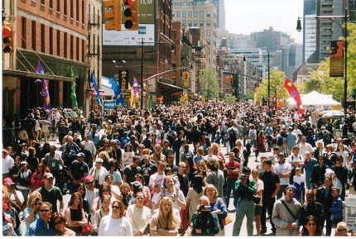
Wednesday, January 25th – 3rd Block
Can you use the word myriad to describe this picture?
Example: A city has a myriad number of people, from all walks of life.
Now use your knowledge of the word to write your own sentence using myriad.

Slide 13
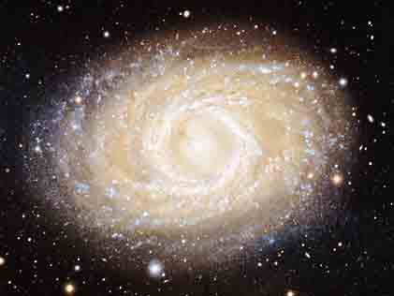
Wednesday, January 25th – 4th Block
Can you think of an image that epitomizes the “word of the day”, myriad?
What’s wrong with this analogy?
Myriad is to stars in the night sky, as lavish is to mendicant friar.
Myriad is an adjective for the stars in the night sky, whereas lavish does not describe the lifestyle of a mendicant friar.

Slide 14
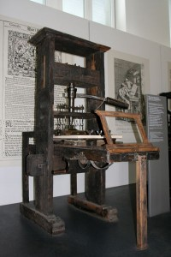
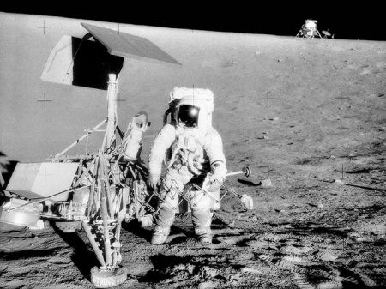
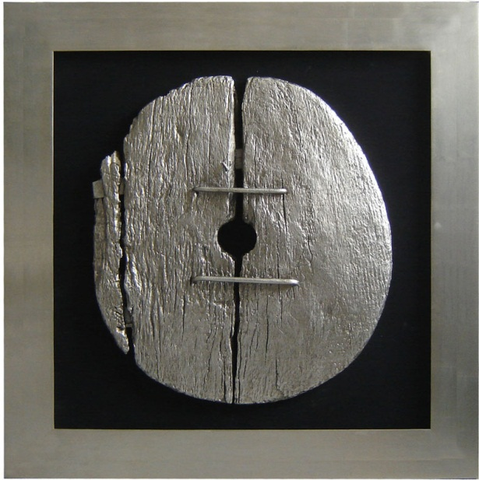
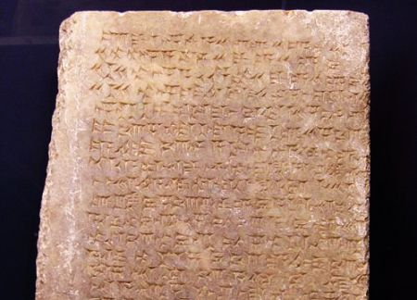
Thursday, January 26th - 1st Block
What is the definition of the word prolific [pruh-lif-ic]?
What part of speech is prolific?
From the Latin proles (offspring) + facere (to make)
Other forms of the word: prolifically (adv); prolificacy (noun); prolificness (noun); prolicicity (noun)
“Periods of tranquility are seldom prolific of creative achievement. Mankind has to be stirred up.”
- Alfred North Whitehead British Mathematician and Philosopher, 1861-1947

Slide 15
Thursday, January 26th – 2nd Block
Prolific - adj. Producing a great deal; fertile; abundant.
What is another word for prolific (synonym)?
Fecund, teeming, copious, bountiful, productive
What word means the opposite of prolific (antonym)?
Barren, fruitless, unproductive

Slide 16
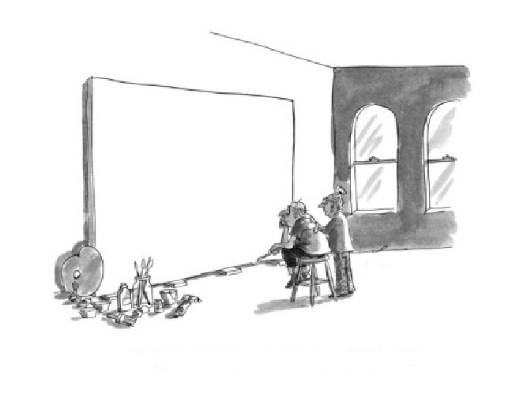
Thursday, January 26th – 3rd Block
Can you create dialogue relating to the word prolific for this cartoon?
Example: “If only you could have frozen some ideas from your prolific youth, dear.”

Slide 17
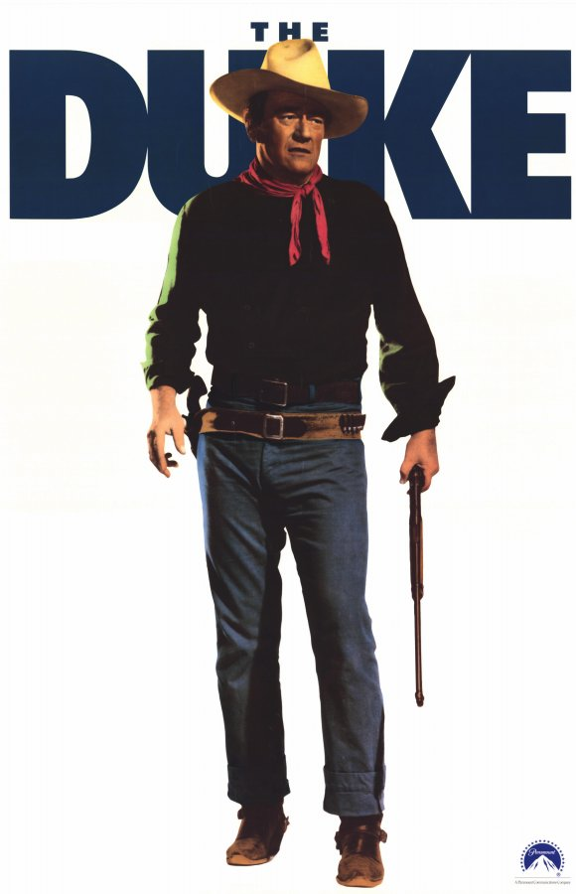
Thursday, January 26th – 4th Block
How does this picture relate to the word of the day, prolific?
Complete the analogy:
Prolific is to productive, as _________ is to myriad.
Infinite, multitudinous, plethora, etc.
[Synonyms]
John Wayne played the starring role in 142 movies, making him the most prolific leading man in American cinema.
Source: IMDB.com, 2012

Slide 18
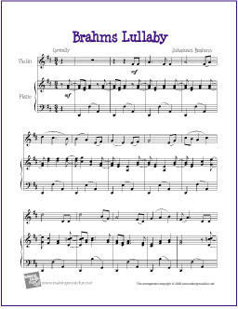
friday, January 27th - 1st Block
What is the definition of the word superfluous [soo-pur-floo-uhs]?
What part of speech is superfluous?
From the Latin super (over) + fluere (to flow)
Other forms of the word: superfluously (adv); superfluousness (noun)
“It is not hard to compose, but what is fabulously hard is to leave the superfluous notes under the table.”
- Johannes Brahms
Composer (1833-1897)

Slide 19
friday, January 27th – 2nd Block
Superfluous– adj. Overabundant; more than is needed; unnecessary.
What is another word for superfluous (synonym)?
Gratuitous, expendable, needless
What word means the opposite of superfluous (antonym)?
Important, necessary, needed

Slide 20
Friday, January 27th – 3rd Block
How does this cartoon relate to the word superfluous?
What might Superfluousman’s super-power be?
One possibility: The super ability to always show up when everything is under control.

Slide 21

Friday, January 27th – 4th Block
The title of this clip is Charger’s Superfluous Jump.
Complete the analogy:
Superfluous is to expendable, as ______________ is to revere.
Honor, pay homage, venerate, etc.
[Synonyms]
Video Clip

Slide 22
Word of the Day
Have a safe and fun-filled weekend Hurricanes!

