Slide 1
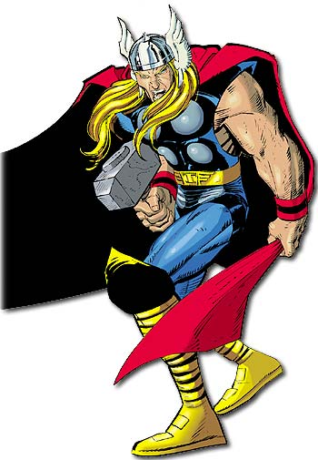
Word of the Day
Knowledge is
Power!
Monday, October 24th and Tuesday, October 25th

Slide 2
Word of the Day
Be sure to look for:
The Audio Links in each Block 1 slide - to help with word pronunciation;
Embedded Video & Audio links throughout.

Slide 3
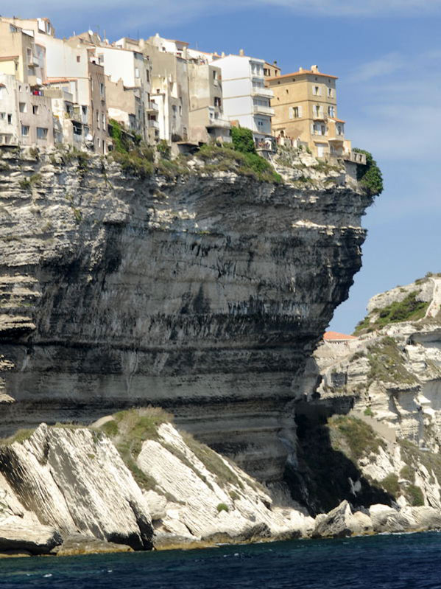
Monday, October 24th – 1st Block
What is the definition of the word precarious [pri-kair-ee-uhs] ?
What part of speech is precarious?
From the Latin precarius (obtained by asking or praying).
Word variations include: precariousness (noun), precariously (adv).
“What I do is put my characters into situations that are so precarious there is no way to get them out. And then I figure how to get them out.”
Sidney Sheldon, author

Slide 4
Monday, October 24th - 2nd Block
Precarious – adjective. Dangerous or risky; uncertain. Dependent on circumstances beyond one’s control.
What is another word for precarious (synonym)?
Unsure, unsteady, unreliable, hazardous, baseless, perilous, dicey
What word means the opposite of precarious (antonym)?
Certain, careful, safe, secure

Slide 5
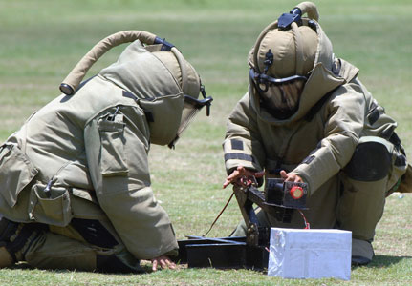
Monday, October 24th – 3rd Block
Can you use the word precarious to describe the picture at right?
Example: A bomb disposal expert must remain calm in even the most precarious situation.
Now write your own sentence using the word precarious in a manner that illustrates your understanding of the word.

Slide 6
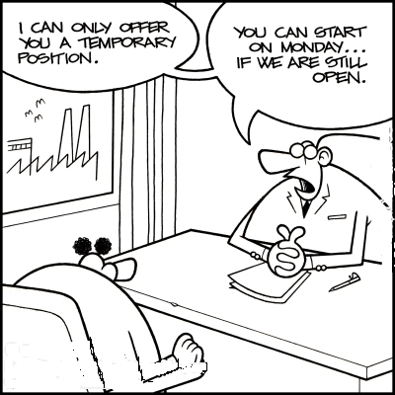
Monday, October 24th - 4th Block
Draw a cartoon that expresses the adjective, precarious.
Complete the analogy below:
Frightful is to ___________, as precarious is to perilous.
Scary, horrible, terrifying. [Synonyms]

Slide 7
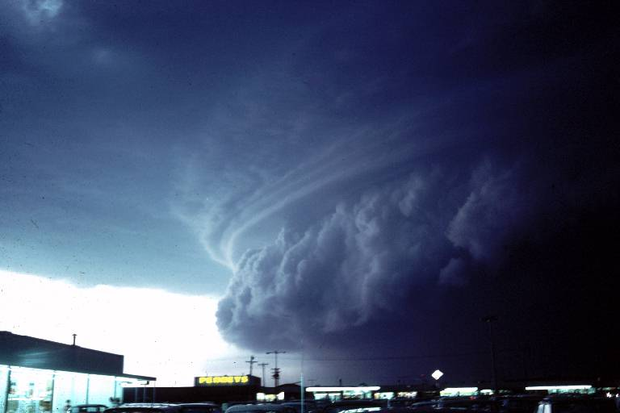
Tuesday, October 25th – 1st Block
What is the definition of the word ominous [om-uh-nuhs]?
What part of speech is ominous?
From the Latin ominosus (foreboding).
Other forms of the word include: ominously (adv), ominousness (noun), unominous (adj).
“The past is an old armchair in the attic, the present an ominous ticking sound, and the future is anybody’s guess.”
- James Thurber, writer

Slide 8
Tuesday, October 25th – 2nd Block
Ominous – adjective. Pertaining to an evil omen; foreboding; inauspicious; threatening.
What is another word for ominous (synonym)?
Portentous, menacing, baleful, dire, sinister
What word means the opposite of ominous (antonym)?
Auspicious, promising, unthreatening, propitious
Ominous in Dutch: onheilspellend

Slide 9
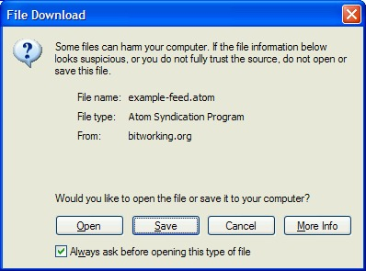
Tuesday, October 25th – 3rd Block
Can you use the word ominous to describe the picture to the right?
Microsoft has perfected the ominous dialogue box warning.
Now write your own sentence using the word ominous in a manner that illustrates your understanding of the word.

Slide 10
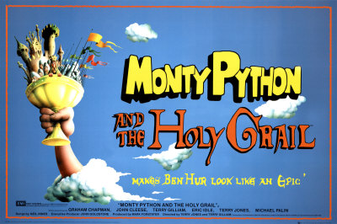
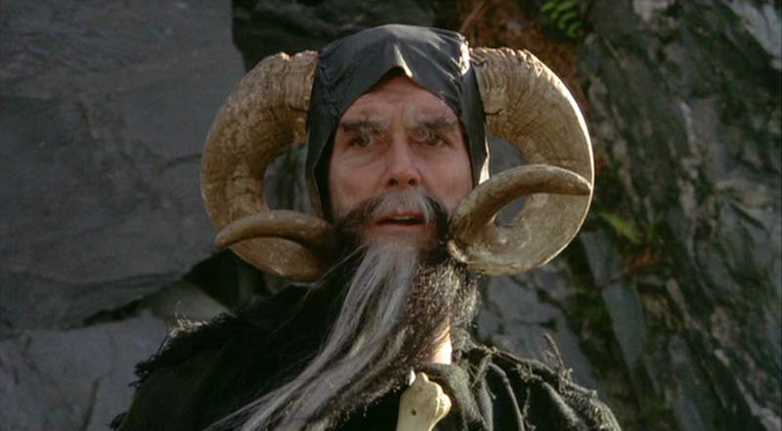

Tuesday, October 25th - 4th Block
Can you think of another example from film or literature that relates to the term ominous?
Complete the following analogy:
Ominous is to dire warning, as fondness is to ___________.
Affection, love, admiration, etc.
  [Synonyms]
Audio Link

