Slide 1
Forms and Transformation of Energy
Chapter 13 Sections 3-4
(pages 444-461)

Slide 2
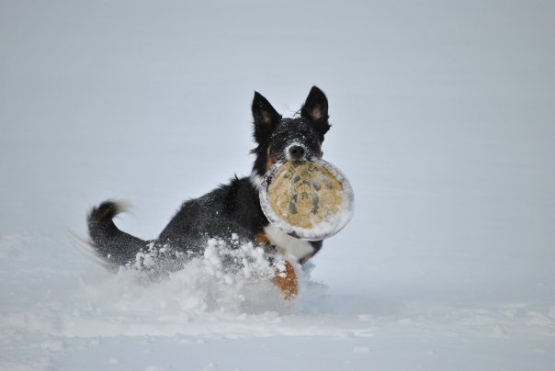
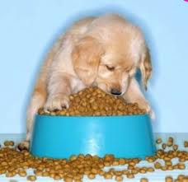
Why do living organisms need energy?
Movement
Metabolism
Response to stimuli
Can you think of some examples of movement, metabolism, or response to stimuli in other organisms?

Slide 3
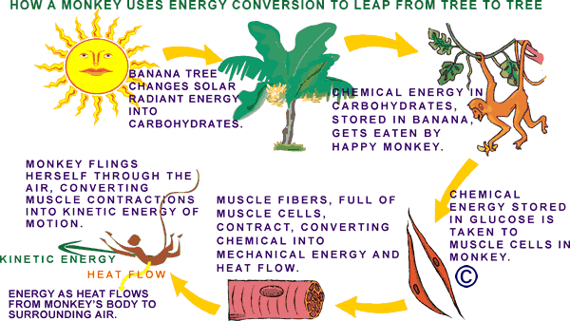
Energy flows throughout an ecosystem

Slide 4
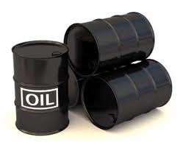
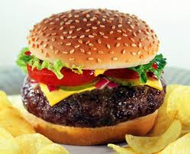
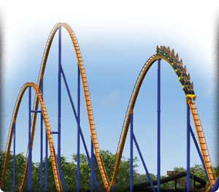
What do these items have in common?
This point on roller coaster

Slide 5
They all contain potential energy
Potential Energy is the energy that an object has because of the position, shape, or condition of the object
  It can be stored in chemical bonds
  It can be gravitational potential energy between two objects that are a measured vertical distance apart
    Gravitational Potential Energy = mass x free-fall acceleration x height OR
    PE = mgh

Slide 6
Example of gravitational potential energy
Gravitational potential energy results from the gravitational attraction between the car and the Earth

Slide 7
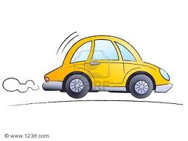
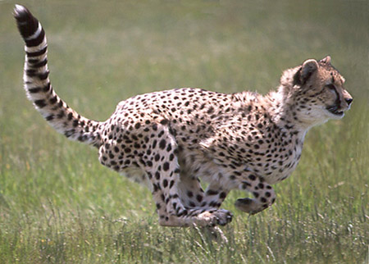
What do these items have in common?
The energy that is exhibited during this part of the roller coaster

Slide 8
They all exhibit kinetic energy
Kinetic energy is the energy of an object due to the object’s motion
  Includes light, heat, electricity, and movement of objects
  Kinetic energy can be calculated:
    Kinetic energy = ½ x mass x speed squared OR
    KE = ½mv²

Slide 9
Example of kinetic energy
Kinetic energy is
exhibited by the motion
of the roller coaster car
as it travels down the
hill

Slide 10
Other forms of energy
Mechanical Energy- the amount of work an object can do because of the object’s kinetic and potential energies
  Example: a person running
    Potential energy is the energy stored in the form of glycogen
    Kinetic is the energy being used to move the person as well as account for the heat they produce when running

Slide 11
Other forms of energy cont…
Chemical energy- the energy stored in bonds between atoms
  Example: Energy stored inside the head of a match is released as light and heat
  Example: Energy stored in a molecule of glucose that is produced via photosynthesis
  Remember, you must break bonds to release energy!!

Slide 12
Other forms of energy cont…
Solar Energy- the energy that we get from the sun; comes from nuclear fusion reactions in the sun
  Uses for solar energy include photosynthesis in plants (energy is converted into chemical energy stored in glucose molecules, heating the earth, and providing light

Slide 13
Law of Conservation of Energy
AKA “First Law of Thermodynamics”
Total energy remains constant in a closed system
Energy cannot be created or destroyed
  But it can be transformed!
    Recall Energy Flow in an Ecosystem

Slide 14

Endergonic reaction
Exergonic reaction

