Slide 1
Energy Transfer
Chapter 14 Section 2 (pages 480 – 487)

Slide 2
Methods of Energy Transfer
What are the methods of energy transfer?
  Conduction
  Convection
  Radiation
What is the difference between each of these methods of energy transfer?

Slide 3
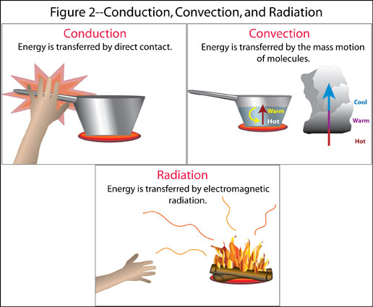
Methods of Energy Transfer cont…

Slide 4
Conduction
Thermal conduction occurs when energy is transferred as heat through a material.
  Example: When heat travels up a metal wire as you are holding it while cooking marshmallows
  Can you think of any other examples?

Slide 5
Convection
Convection is the energy transfer resulting from the movement of warm fluids (includes liquids and gases, or any matter that flows).
Convection currents occur from any movement of matter that results from differences in density; may be vertical, circular, or cyclical.
  Examples: wind, sparks swirling away from a fire
  Can you think of any other examples?

Slide 6
Radiation
Radiation is energy that is transferred as electromagnetic waves.
  Radiation differs from conduction and convection in that it does not involve the movement of matter across space.
  The warmer something is, the more infrared radiation it gives off.
  Example: the warmth you experience when standing near a campfire or the energy that we receive that is transferred from the sun
  Can you think of any other examples?

Slide 7
What is the difference between conductors and insulators?
A conductor is a material through which energy can be easily transferred as heat whereas an insulator is a material that transfers heat poorly
    For example, a cooking pan is metal which allows for the energy to pass quickly between the particles but has an insulated handle so that you do not get burned by the pan.
    Can you think of other examples of conductors and insulators that we see in everyday life?

Slide 8
Review
What are the methods of energy transfer and what happens in each method?
What are some of the real-life applications of the methods of energy transfer?
What makes good conductors and insulators?

