Slide 1
Temperature
Chapter 14 Section 1 (pages 473 - 479)

Slide 2
What is temperature?
Temperature is a measure of how hot or cold something is
    MORE SPECIFICALLY, IT IS A MEASURE OF THE AVERAGE KINETIC ENERGY OF THE PARTICLES IN AN OBJECT
      The temperature of a substance is proportional to the average kinetic energy of the substance’s particles
  How do we measure temperature?

Slide 3
Thermometers
Thermometers use the expansion of liquids such as mercury or colored alcohol to measure temperature
  As something heats up, the particles of the liquid inside a thermometer gain kinetic energy and move faster and then farther apart
    As the liquid continues to expand, it moves up the tube of the thermometer
What happens to the liquid in the thermometer when the temperature decreases?

Slide 4
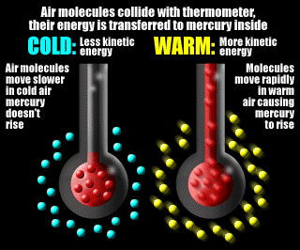
Temperature and Thermometers cont…

Slide 5
Temperature Scales
The different temperature scales include Fahrenheit, Celsius, and Kelvin
To convert from Celsius to Fahrenheit, use the following equation:
  T_{F} = 1.8T_{C} + 32.0
To convert from Fahrenheit to Celsius, use the following equation:
  T_{C} = T_{F} – 32.0
  1.8

Slide 6
Practice
Convert the following into Celsius:
32 °F
120 °F
55 °F
Convert the following into Fahrenheit:
0 °C
100 °C
45 °C

Slide 7
How does temperature relate to energy transfer?
What would you expect to feel from the following?
  Touching a piece of ice with your hand
  Getting into a hot bath
  Clasping your hands together
When two objects that are at different temperatures are touching, energy will be transferred from one to the other

Slide 8
How does heat relate to energy transfer?
Heat is the energy transferred between the particles of two objects, because of a temperature difference between the two objects
  The energy (or heat) is ALWAYS transferred from something with a higher temperature to something with a lower temperature
  Can you think of any other examples?

Slide 9
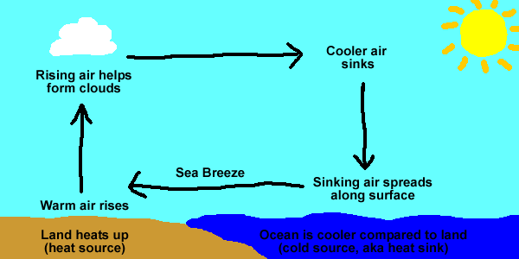
Heat Transfer

Slide 10
Review
How are heat and temperature related to the kinetic energy of a substance?
What do we expect to happen with energy transfer as we hold a cup of cold water?
How do thermometers work?

