Slide 1
Circuits
Chapter 17 Section 3 (pages 600-607)

Slide 2
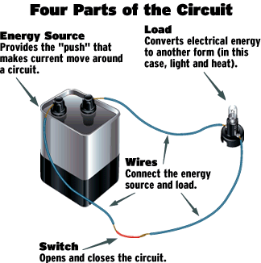
What are circuits?
Electric circuits are formed by the set of electrical components that provide one or more complete paths for the movement of charges.
  The conducting path produced when a load, such as a string of light bulbs, is connected across a source of voltage is called a closed circuit.

Slide 3
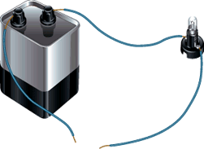
What are circuits cont…
Without a complete path, there is no charge flow and therefore, no current.
When there is no complete path, the circuit is called an open circuit
open circuit

Slide 4
Schematic Diagrams
Schematic diagrams depict the construction of an electric circuit or apparatus.
Components of a schematic diagram may include the following:
  Wires
  Conductors
  Resistors
  Light bulbs
  Battery or other current source
  Switches
Draw a table representing each of the components as well as their symbols with explanations (see page 602)

Slide 5
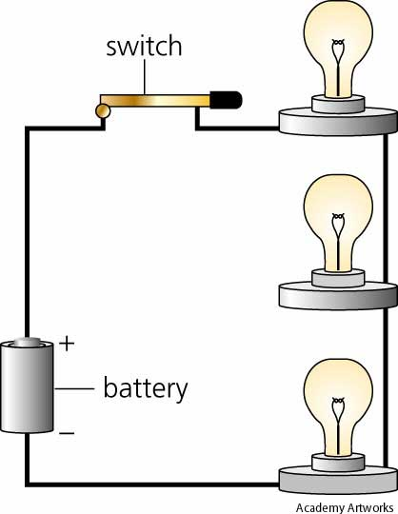
Series Circuits
Series circuits are circuits in which the parts are joined one after another such that the current in each part is the same.
If one of the light bulbs in a series circuit were removed, the other one would not glow.

Slide 6
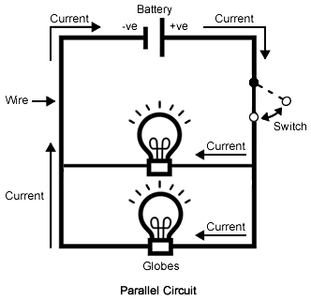
Parallel Circuits
Parallel circuits are circuits in which the parts are joined in branches such that the potential difference across each part is the same.
If one of the light bulbs in a parallel circuit were removed, the charges would still move through the other loop.

Slide 7
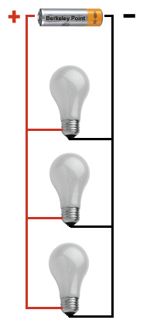
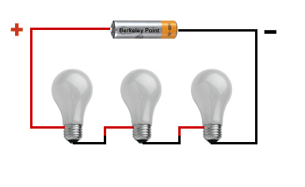
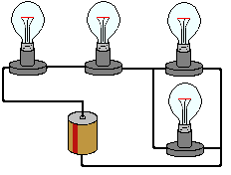
Which type of circuits are each of the following?
A.
B.
C.

Slide 8
Electrical Energy and Electric Power
When a charge moves in a circuit, the charge loses energy.
  Some of this energy is transformed into useful work, such as the turning of a motor, and some is lost as heat.
Electric power is the rate at which electrical energy is converted into other forms of energy.
Electric power can be calculated:
  power = current × voltage or
  P = I × V
What is the SI unit for power?

Slide 9
Fuses and Circuit Breakers
High currents in overloaded circuits can cause fires.
  A fuse is an electrical device that contains a metal strip that melts when current in the circuit becomes too great.
    A blown fuse is a sign that a short circuit or a circuit overload may exist somewhere in your home.
  A circuit breaker is a switch that opens a circuit automatically when the current exceeds a certain value.
    Circuit breakers can be reset by turning the switch back on.

Slide 10
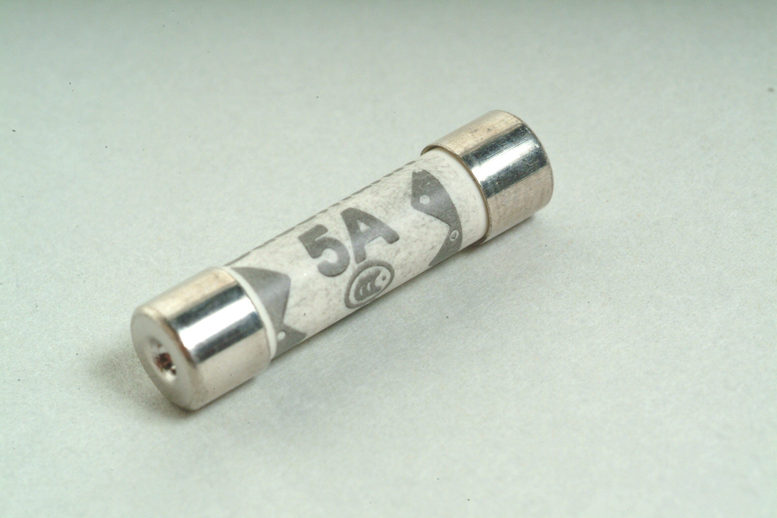
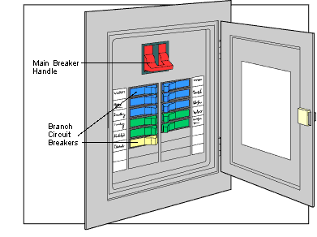
Have you seen these before?

Slide 11
What to do next…
Construct a table of Schematic Diagram Symbols like you see on page 602 of text
Complete word problems #1-4 on page 606 and #8-9 on page 607- WRITE ALL QUESTIONS!

