Slide 1
Electricity
Chapter 17 Section 1 (pages 585-590)

Slide 2
Electric Charge
Electric charge is an electrical property of matter that creates electric and magnetic forces and interactions
  An object can have a positive charge or negative charge or no charge at all
    Positive and negative charges are opposite
    An object with no charge is neutral
What kind of floor is likely to cause the buildup of electric charge?

Slide 3
Do you expect the following charges to attract or repel?
  Positive – Negative
  Negative – Negative
  Positive – Positive
Like charges repel and opposite charges attract

Slide 4
How do protons and electrons play a role?
Recall:
  Protons have a _________ charge
  Electrons have a _________ charge
Whenever an atom, molecule, or object has an imbalance of protons or electrons the object has a net charge.

Slide 5
SI Unit of Charge
The SI unit of electric charge is the coulomb (C)
An electron has a charge of -1.6 x 10⁻¹⁹ C
A proton has a charge of 1.6 x 10⁻¹⁹ C
Because electrons and protons have the same amount of charge, a net electric charge of a charged object will always be an exact multiple of 1.6 x 10⁻¹⁹ C

Slide 6
What happens to the electric charge when you rub two objects together?
When two materials are rubbed together, the material that is closer to the positive end of the series charges positively, and the material that is closer to the negative end charges negatively.
The Triboelectric Series chart can help us determine what kind of charge certain materials are expected to have

Slide 7
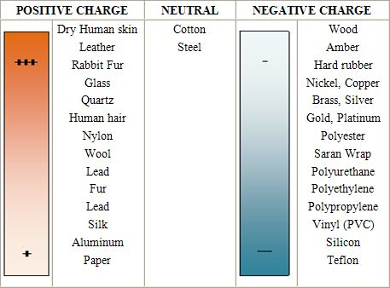
Triboelectric Series

Slide 8
Transfer of Electric Charge
Charges can move within uncharged objects
  Example, see Figure 4 on page 588
Objects can be charged by contact
  Example, see Figure 5 on page 589
Objects can be charged by friction
  Clothes on the inside of a dryer are charged by friction as they rub against each other
A surface charge can be induced on insulators
  Example, see Figure 6 on page 590

